Slide 1
Using HRQoL data from children and youth to strengthen HTA.
Experiences from the National Health Care Institute
Saskia Knies PhD
National Health Care Institute
18 November 2024
EuroQol Symposium ISPOR Europe 2024

Slide 2
Disclaimer
Advisor working at National Health Care Institute with experience in pharmaceutical assessment and methods development with focus on use for policy/decision making
I am not a member of EuroQol group or received any funding from the EuroQol Group

Slide 3

Experienced problems regarding Quality of Life data
Quality of life (QoL) very relevant outcome measure for decision making
Often no QoL data available from clinical trials
  Not collected
  Selection of patients e.g. patients without progress
  Not validated or very specific disease related QoL instrument
Additional issues QoL from children and youth
  Expert opinion from caretakers and health professionals
  Not always comparable instrument for adult population

Slide 4

New health economic guideline
Update of Dutch health economic guideline published in January 2024
October 2024 onwards: guideline mandatory for reimbursement dossiers from pharmaceutical industry
Two types of changes:
Methodological changes, e.g. changes or new elements in reference case
More clarification or guidance, e.g. extrapolation or expert opinion/elicitation

Slide 5
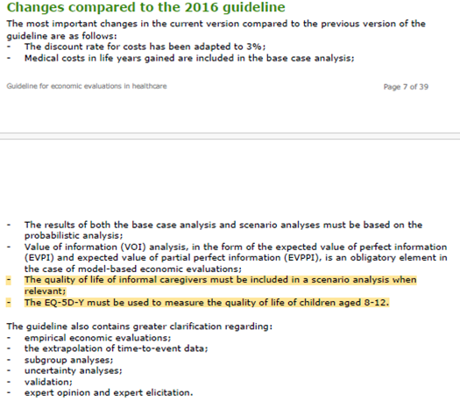
Guidance on quality of life
Since 2016 EQ-5D-5L mandatory
Second choice EQ-5D-3L
Use of Dutch value sets
Children 8 to 12 years: EQ-5D-Y
Scenario analyses
Quality of life informal caregiver (EQ-5D-5L)
Other sources of quality of life data

Slide 6
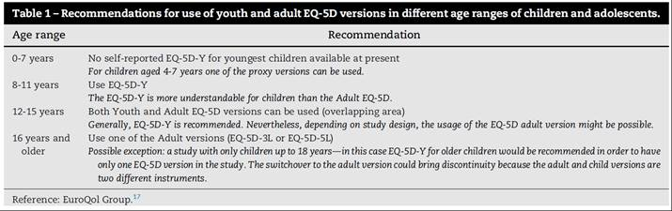
Collecting HRQoL data by children and youth
Adult version too complicated for children
Measuring quality of life by person experiencing health problem
Advice given by EuroQol group:
  < 8 years: proxy versions
  8 to 12 years: use EQ-5D-Y
  12 to 15 years old: both adult and youth version can be used
  > 16 years: use adult version

Slide 7

Why these recommendations?
Consistency
Available value sets in the Netherlands
Preferably no expert opinion
Generic instruments

Slide 8

Remaining practical issues
When using which version?
Studies having children/youth and adults
  All participants same version or different versions
Studies with longer follow-up starting with children/youth
Comparability value sets
EQ-5D-3L, EQ-5D-5L and EQ-5D-Y all have own value sets
Similar utilities for same health states?
  if yes, no big problems
  if not, how to deal with this, what is the ‘real’ utility

Slide 9
Some methodological issues
Important to capture realistic QoL measurements of patients
Capturing deterioration and fluctuations in health and quality of life
Fluctuating health states
  Not uncommon in diseases affecting children/youth
  Unpredictable by episodic disorders, e.g. epilepsy and migraine
  Sometimes predictable, e.g. adverse events/side effects
Several challenges
  Timing of measurement (fixed or not)
  Recall period (1 day or longer back)
  Worst days often missing

Slide 10
Thank you for your attention

