Slide 1

ISPOR panel: Using HRQoL data from children and youth to strengthen HTA. What are the barriers? How can we improve current practice?
Novel Strategies for Assessing Preferences for Pediatric Health States
Wendy J Ungar, MSc, PhD
Canada Research Chair in Economic Evaluation and Technology Assessment in Child Health
Director, Technology Assessment at Sick Kids (TASK)
Senior Scientist, Hospital for Sick Children, Toronto, Canada

Slide 2
Disclosures
Senior Scientist at SickKids
The following financial relationships are disclosed:
Grant support from Genome Canada, Canadian Institutes for Health Research, US PhRMA Foundation, and the Hospital for Sick Children Research Institute
Paid consultant to Broad Street HEOR Inc.
Honourarium from the Canadian Fertility and Andrology Society
Attendance at ISPOR paid for by the EuroQol Research Foundation
The views expressed are those of the presenter and do not represent the views of The Hospital for Sick Children, The Hospital for Sick Children Research Institute, the University of Toronto, Ontario Health, or any other organizations with which the presenter is affiliated.

Slide 3
Pediatric Economic Evaluations 1980-2023 (n=5083)
Notes:
1832 CUAs / 5083 = 36%
n= 7642 separate age-group-specific analyses
2805 CUAs / 7642 = 37%
Distribution of 2805 CUAs:
perinate 6%
neonate 14%
infant 15% 6+14+15 = 35%
child 38%
adolescent 18%
adult 9%

Slide 4
Barriers to Pediatric Utility Estimation
Lack of validated preference-weighted HRQoL instruments and value sets for very young children
Utilities vary as a function of instrument and tariff set used
Lack of consensus on the concept of HRQoL for children and how it varies by age group
Need to capture HRQoL in parents/caregivers
Notes:
Joseph Kwon, University of Warwick

Slide 5
Indirect Utility Elicitation Instruments for Young Children and Toddlers
Instrument | Age group (years) | Child-specific QoL attributes? | Whose preferences used to derive underlying weights?
17D | 8-11 | Yes | Parents
CHU-9D | 7-11 | Yes | Adolescents/students; General adult population
HUI2/3 | 5-8 | No | Parents; General adult population
EQ-5D-Y | 3-7 | No | General adult population
HuPS | 2-5 | Yes | Parents
EQ-TIPS (TANDI) | 0-3 | Yes | N/A
IQI | 0-1 | Yes | Parents; General adult population
From: Kwon et al. PharmacoEconomics 2022. https://doi.org/10.1007/s40273-021-01128-0

Slide 6
Child-specific Instrument: CHU-9D
Descriptive system
  Developed in children
  9 dimensions: worried, sad, pain, tired, annoyed, schoolwork, sleep, daily routine, activities
Preference weights
  Sample of UK adult population: adult preferences using SG
  Sample of Australian adolescent population valuing health states using BWS
Self-completed by child
Present state (no recall)
Stevens KJ. Qual Health Res. 2010

Slide 7
CHU9D and HUI Health Utilities in Pediatric Crohn’s Disease (CD) and Ulcerative Colitis (UC)
Bashir et al., Children 2021. https://doi.org/10.3390/children8050343

Slide 8
Health‑related quality of life in neonates and infants: Theoretical construct
From: Oliveira et al. Qual Life Res. 2020
https://doi.org/10.1007/s11136-020-02432-6

Slide 9
To Improve Current Practice:
Family Perspective
Interdependency of HRQoL within a family
Value of reporting HRQoL effects on caregivers and other family members
Emphasis on individual preferences for health state valuation assumes the respondent is autonomous
Direct disease effects
Child health state utility
Indirect effect of family member’s HRQoL on patient’s utility
direct effect of child’s state on family members’ utilities
Adapted from Basu A & Meltzer D. J Health Econ. 2005; 24:751-773

Slide 10
Moving the Guidelines Forward

Slide 11
Family Perspective
Lamsal et al.:
Systematic reviews of methods used in 1) pediatric and 2) maternal-perinatal CUAs to include family health effects
1. Pediatric (PharmacoEconomics 2024; doi: 10.1007/s40273-023-01331-1)
  35 CUAs included quality-of life effects in family members
2. Maternal-perinatal (PharmacoEconomics 2024; doi: 10.1007/s40273-024-01397-5)
  62 CUAs considered QALYs or DALYS of mothers and/or neonates

Slide 12
Measuring Family HRQoL Effects
Pediatric CUAs (n=35):
24 studies (69%) incorporated effects on just one caregiver
QALY loss of the caregiver/parent due to a child’s illness or disutility of a child’s illness on caregiver/parent most common approach
11 studies (31%) measured overall health utility of the caregiver or parent
13 studies (37%) studies calculated QALYs separately for children and parents/caregivers
17 studies (50%) studies summed child + parent QALYs and reported incremental family QALYs

Slide 13
Measuring Family HRQoL Effects
Maternal-Perinatal CUAs (n=54):
50 studies (93%) measured separate health utilities of pregnant woman and of child (neonate)
12 studies (22%) estimated a disutility or utility decrement of a maternal or fetal condition on pregnant woman and/or child
21 studies (39%) included neonate QALY losses due to fetal demise, stillbirth, or miscarriage
19 studies (35%) incorporated effects of neonatal demise on a mother’s HRQoL
21 studies (39%) incorporated effects of a child’s condition on a mother’s HRQoL
In 46 studies (85%) , QALYs of pregnant women and children were summed in each comparator group o determine family QALYs
In 42 studies (78%), incremental family QALYs used in CUA

Slide 14
Approaches to Integrating HRQoL of Family Members
Child’s health state utility reduced by disutility of caregiving (NICE HST8, 2018)
Child’s health state utility reduced by disutility of parent/caregiver, with models including both child and caregiver health states (NICE, HST2 2015)
QALYs calculated and reported separately for children and family members (Chatterton 2019)
QALYs calculated and reported separately for children and family members and also summed (Tubeuf 2019)
Family perspective via discrete choice experiments with attributes reflecting family effects

Slide 15
Next Steps to Further Improve Practice
Validation studies for reworded, recalibrated and new instruments
Comparative performance research
Additive or multiplicative models for combining family members’ utilities; statistical household functions
Discrete choice methods to derive utilities for pediatric health state incorporating attributes relevant to family
Health economic guidelines must be updated to reflect methodologic challenges and guide alternative approaches

Slide 16
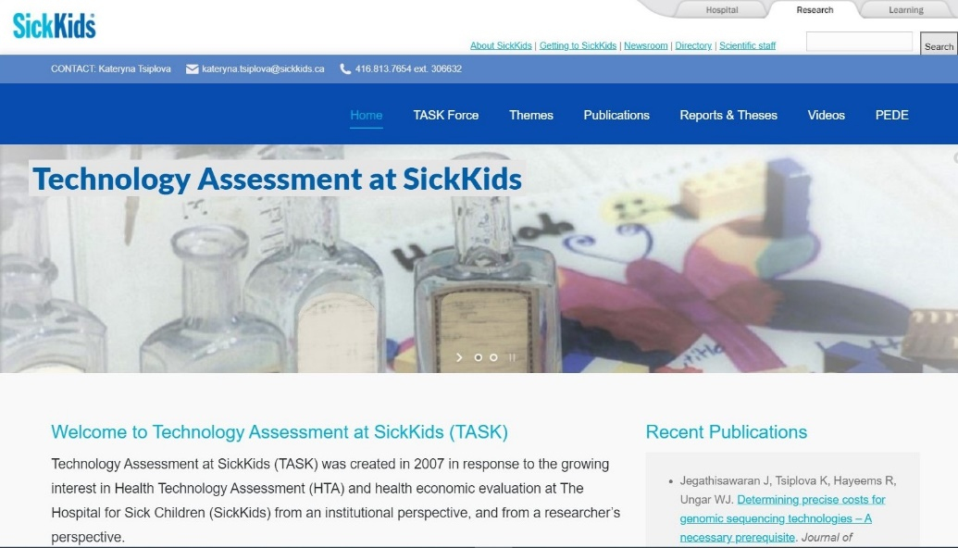





Acknowledgements
For more information:
https://www.sickkids.ca/en/staff/u/wendy-ungar
https://lab.research.sickkids.ca/task
e-mail: wendy.ungar@sickkids.ca
https://www.linkedin.com/in/wendy-ungar/

