Slide 1
EQ-5D
Core slide set
July 2026
Notes:
This slide deck was developed by the EuroQol Communications Team
Including the copyright line © EuroQol Research Foundation is mandatory when using information and/or images and/or any part of this slide deck in any other work or publication
Neither this presentation nor any of its parts may be sold, distributed or modified for commercial gain

Slide 2
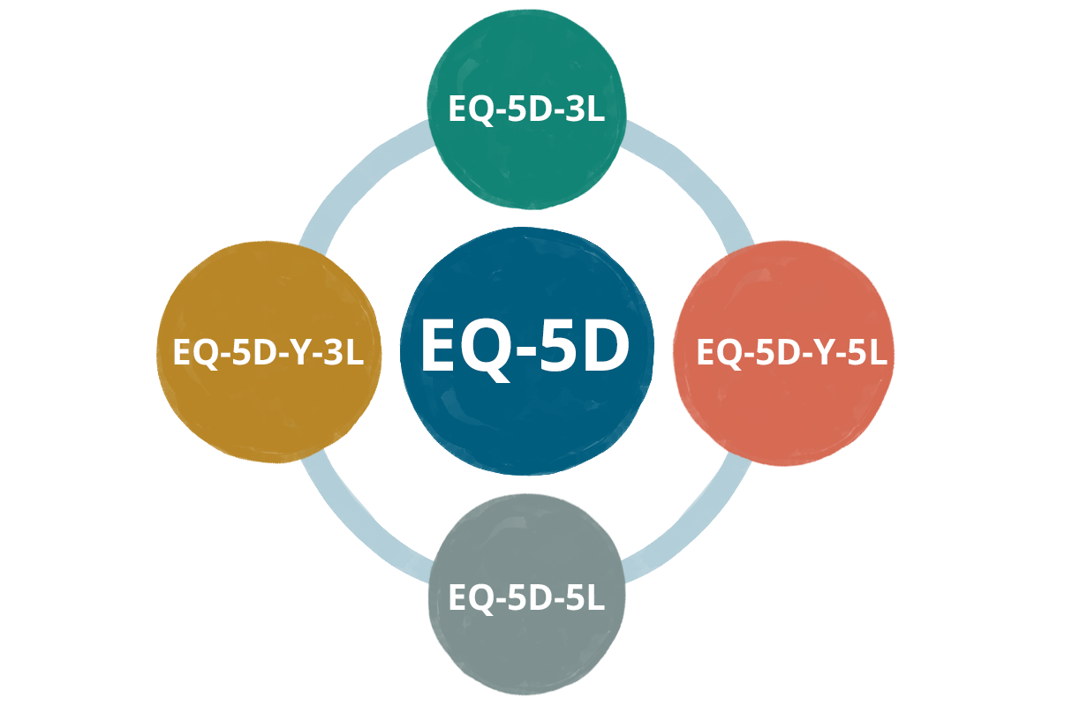
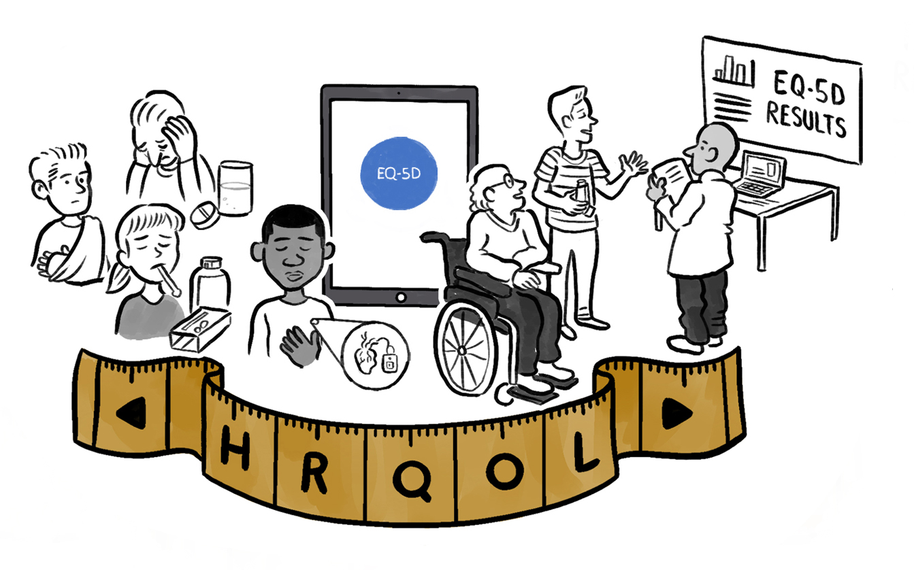
Content
          EQ-5D overview
            Various slides on versions, formats, use
          Scientific support for the EQ-5D
          International use of the EQ-5D
          Studies using the EQ-5D
          EQ-5D value sets
          EQ-5D and health technology assessment (HTA)
          How to obtain EQ-5D
          Useful resources
          Copyright information*
*Copyright information also provided in slide note pages
2
Notes:
This slide deck was developed by the EuroQol Communications Team
Including the copyright line © EuroQol Research Foundation is mandatory when using information and/or images and/or any part of this slide deck in any other work or publication
Neither this presentation nor any of its parts may be sold, distributed or modified for commercial gain

Slide 3

The EQ-5D – One of the world’s most popular measures of health outcomes
EQ-5D instruments are widely used to describe and value health related quality of life (HRQoL)
As short, simple and reliable measures EQ-5D instruments are practical to use in studies
There are two adult versions (EQ-5D-3L, EQ-5D-5L) and two youth versions (EQ-5D-Y-3L, EQ-5D-Y-5L)
HRQoL is measured across the same 5 dimensions in all EQ-5D instruments
          Mobility
          Self-care
          Usual activities
          Pain & discomfort
          Anxiety & depression
EQ-5D is developed by the EuroQol Group, an international network of researchers, and made available for use by the EuroQol Research Foundation
3
Notes:
This slide deck was developed by the EuroQol Communications Team
Including the copyright line © EuroQol Research Foundation is mandatory when using information and/or images and/or any part of this slide deck in any other work or publication
Neither this presentation nor any of its parts may be sold, distributed or modified for commercial gain

Slide 4
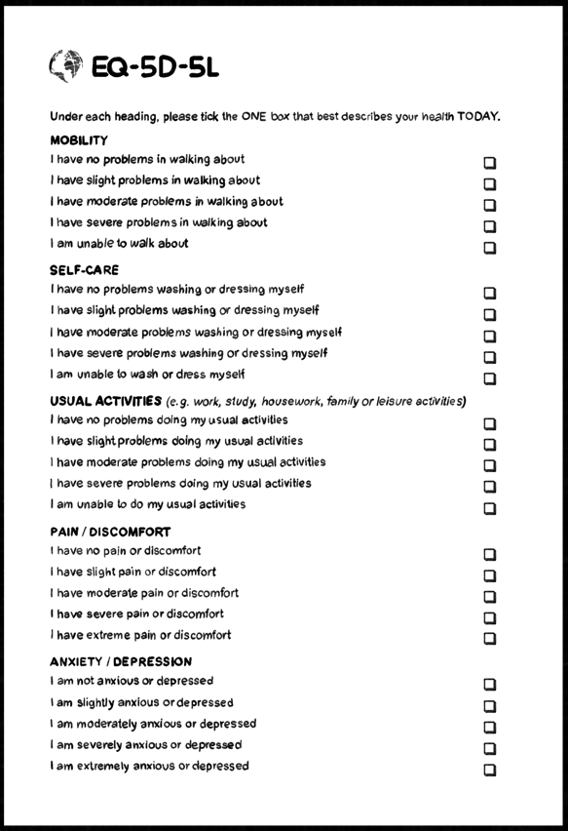
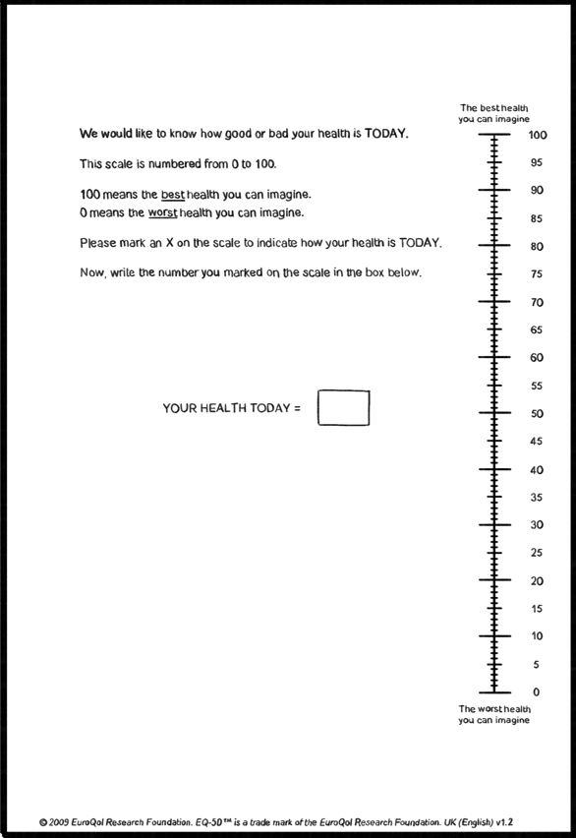
All four EQ-5D instruments have two parts
Both parts of EQ-5D are integral and should always be administered together
A short descriptive system questionnaire where respondents indicate their current health status on 5 dimensions of health
…and a visual analogue scale which is used to obtain a global rating of the respondents self-perceived health status
(EQ VAS)
Please see the animations on the descriptive system and EQ-VAS (both available on the EuroQol website)
Notes:
This slide deck was developed by the EuroQol Communications Team
Including the copyright line © EuroQol Research Foundation is mandatory when using information and/or images and/or any part of this slide deck in any other work or publication
Neither this presentation nor any of its parts may be sold, distributed or modified for commercial gain

Slide 5
EQ-5D versions
There are four different EQ-5D instruments
They differ in the population they should be used in, and the number of levels of severity for each dimension (the same five dimensions are included in the descriptive system of each instrument)
Youth instruments use language that is easy for children to understand
Instrument | Population | Levels of severity in descriptive system
EQ-5D-3L | Adults | 3
EQ-5D-Y-3L | Children (4-17 years)* | 3
EQ-5D-5L | Adults | 5
EQ-5D-Y-5L | Children (4-17 years)* | 5
Please see the slide deck ‘Measuring health-related quality of life in children and adolescents: The EQ-5D-Y-5L’ and the animation ‘EQ-5D-Y-5L explained in about two minutes’ for a summary of the five-level youth version (both available on the EuroQol website)
*It is recommended that an interviewer-administered or proxy version is used in children aged 4-7 years, with the self-complete version used in those aged 8-15 years
5
Notes:
This slide deck was developed by the EuroQol Communications Team
Including the copyright line © EuroQol Research Foundation is mandatory when using information and/or images and/or any part of this slide deck in any other work or publication
Neither this presentation nor any of its parts may be sold, distributed or modified for commercial gain

Slide 6
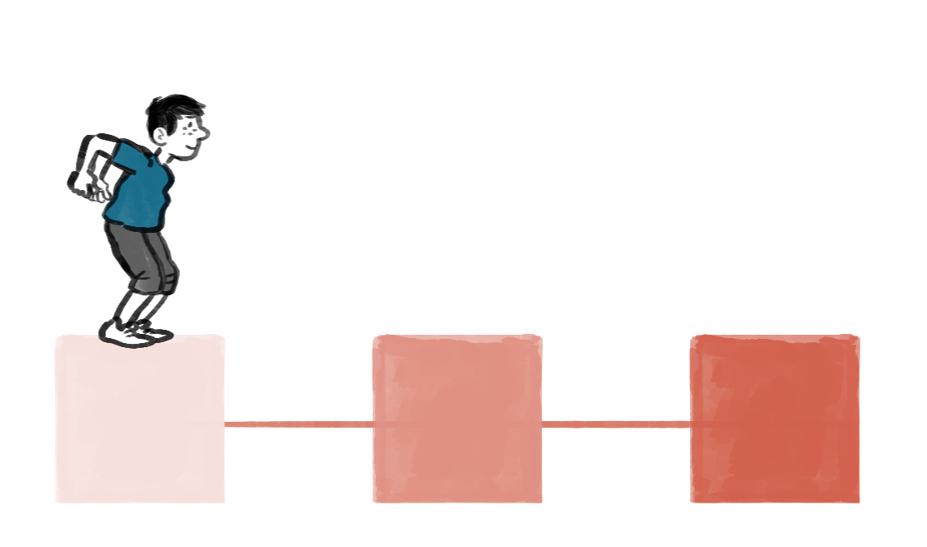

Why were 5 level versions of EQ-5D developed ?
HRQoL can be described more precisely with 5 response levels as compared to 3 response levels
For example, in the Mobility domain in the youth instruments the response levels are:
          EQ-5D-Y-3L: No problems, some problems, a lot of problems
          EQ-5D-Y-5L: No problems, a little bit of a problem, some problems, a lot of problems, cannot walk
Having 5-level instruments for both the youth and adult versions enhances comparability of results between adults, children and adolescents
6
Notes:
This slide deck was developed by the EuroQol Communications Team
Including the copyright line © EuroQol Research Foundation is mandatory when using information and/or images and/or any part of this slide deck in any other work or publication
Neither this presentation nor any of its parts may be sold, distributed or modified for commercial gain

Slide 7

Use of EQ-5D across different conditions
As a generic measure, the EQ-5D is versatile enough to compare health across different disease areas
It has been used so far in over 100 different clinical areas
7
Notes:
This slide deck was developed by the EuroQol Communications Team
Including the copyright line © EuroQol Research Foundation is mandatory when using information and/or images and/or any part of this slide deck in any other work or publication
Neither this presentation nor any of its parts may be sold, distributed or modified for commercial gain

Slide 8

EQ-5D formats
EQ-5D is available in different formats and is therefore very flexible, the different modes of administration are:
          Smartphone
          Tablet
          Laptop/desktop computer
          Paper
There are self-complete, interviewer-administered (face-to-face and by telephone) and proxy versions. EQ-5D can also be used in interactive voice response systems
The Version Management Committee at EuroQol has responsibility for overseeing and approving all versions of the EQ-5D
It is important to use the latest EQ-5D version, see the EuroQol website… Available versions - EuroQol
8
Notes:
This slide deck was developed by the EuroQol Communications Team
Including the copyright line © EuroQol Research Foundation is mandatory when using information and/or images and/or any part of this slide deck in any other work or publication
Neither this presentation nor any of its parts may be sold, distributed or modified for commercial gain

Slide 9
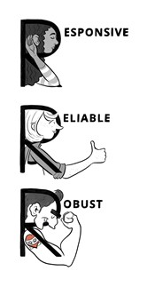
Scientific research on EQ-5D
Extensive research shows that EQ-5D is a robust, reliable and responsive method of measuring health in a wide range of conditions and populations
Key publications for each version can be found on the EuroQol website
A wide range of research projects are ongoing to support the EQ-5D
The EuroQol membership and the staff at the EuroQol Office include scientific experts from many different fields
9
Notes:
This slide deck was developed by the EuroQol Communications Team
Including the copyright line © EuroQol Research Foundation is mandatory when using information and/or images and/or any part of this slide deck in any other work or publication
Neither this presentation nor any of its parts may be sold, distributed or modified for commercial gain

Slide 10



International use of the EQ-5D
EQ-5D has been used in studies around the globe, with translations available in over 200 different languages
Careful translation, or even adaptation of items to make them culturally relevant, is critical. For, example trying to gain insight on physical functioning by asking about vacuuming wouldn’t be appropriate in many countries
The translation process, which needs to be endorsed by EuroQol, needs to be rigorous and robust to ensure that the psychometric properties of the source instrument are not compromised
EuroQol uses a rigorous, standardised, state-of-the-art translation procedure that is based on internationally accepted guidelines
Please see the slide set and animation (available on the EuroQol website) ‘Translating PROMs for use around the world: the example of EQ-5D’ for further insight
10
Notes:
This slide deck was developed by the EuroQol Communications Team
Including the copyright line © EuroQol Research Foundation is mandatory when using information and/or images and/or any part of this slide deck in any other work or publication
Neither this presentation nor any of its parts may be sold, distributed or modified for commercial gain

Slide 11
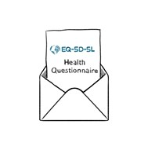

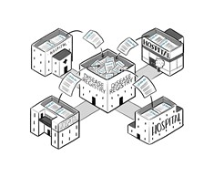

Studies using the EQ-5D
EQ-5D is extensively used worldwide
To date, it has been registered for use in more than 65,000 studies¹
EQ-5D has been used in studies undertaken in many different settings, such as:
          Surveys of population health
          Clinical trials to assess the impact of drugs or medical technologies
          Disease registries for large real-world studies on specific conditions
          In clinical practice, to collect routine outcome measurements
Current data on file. Use of EQ-5D continues to grow (in 2015, it had been registered for use in 17,000 studies²), 2. Devlin and Brooks, Value in Health 2017 Apr;15(2):127-137)
11
*
Notes:
This slide deck was developed by the EuroQol Communications Team
Including the copyright line © EuroQol Research Foundation is mandatory when using information and/or images and/or any part of this slide deck in any other work or publication
Neither this presentation nor any of its parts may be sold, distributed or modified for commercial gain

Slide 12

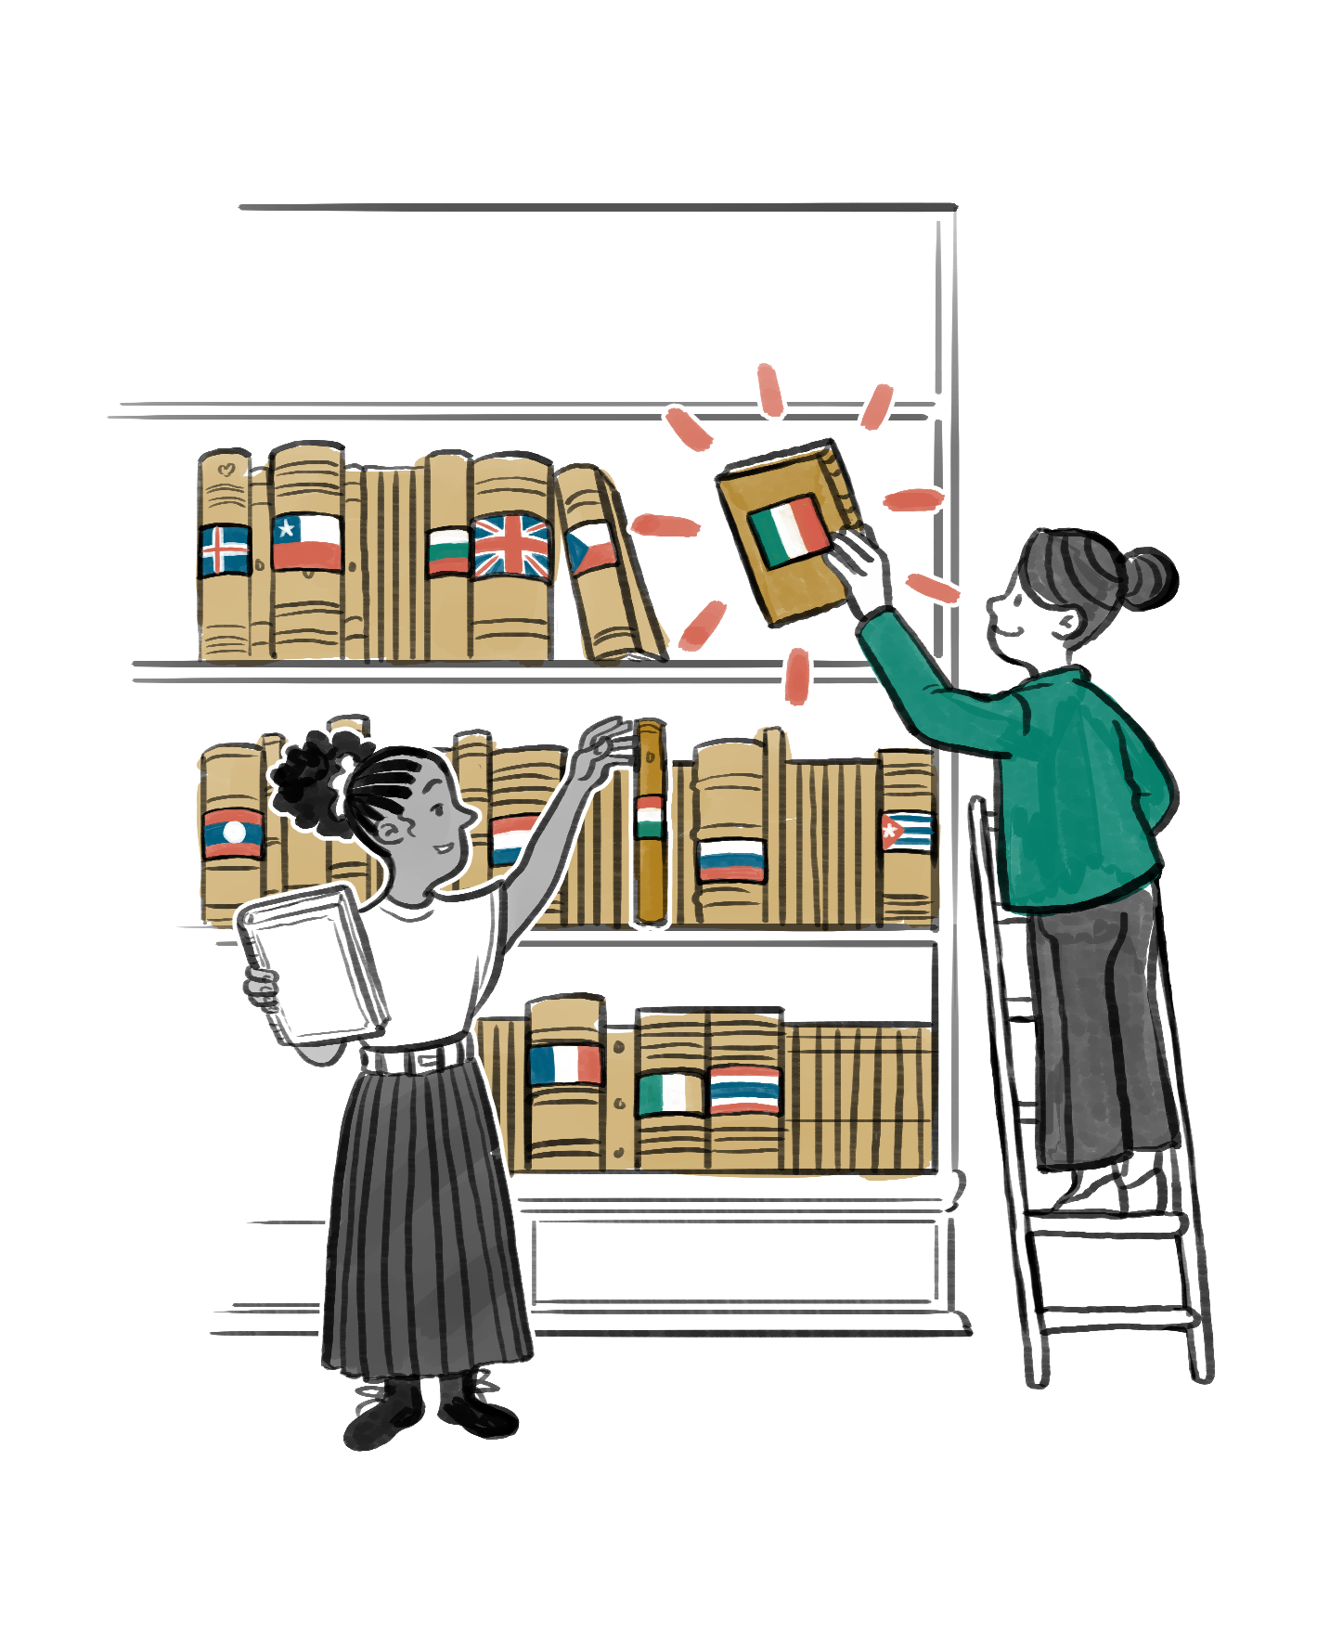
EQ-5D value sets
Scores from the EQ-5D can be translated into an overall number (often called a ‘utility value’ or an ‘index score’) using a value set
A value set is the collection of utility values for ALL possible EQ-5D health states
Utilities, when combined with length of time spent in a health state, help support the computation of quality adjusted life years (QALYs)
QALYs are an essential element of cost-utility analysis, a key requirement for NICE and other health technology assessment bodies
A value set is developed by undertaking valuation research* that measures people’s preferences with respect to health or, in other words, how health is valued
Up-to-date country specific value sets are needed as preferences may differ across cultures and over time. A strength of the EQ-5D is that there are lots of value sets and new ones are regularly being added
        *Valuation studies involving participants from the general population. An international valuation protocol (called EQ-VT) is available to guide the design of valuation studies. This guidance has enabled teams from all over the world to create value sets and it helps to guarantee quality and consistency
Please see the slide set and animation (available on the EuroQol website) on ‘EQ-5D value sets’ for further insight
12
*
Notes:
This slide deck was developed by the EuroQol Communications Team
Including the copyright line © EuroQol Research Foundation is mandatory when using information and/or images and/or any part of this slide deck in any other work or publication
Neither this presentation nor any of its parts may be sold, distributed or modified for commercial gain

Slide 13

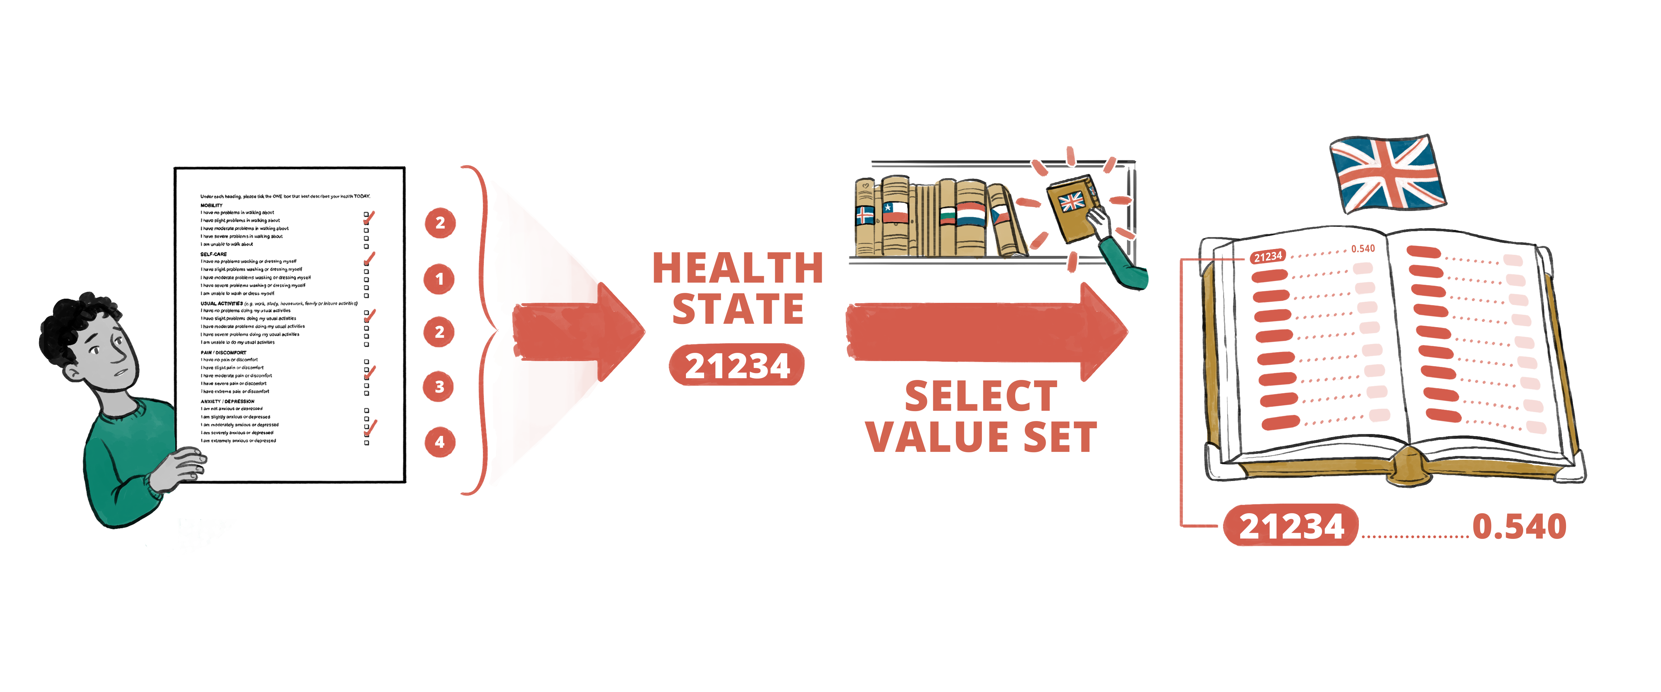
Using a value set – an example
An example of how to use a value set……
          Tom completes the EQ-5D-5L
          His profile of responses is referred to as a health state
          They represent a health state of 21234
          By using the appropriate Value Set (in this case the one for the UK) this health state of 21234 translates to a utility value of 0.540
13
Notes:
This slide deck was developed by the EuroQol Communications Team
Including the copyright line © EuroQol Research Foundation is mandatory when using information and/or images and/or any part of this slide deck in any other work or publication
Neither this presentation nor any of its parts may be sold, distributed or modified for commercial gain

Slide 14

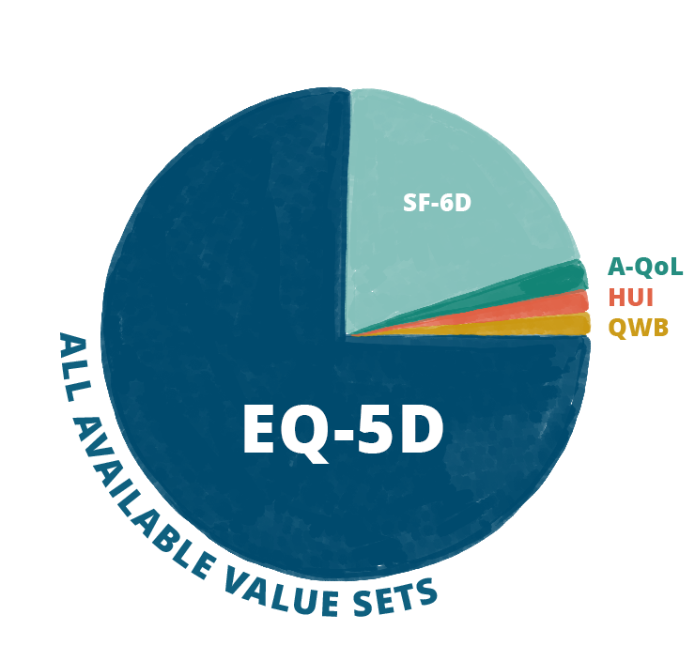
EQ-5D and health technology assessment
Cost-utility analysis (CUA) is a form of cost-effectiveness analysis that reports the incremental cost per quality-adjusted life-year (QALY) and is commonly used in health technology assessment (HTA) to understand whether a treatment offers value for money
Estimation of QALYs is often based on health state utility values determined using a multi-attribute utility instrument (MAUI)
EQ-5D is the most commonly cited MAUI in HTA guidelines¹
          It is the preferred MAUI, or given as an example of a suitable
          MAUI, in 85% of the pharmacoeconomic guidelines applied by
          HTA agencies for reimbursement or market access
          The EQ-5D is cited in 29 guidelines, almost 3 times as often as the second most common MAUI which is mentioned in 11 guidelines
There are many more value sets available for EQ-5D as compared to other MAUIs
          In a recent literature review EQ-5D value sets accounted for three-quarters (75.2%) of all available value sets, followed by SF-6D (20%), A-QoL (2.1%), HUI (1.4%) and QWB (1.4%)²
1. Kennedy-Martin et al. Eur J Health Econ. 2020 Nov;21(8):1245-1257; 2. Thakumar et al. Value in Health. Volume 28, Issue S2
14
Notes:
This slide deck was developed by the EuroQol Communications Team
Including the copyright line © EuroQol Research Foundation is mandatory when using information and/or images and/or any part of this slide deck in any other work or publication
Neither this presentation nor any of its parts may be sold, distributed or modified for commercial gain

Slide 15




How to obtain EQ-5D for use in a study (1)
Studies involving the EQ-5D need to be registered by completing the online EQ-5D registration form at www.euroqol.org
Registration takes about 10 minutes, and will ensure that the latest EQ-5D version is used
At the start of registering the system asks whether EQ-5D is being used for commercial or non-commercial use
          The EuroQol Research Foundation does not charge a license fee for non-commercial use (research or non-research) of EQ-5D. Over 90% of all requests are provided for free
          For commercial use a license fee is charged, registering is not associated with any commitment to purchase a license
Copyright for EQ-5D, its representations, and translations are managed by the EuroQol Research Foundation on behalf of the EuroQol Group Association. The EQ-5D should not be amended unless permission is obtained*
*EuroQol can discuss options and next steps if a format is required that isn’t currently available
15
Notes:
This slide deck was developed by the EuroQol Communications Team
Including the copyright line © EuroQol Research Foundation is mandatory when using information and/or images and/or any part of this slide deck in any other work or publication
Neither this presentation nor any of its parts may be sold, distributed or modified for commercial gain

Slide 16
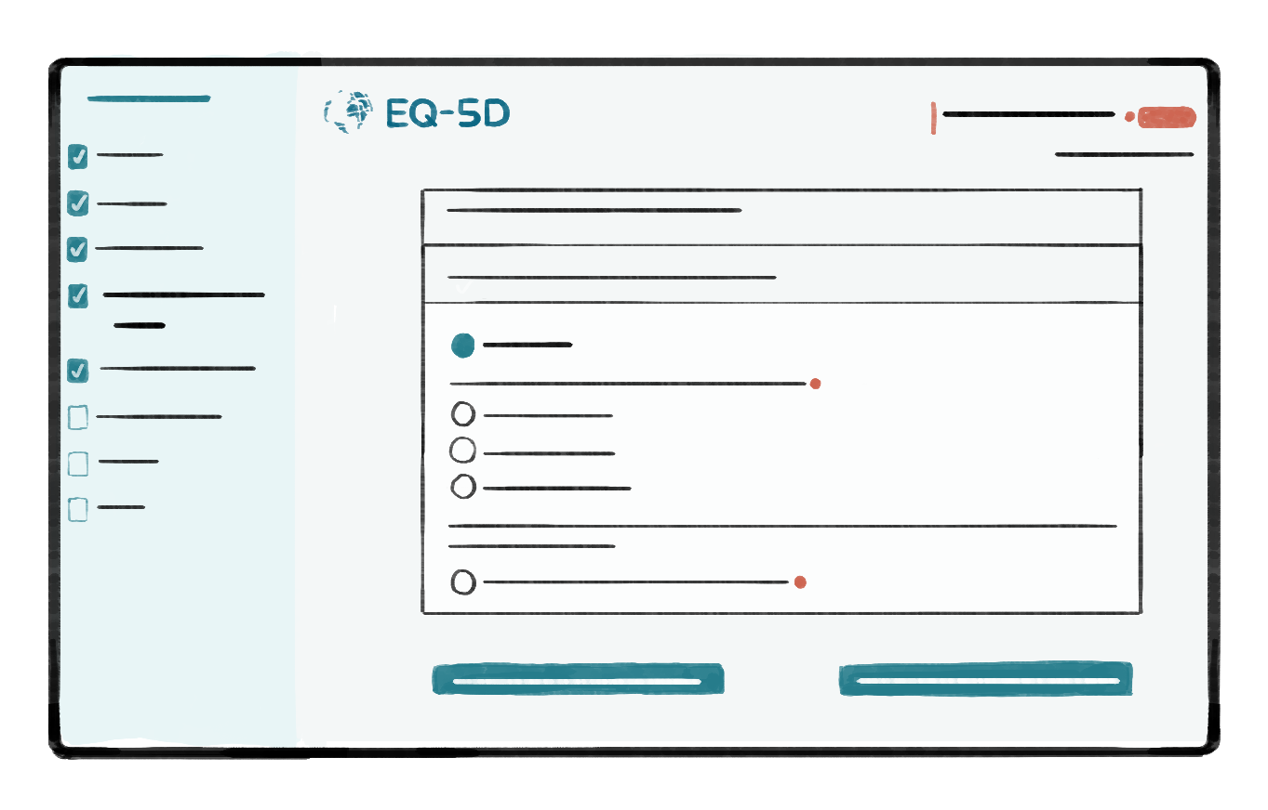
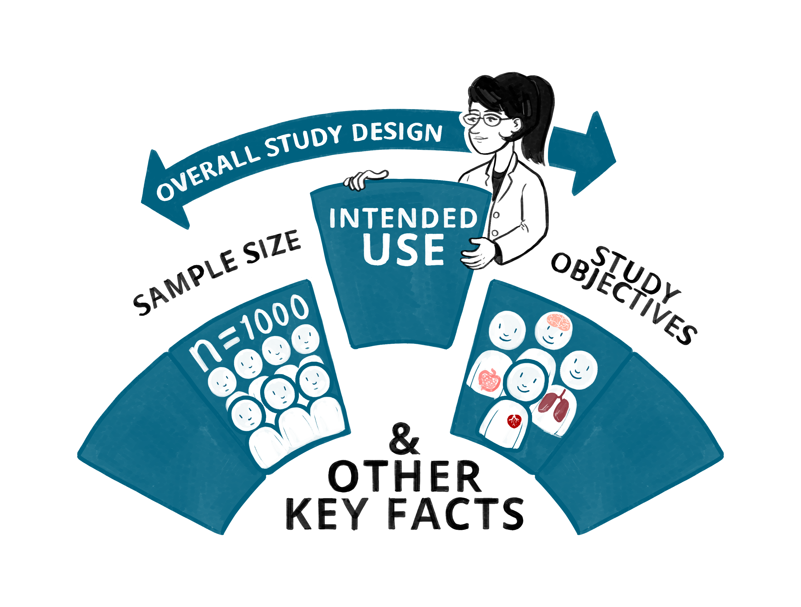

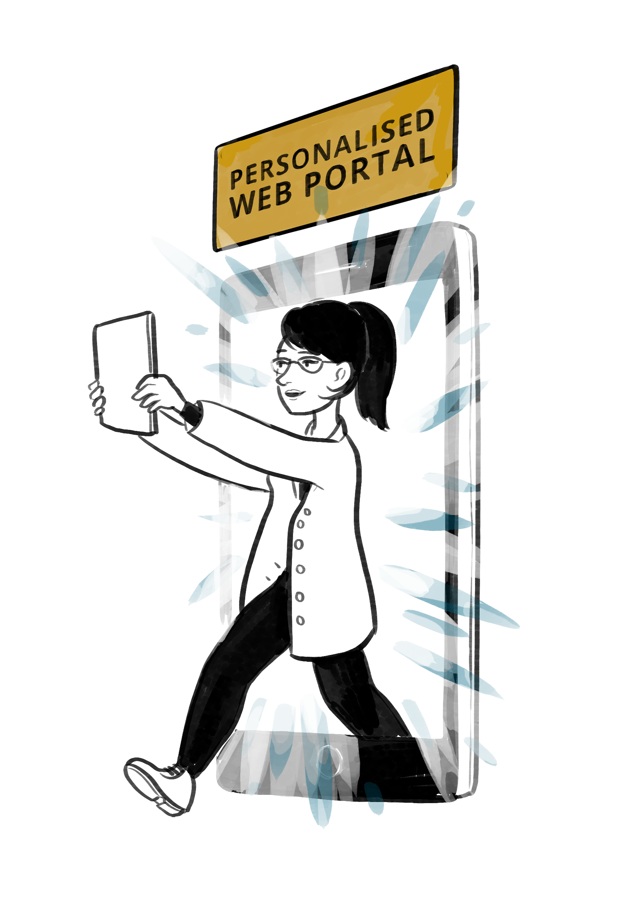
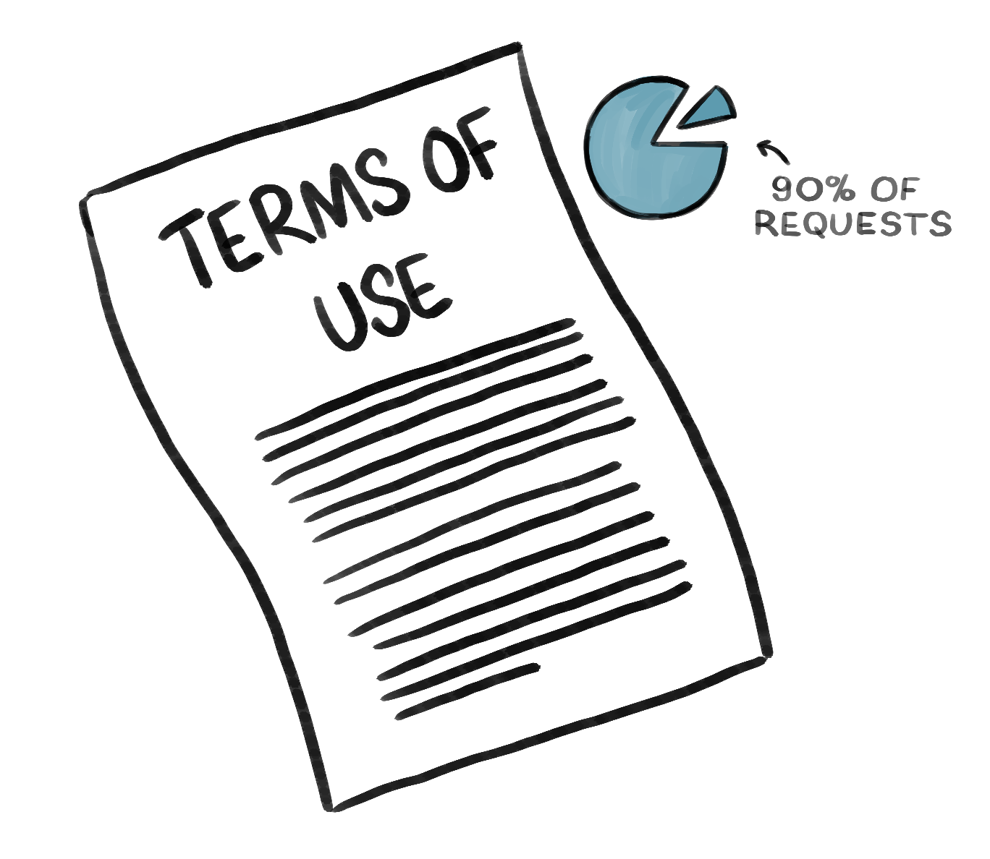
How to obtain EQ-5D for use in a study (2)
Study information (top-level) needs to be added during the registration process into an online form
The required EQ-5D instrument, format and mode of administration, and language version all need to be selected as part of the registration process. There are over 2000 options available!*
Once submitted ‘Terms of use’ for non-commercial use, or a ‘License agreement’ for commercial use will be sent over for signature
A link to a personalised web portal (the EuroQol User Portal) containing the requested EQ-5D versions is then made available
Copyright for EQ-5D, its representations, and translations are managed by the EuroQol Research Foundation on behalf of the EuroQol Group Association. The EQ-5D should not be amended unless permission is obtained
*EuroQol can discuss options and next steps if a format is required that isn’t currently available
16
Notes:
This slide deck was developed by the EuroQol Communications Team
Including the copyright line © EuroQol Research Foundation is mandatory when using information and/or images and/or any part of this slide deck in any other work or publication
Neither this presentation nor any of its parts may be sold, distributed or modified for commercial gain

Slide 17
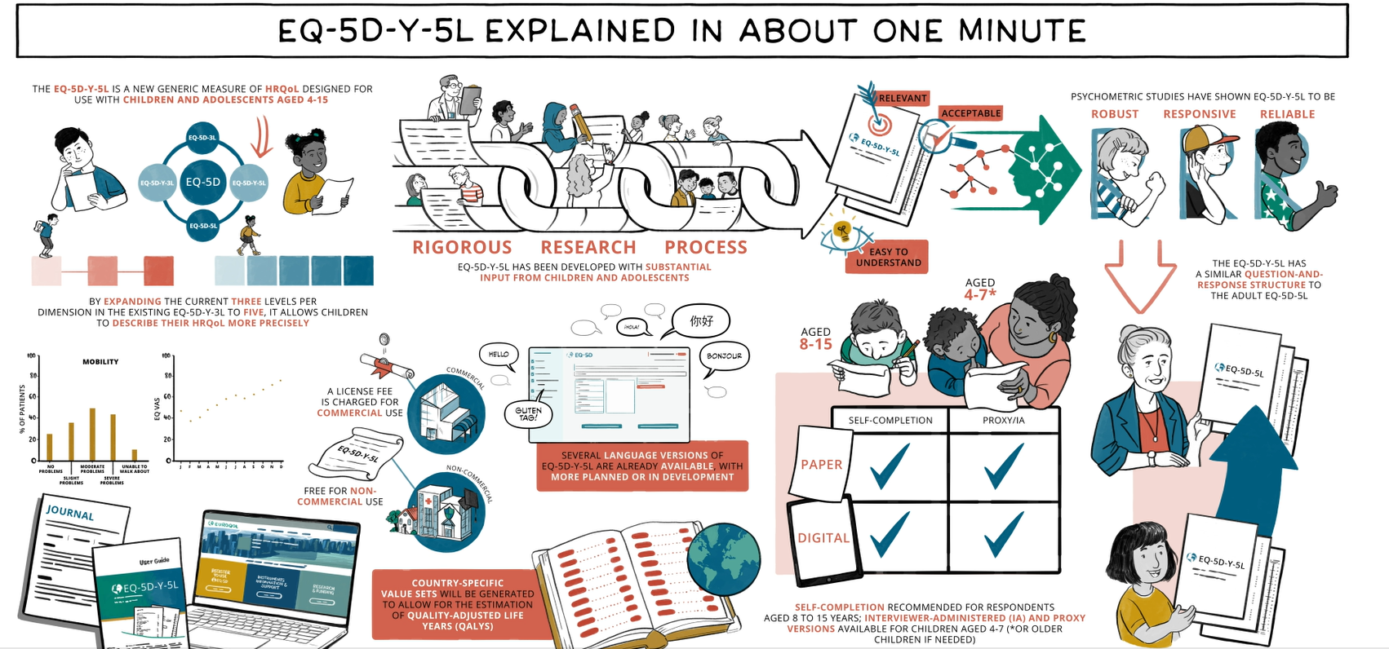
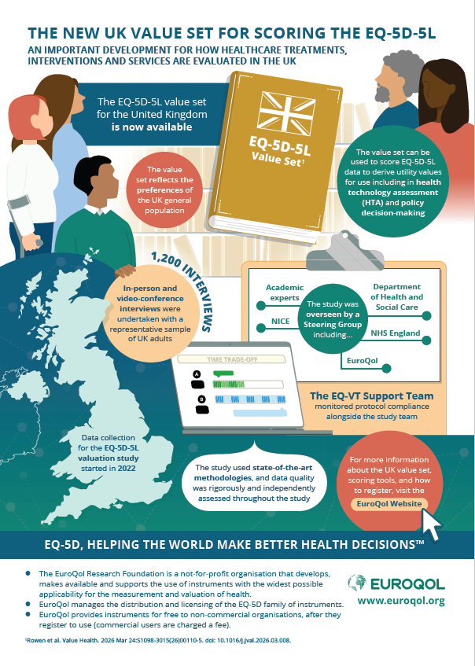
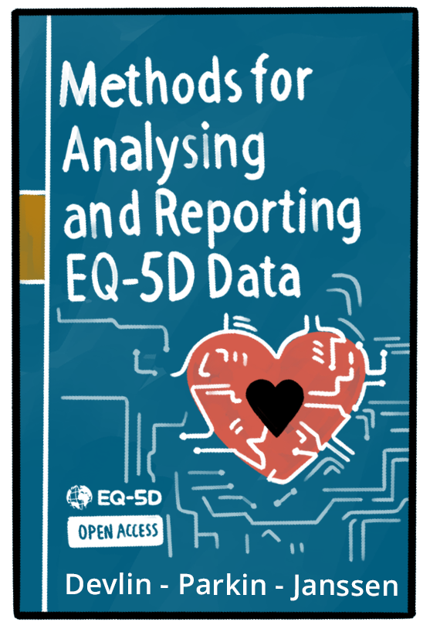
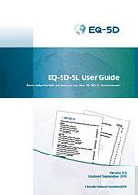
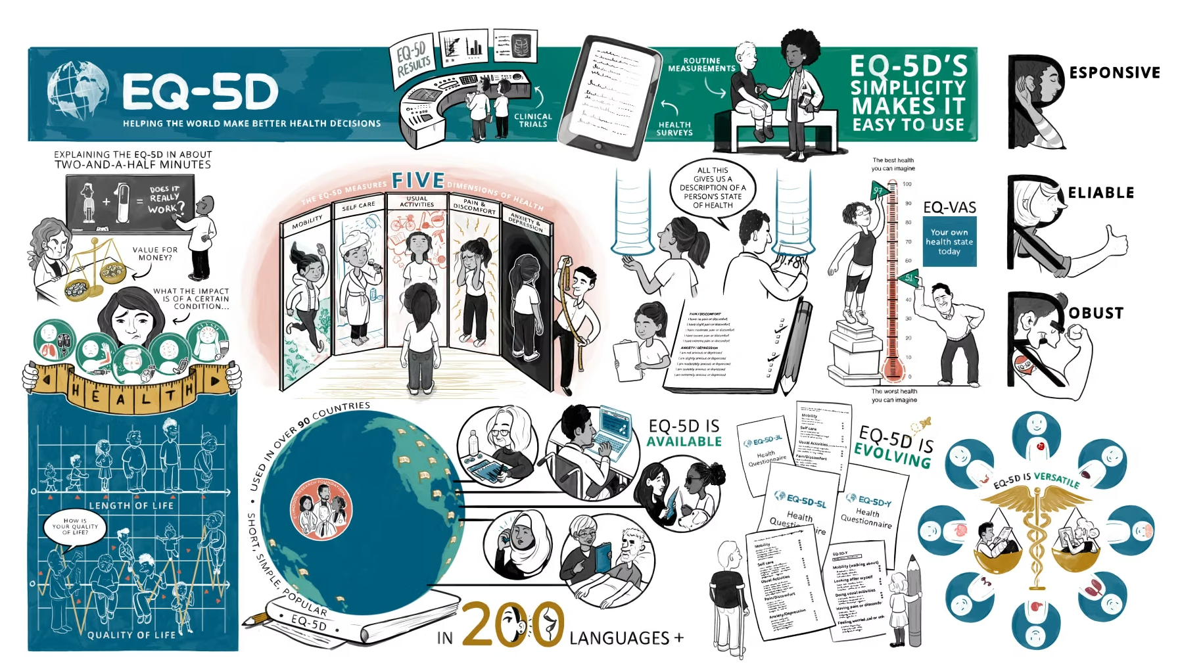
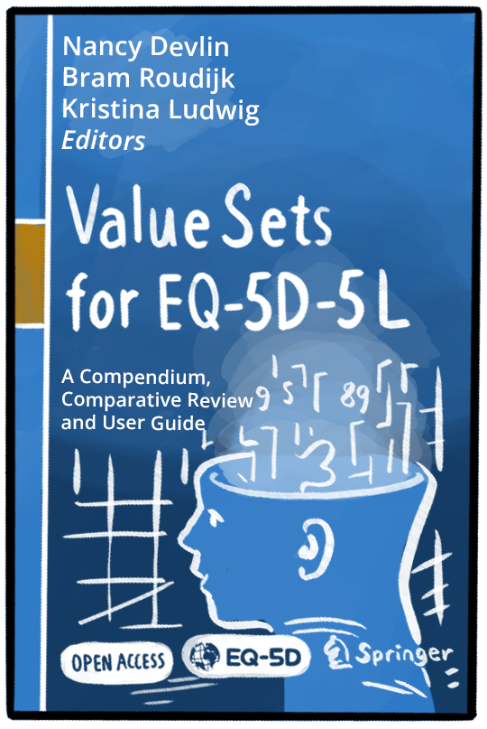
Further information on EQ-5D
The EuroQol website (www.euroqol.org) contains a wealth of information on EQ-5D instruments, and includes links to several open-access books
If you wish to speak to someone, contact the EuroQol office on +31 (0)88 2026890 or complete the ‘support form’ at: EuroQol Support Form
User guides provide guidance on how to use and analyse EQ-5D data
Animated videos and slide decks provide accessible and quick overviews across a number of useful topics, click here to access: Educational Material - EuroQol
17
Notes:
This slide deck was developed by the EuroQol Communications Team
Including the copyright line © EuroQol Research Foundation is mandatory when using information and/or images and/or any part of this slide deck in any other work or publication
Neither this presentation nor any of its parts may be sold, distributed or modified for commercial gain

Slide 18

In summary…
The EQ-5D family of instruments are widely used to describe and value health related quality of life (HRQoL) and have been used in a wide range of conditions and populations
As short, simple and reliable measures EQ-5D instruments are practical to use in studies, and they are available in over 200 languages
EQ-5D has been used in studies and real-world settings for over 35 years, the findings help inform decision making by healthcare authorities and providers
Many HTA organisations recommend the use of EQ-5D in the appraisal of drugs and medical technologies
EQ-5D is easily downloaded from the EuroQol website, in 90% of cases its use is free
Please see the animation ‘Explaining EQ-5D in about two-and-a-half minutes’ for a summary of EQ-5D (available on the EuroQol website)
18
Notes:
This slide deck was developed by the EuroQol Communications Team
Including the copyright line © EuroQol Research Foundation is mandatory when using information and/or images and/or any part of this slide deck in any other work or publication
Neither this presentation nor any of its parts may be sold, distributed or modified for commercial gain

Slide 19
Copyright information
This slide deck was developed by the EuroQol Communications Team
Including the copyright line © EuroQol Research Foundation is mandatory when using information and/or images and/or any part of this slide deck in any other work or publication
Neither this presentation nor any of its parts may be sold, distributed or modified for commercial gain
19

