Slide 1
The new EQ-5D-5L value set for the United Kingdom (UK)
July 2026
Notes:
This slide deck was developed by the EuroQol Communications Team
Including the copyright line © EuroQol Research Foundation is mandatory when using information and/or images and/or any part of this slide deck in any other work or publication
Neither this presentation nor any of its parts may be sold, distributed or modified for commercial gain

Slide 2
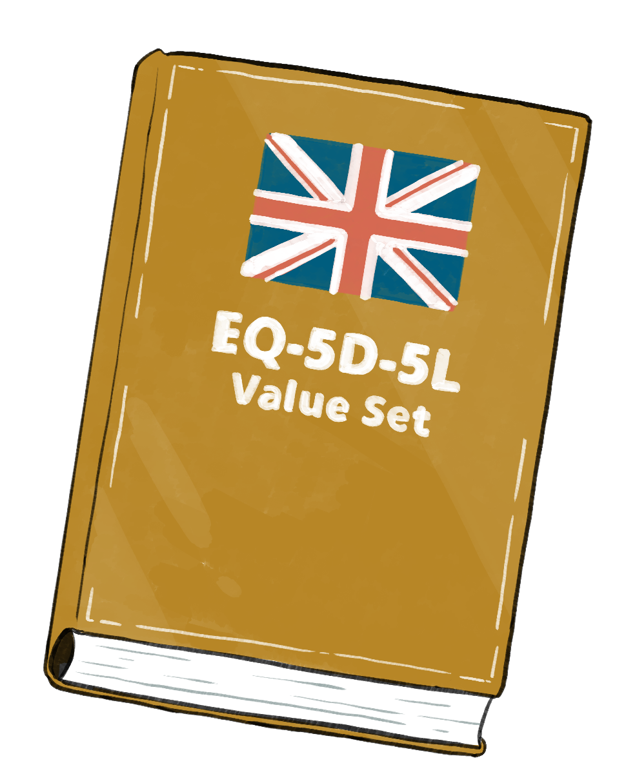
Overview
Slides cover the following topics:
          Utilities and value sets – a recap
          EQ-5D value sets
          Why a new EQ-5D-5L value set was needed for the UK
          The valuation study – overview
          The valuation study - methods
          Using the UK EQ-5D-5L value set
          Resources available on the UK EQ-5D-5L value set
          General information on the EQ-5D
2
Notes:
This slide deck was developed by the EuroQol Communications Team
Including the copyright line © EuroQol Research Foundation is mandatory when using information and/or images and/or any part of this slide deck in any other work or publication
Neither this presentation nor any of its parts may be sold, distributed or modified for commercial gain

Slide 3
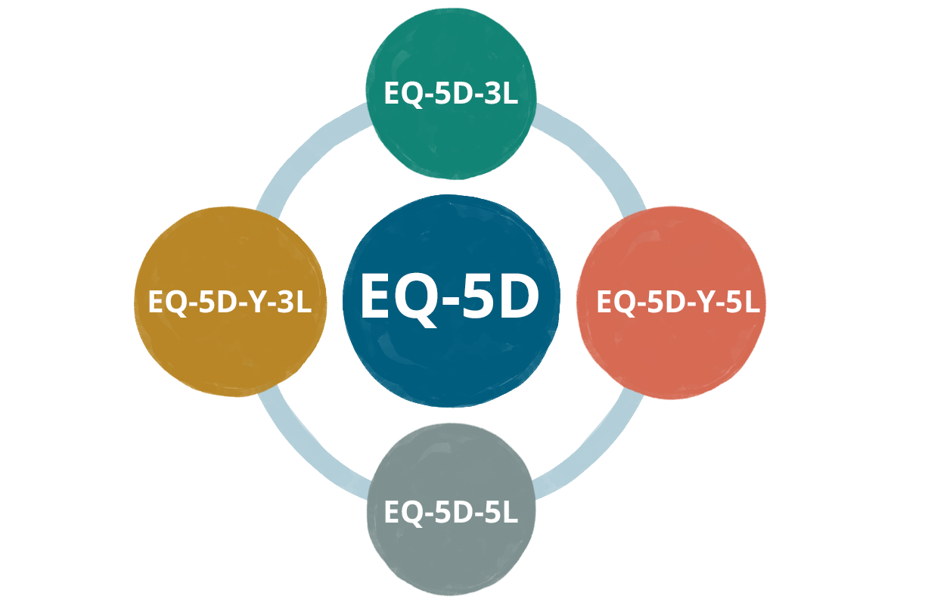
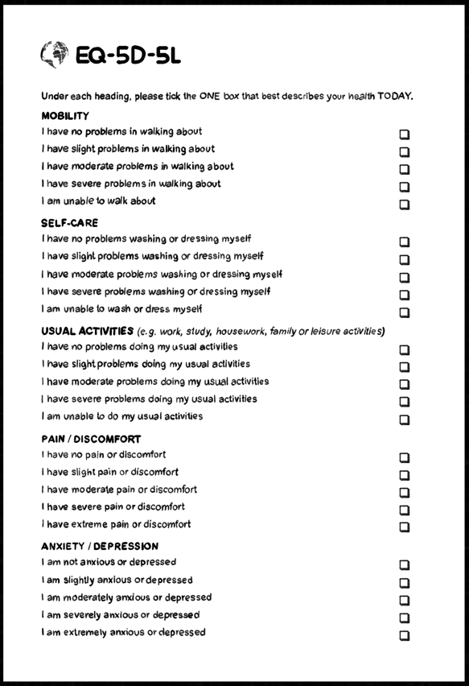
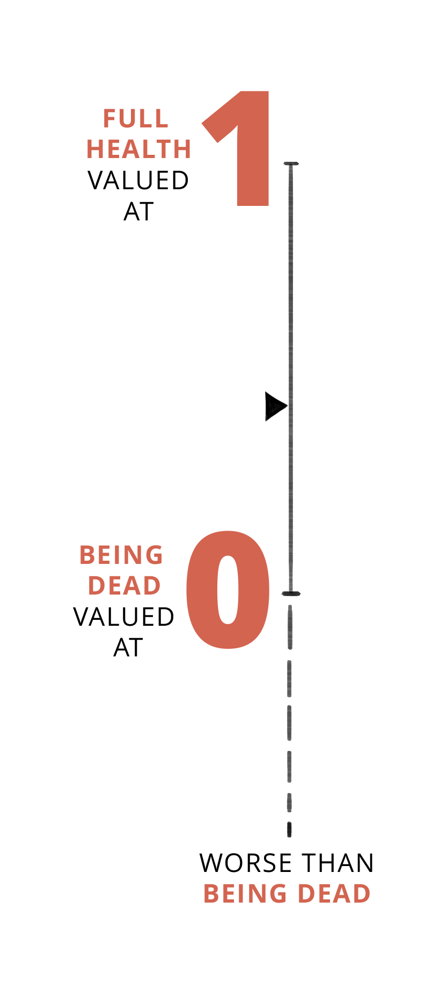
Utilities and value sets – a recap
Descriptive system
EQ-5D-5L is one of the EQ-5D family of instruments, and is widely used to describe and value health related quality of life (HRQoL)
All EQ-5D instruments comprise a descriptive system questionnaire and a visual analogue scale. Both parts should be administered together
Utility values (generally scored between 0 [representing ‘full health’] and 1 [representing ‘being dead’], negative EQ values are possible for states considered worse than being dead) can be generated from an individual’s responses to the EQ-5D descriptive system by using a Value Set
A Value Set is the collection of utility values for all possible EQ-5D health states
Utilities, when combined with length of time spent in a health state, help support the computation of quality adjusted life years (QALYs).
QALYs are an essential element of cost-utility analysis, a key requirement for NICE and other health technology assessment (HTA) bodies
3
Notes:
This slide deck was developed by the EuroQol Communications Team
Including the copyright line © EuroQol Research Foundation is mandatory when using information and/or images and/or any part of this slide deck in any other work or publication
Neither this presentation nor any of its parts may be sold, distributed or modified for commercial gain

Slide 4


EQ-5D value sets
EQ-5D instruments are accompanied by value sets, these allow utilities (EQ values) to be derived from responses to the EQ-5D descriptive system
Because population preferences are incorporated in EQ value sets, they are very useful when it comes to evaluating the perceived societal benefit of healthcare interventions
Country specific value sets are needed as preferences may differ across different cultures
A strength of the EQ-5D is that there are lots of value sets and new ones are regularly being added
The new EQ-5D-5L value set for the United Kingdom (UK) is now available
The value set reflects the preferences of the UK general population and enables
utility values to be generated for all EQ-5D-5L responses
4
Notes:
This slide deck was developed by the EuroQol Communications Team
Including the copyright line © EuroQol Research Foundation is mandatory when using information and/or images and/or any part of this slide deck in any other work or publication
Neither this presentation nor any of its parts may be sold, distributed or modified for commercial gain

Slide 5


Why a new EQ-5D-5L value set was needed for the UK
Having up-to-date and reliable utility values is important for HTA and to help inform healthcare decision making
The National Institute for Health and Care Excellence (NICE) in England had previously been recommending that EQ-5D-5L data should be scored by mapping onto the EQ-5D-3L value set
The need for a UK value set for the EQ-5D-5L is widely acknowledged
          The UK EQ-5D-3L value set that is currently being used for mapping was developed in the 1990s, and is therefore unlikely to reflect current societal preferences or population demographics
          Methods for deriving health state preferences have evolved over the last 30 years
          Direct estimation of utilities from a value set is preferable to an indirect mapping from an instrument with a different classification system
5
Notes:
This slide deck was developed by the EuroQol Communications Team
Including the copyright line © EuroQol Research Foundation is mandatory when using information and/or images and/or any part of this slide deck in any other work or publication
Neither this presentation nor any of its parts may be sold, distributed or modified for commercial gain

Slide 6
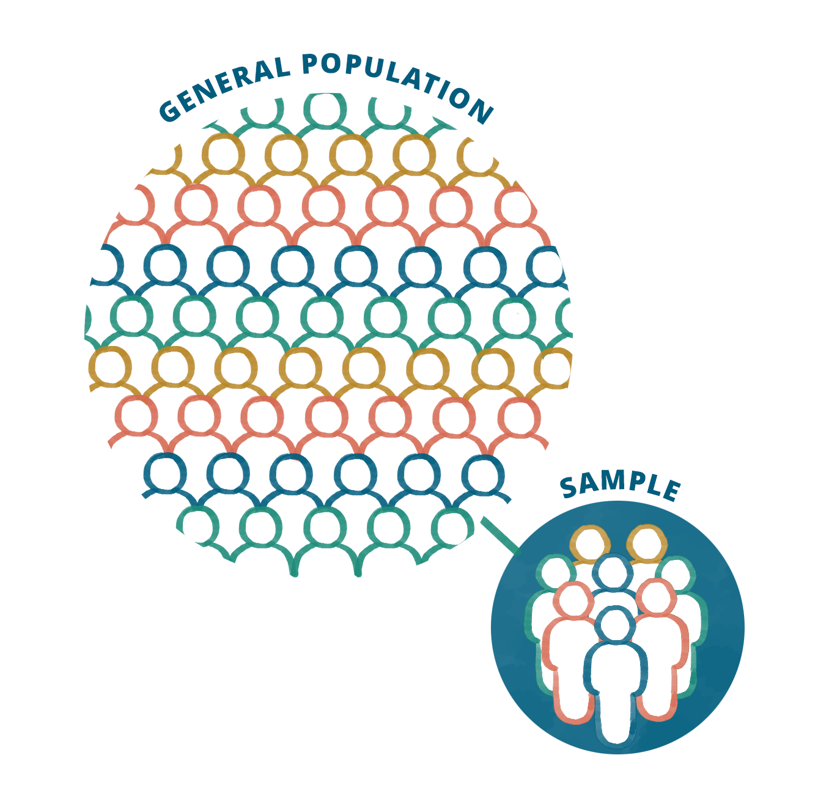
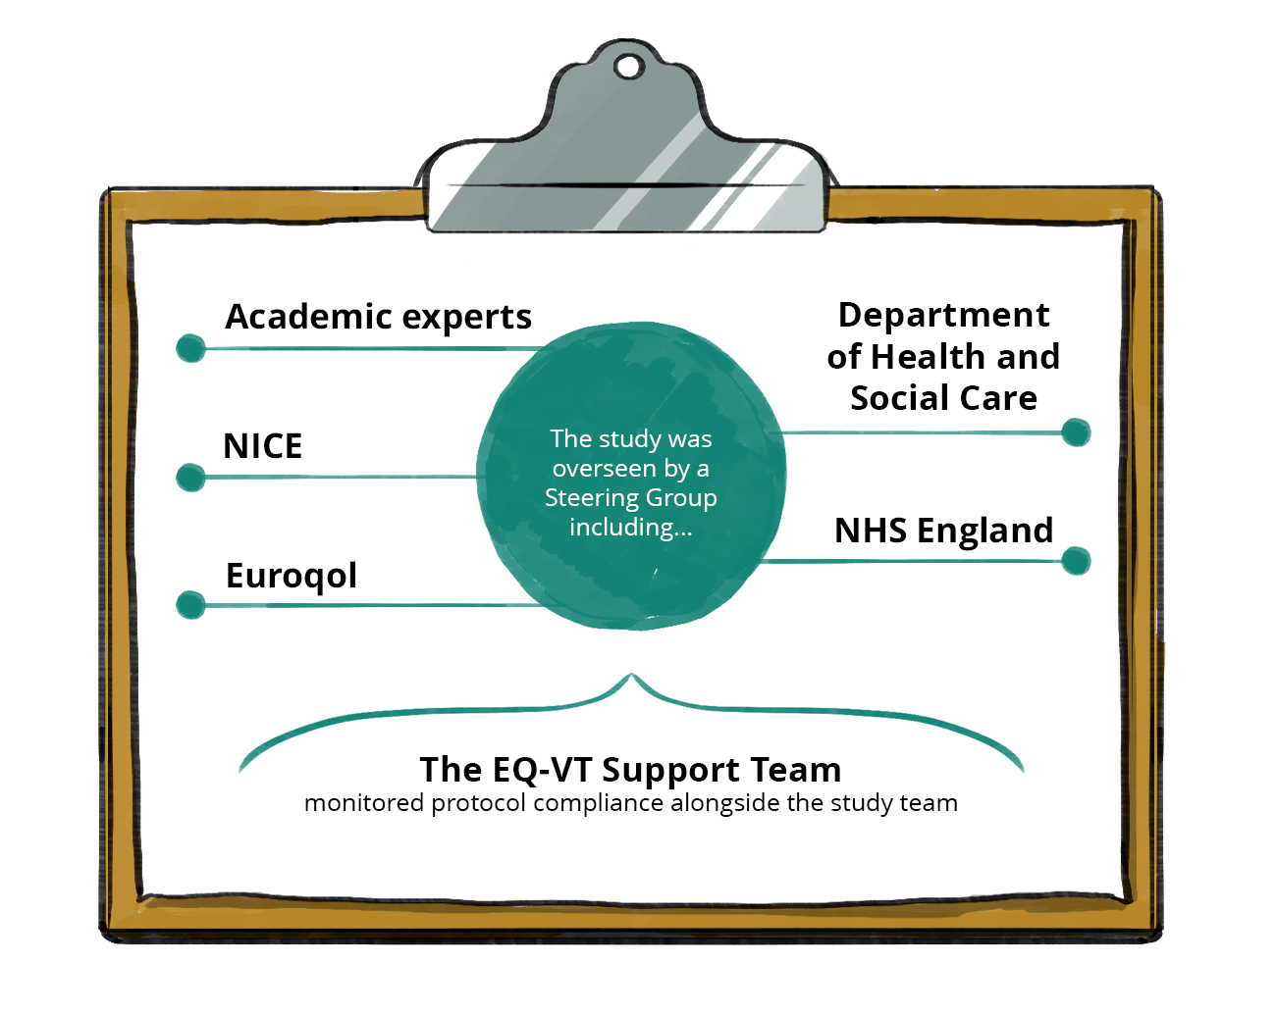

The valuation study - overview
Value sets are derived from valuation studies involving participants from the general population
The protocol for the UK valuation of the EQ-5D-5L was informed by the international EQ-5D-5L valuation protocol which has been used in over 30 studies worldwide^{1,2}
The study sample was selected to be proportionally representative of the four nations (England, Scotland, Wales, and Northern Ireland) and included people with and without health problems
There was input to the valuation study from a wide range of stakeholders
The EQ-5D-5L UK value set is published in Value in Health (Rowen et al, 2026)³
1. Rowen et al. Value Health. 2023 Nov;26(11):1625-1635; 2. Stolk et al. Value Health. 2019 Jan;22(1):23-30; 3. Rowen et al. Value Health. 2026 Mar 24:S1098-3015(26)00110-5.
6
Notes:
This slide deck was developed by the EuroQol Communications Team
Including the copyright line © EuroQol Research Foundation is mandatory when using information and/or images and/or any part of this slide deck in any other work or publication
Neither this presentation nor any of its parts may be sold, distributed or modified for commercial gain

Slide 7
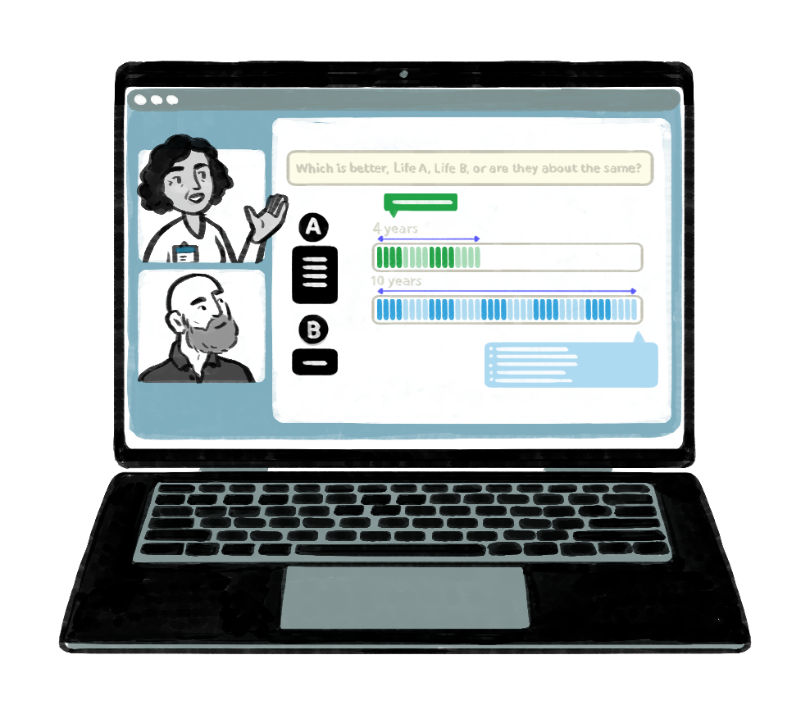


The valuation study – methods¹
To develop the UK value set 1200 interviews were undertaken (January 2023 to September 2023) with a representative (age, sex, ethnicity, and socioeconomic groups) sample of the UK public
Respondents were recruited through a range of methods including a postal mailout, social media posts, word of mouth and posters
The study used state-of-the-art methodologies with preference data elicited using the time trade-off (TTO) method
Both videoconference (91.8%) and face-to-face (8.2%) approaches were used for the interviews to help ensure inclusivity. Interviews were conducted in English or Welsh
Data quality was rigorously and independently assessed throughout the study by the Quality Control team and the study Steering Group
1. Rowen et al. Value Health. 2026 Mar 24:S1098-3015(26)00110-5.
7
Notes:
This slide deck was developed by the EuroQol Communications Team
Including the copyright line © EuroQol Research Foundation is mandatory when using information and/or images and/or any part of this slide deck in any other work or publication
Neither this presentation nor any of its parts may be sold, distributed or modified for commercial gain

Slide 8

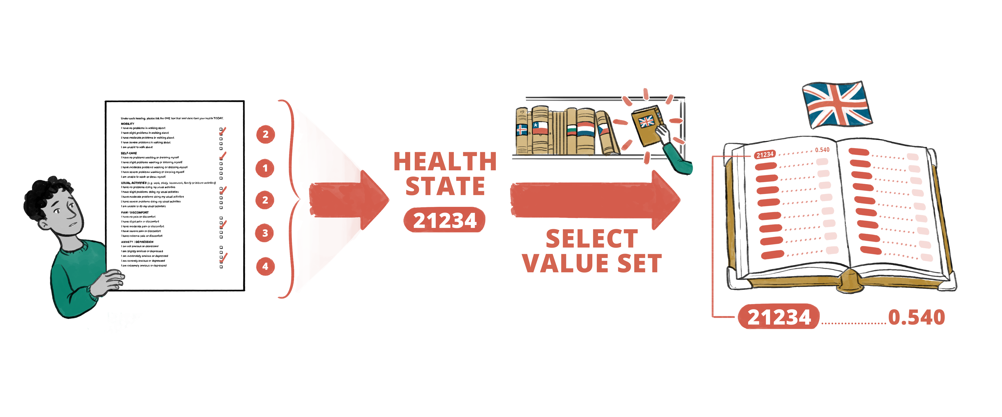
Using the UK EQ-5D-5L value set – an example
An example of how to use a UK EQ-5D-5L value set……
          Tom completes the EQ-5D-5L
          His profile of responses is referred to as a health state
          The health state for his responses is 21234 (see figure below )
          By referring to the appropriate Value Set (in this case the one for the UK) the health state of 21234 is shown to translate to a utility value of 0.540¹
1. Rowen et al. Value Health. 2026 Mar 24:S1098-3015(26)00110-5.
8
Notes:
This slide deck was developed by the EuroQol Communications Team
Including the copyright line © EuroQol Research Foundation is mandatory when using information and/or images and/or any part of this slide deck in any other work or publication
Neither this presentation nor any of its parts may be sold, distributed or modified for commercial gain

Slide 9


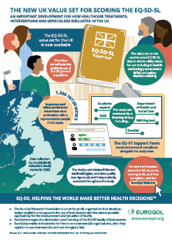
Resources available on the UK EQ-5D-5L value set
EuroQol has developed a number of scoring tools (in Excel, SPSS, R, SAS and STATA) to score the EQ-5D-5L using the new UK value set. See: Scoring EQ-5D-5L with the new UK value set - EuroQol
A Frequently Asked Questions (FAQ) page on the EuroQol website provides useful insights. See FAQS - EuroQol
An infographic on the EQ-5D-5L value set provides an accessible and simple graphical overview. See Educational Material - EuroQol
There are lots of useful resources on the NICE website, including:
A blog on the importance of the recently published EQ-5D-5L value set and how it has the potential to help inform if new treatments offer good value for money for the NHS. Available at: Better data for better decisions | NICE
A public consultation on the proposed adoption of the EQ-5D-5L UK value set in the NICE methods manuals. Available at: Available at: Consultation | Modular update to NICE manuals: EQ-5D-5L value set | Guidance | NICE
FAQs on the implications of the EQ-5D-5L value set for the UK. Available at: The EQ-5D-5L | NICE
9
Notes:
This slide deck was developed by the EuroQol Communications Team
Including the copyright line © EuroQol Research Foundation is mandatory when using information and/or images and/or any part of this slide deck in any other work or publication
Neither this presentation nor any of its parts may be sold, distributed or modified for commercial gain

Slide 10


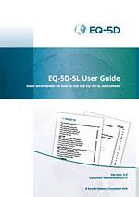

General information on EQ-5D
The EuroQol website (www.euroqol.org) contains a wealth of information on EQ-5D instruments, and includes links to a number of open-access books
Available value sets* are listed on the EuroQol website, the website also includes tools to help calculate utility values (EQ values)
User guides on the different EQ-5D instruments provide guidance on how to use and analyse EQ-5D data
Animated videos provide accessible and quick overviews across a number of useful topics, click here to access: Educational Material - EuroQol
          Explaining the EQ-5D in about two-and-a-half minutes
          The EQ-5D visual analogue scale (EQ VAS)
          The EQ-5D-5L descriptive system
          How to obtain EQ-5D
          Translating Patient Reported Outcome Measures (PROMS) for use around the world: the example of EQ-5D
          Measuring HRQoL in children and adolescents: the EQ-5D-Y-3L
          EQ-5D-Y-5L explained in about two minutes
*EuroQol is developing a protocol for the valuation of EQ-5D-Y-5L health states – once finalized, value sets will be developed. It is anticipated that a limited number of value sets will become available in 2027. EuroQol is also developing a crosswalk function which will allow users to link individual responses on the EQ-5D-Y-5L descriptive system with existing EQ-5D-Y-3L value sets.
10
Notes:
This slide deck was developed by the EuroQol Communications Team
Including the copyright line © EuroQol Research Foundation is mandatory when using information and/or images and/or any part of this slide deck in any other work or publication
Neither this presentation nor any of its parts may be sold, distributed or modified for commercial gain

Slide 11
Copyright information
This slide deck was developed by the EuroQol Communications Team
Including the copyright line © EuroQol Research Foundation is mandatory when using information and/or images and/or any part of this slide deck in any other work or publication
Neither this presentation nor any of its parts may be sold, distributed or modified for commercial gain
11

