Slide 1
An introduction to EQ-5D value sets
September 2026
Notes:
This slide deck was developed by the EuroQol Communications Team
Including the copyright line © EuroQol Research Foundation is mandatory when using information and/or images and/or any part of this slide deck in any other work or publication
Neither this presentation nor any of its parts may be sold, distributed or modified for commercial gain

Slide 2
Overview
This slide set provides a very top-level overview of EQ-5D value sets
Slides cover the following topics:
          Overview of EQ-5D
          The two parts of the EQ-5D
          What are utilities?
          The difference between a utility value and an EQ VAS score
          Deriving utilities from the EQ-5D descriptive system
          Using a value set with EQ-5D descriptive system results – an example
          How are value sets developed?
          Resources and further information
2
Notes:
This slide deck was developed by the EuroQol Communications Team
Including the copyright line © EuroQol Research Foundation is mandatory when using information and/or images and/or any part of this slide deck in any other work or publication
Neither this presentation nor any of its parts may be sold, distributed or modified for commercial gain

Slide 3
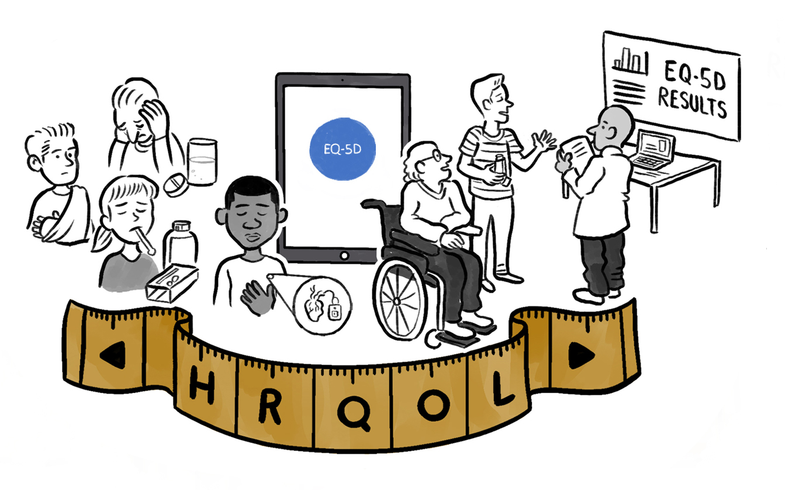
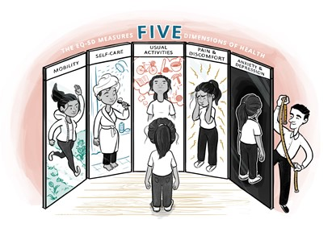
Overview of EQ-5D
The EQ-5D family of instruments are widely used to describe and value health related quality of life (HRQoL)
There are four different EQ-5D instruments (EQ-5D-3L, EQ-5D-5L, EQ-5D-Y-3L, EQ-5D-Y-5L).
As short, simple and reliable measures EQ-5D instruments are practical to use in studies
HRQoL is measured across the same 5 dimensions in all EQ-5D instruments
3
Notes:
This slide deck was developed by the EuroQol Communications Team
Including the copyright line © EuroQol Research Foundation is mandatory when using information and/or images and/or any part of this slide deck in any other work or publication
Neither this presentation nor any of its parts may be sold, distributed or modified for commercial gain

Slide 4
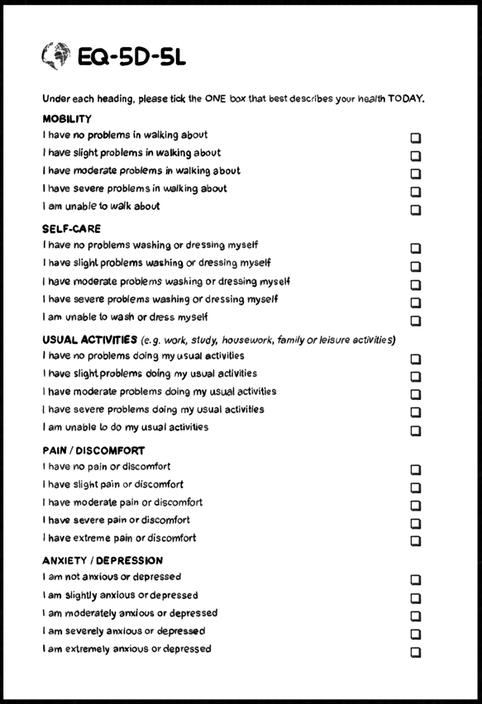
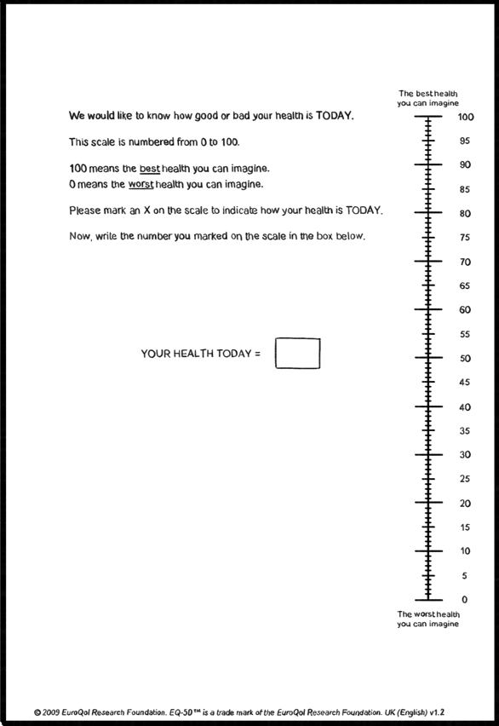
The two parts of the EQ-5D
All EQ-5D instruments comprise a descriptive system questionnaire and a visual analogue scale. Both parts of the EQ-5D questionnaire are integral to the instrument and should always be administered together
A short descriptive system questionnaire where respondents indicate their current health status on 5 dimensions of health*
…and a visual analogue scale (EQ VAS)
which is used to obtain a global rating of the respondents self-perceived health status
*This shows the EQ-5D-5L, the EQ-5D-3L version has three response levels for each question
Notes:
This slide deck was developed by the EuroQol Communications Team
Including the copyright line © EuroQol Research Foundation is mandatory when using information and/or images and/or any part of this slide deck in any other work or publication
Neither this presentation nor any of its parts may be sold, distributed or modified for commercial gain

Slide 5
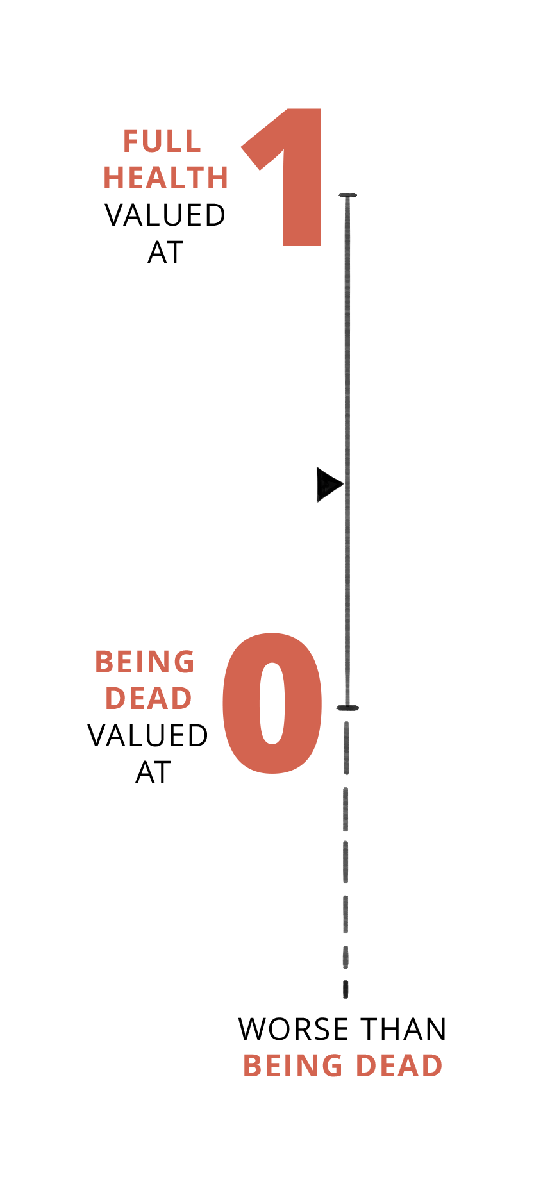
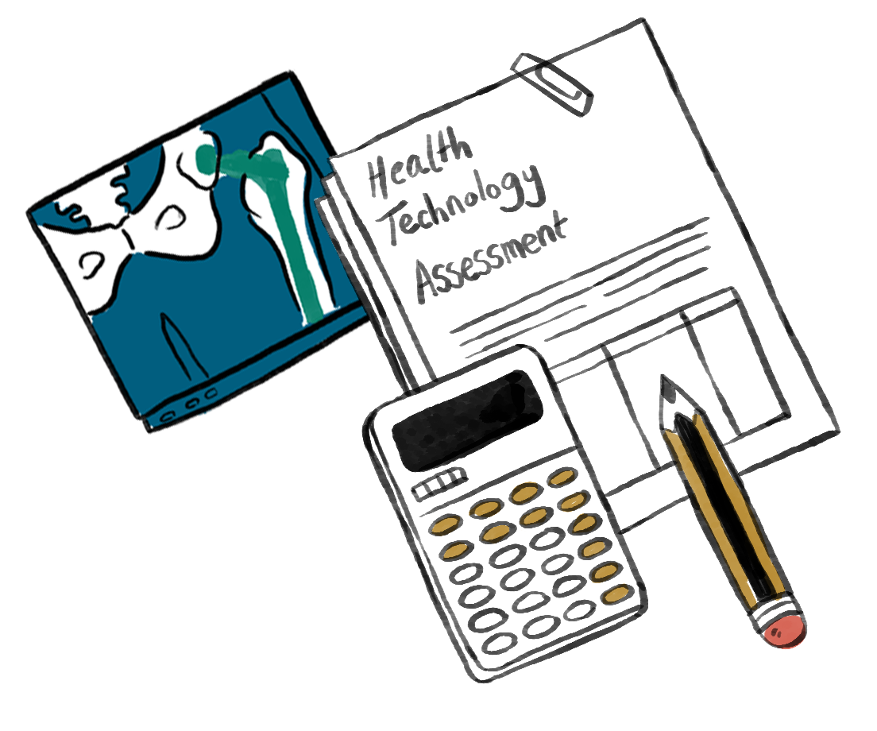
What are utilities?
A utility (or utility value), which may also be known as an EQ value, index value…etc.) is used to represent the strength of individuals’ (societies) preferences for different health states
Utilities are measured relative to full health (1) and being dead (0), it is also possible to have negative utility values that represent states worse than death
Utilities can be generated using direct methods (in studies that use approaches like standard gamble or time trade-off) or through indirect methods (using a preference-based instrument like EQ-5D)
Utilities, when combined with length of time spent in a health state, help support the computation of quality adjusted life years (QALYs)
QALYs are an essential element of cost-utility analysis, a key requirement for NICE and other health technology assessment (HTA) bodies
Note: a utility captured using the EQ-5D can be referred to as an EQ value
5
Notes:
This slide deck was developed by the EuroQol Communications Team
Including the copyright line © EuroQol Research Foundation is mandatory when using information and/or images and/or any part of this slide deck in any other work or publication
Neither this presentation nor any of its parts may be sold, distributed or modified for commercial gain

Slide 6
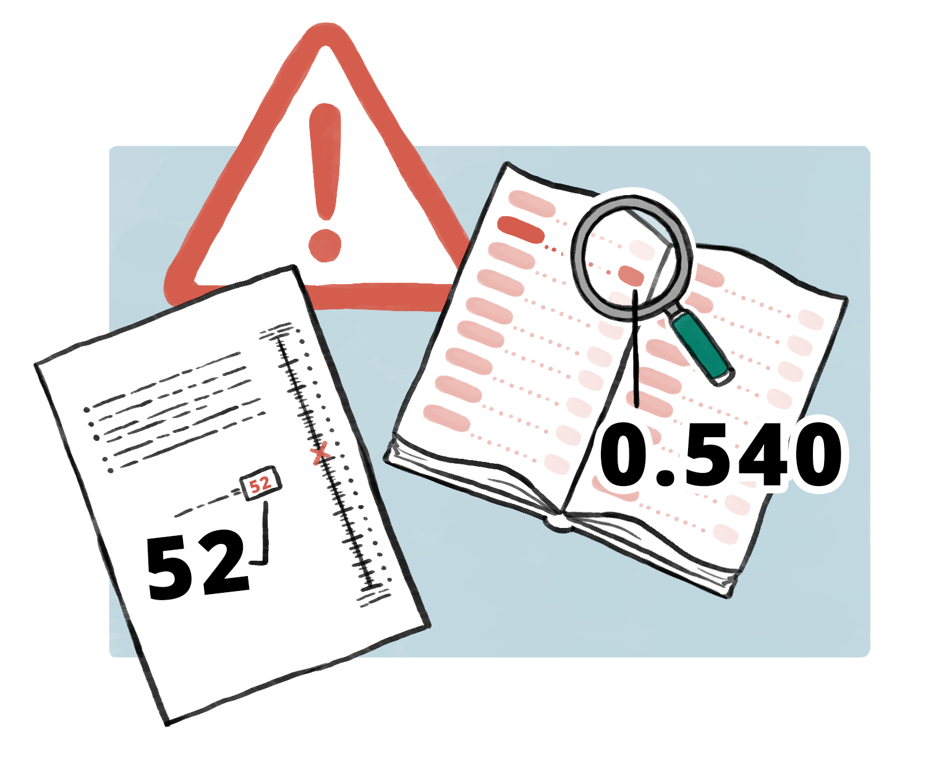
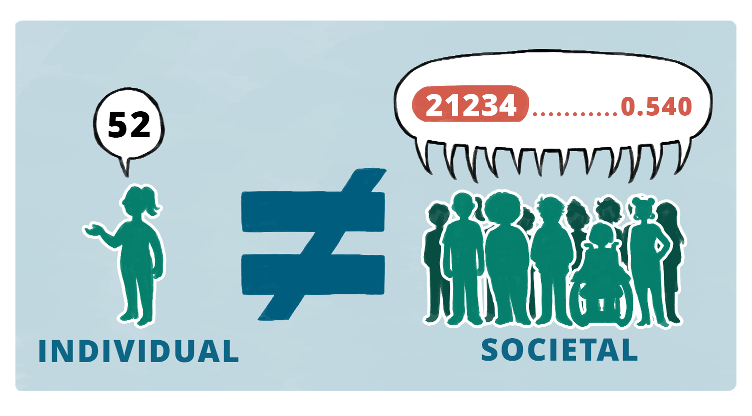
The difference between a utility value and an EQ VAS score
Although both are numbers the utility value (EQ value) is measuring something different to the EQ VAS score
A utility value is derived from a value set and represents the societal perspective for a specific health state
Whereas the score on the EQ VAS gives the individual’s perspective of their own health
6
Notes:
This slide deck was developed by the EuroQol Communications Team
Including the copyright line © EuroQol Research Foundation is mandatory when using information and/or images and/or any part of this slide deck in any other work or publication
Neither this presentation nor any of its parts may be sold, distributed or modified for commercial gain

Slide 7



Deriving utilities from the EQ-5D descriptive system
Utility values can be generated from an individuals’ responses to the EQ-5D descriptive system by using a Value Set
A Value Set is the collection of utility values for ALL possible EQ-5D health states
Up-to-date country specific value sets are needed as preferences may differ across cultures and over time. A strength of the EQ-5D is that there are lots of value sets and new ones are regularly being added
Because population preferences are incorporated in EQ value sets they are very useful when it comes to evaluating the perceived societal benefit of healthcare interventions
7
Notes:
This slide deck was developed by the EuroQol Communications Team
Including the copyright line © EuroQol Research Foundation is mandatory when using information and/or images and/or any part of this slide deck in any other work or publication
Neither this presentation nor any of its parts may be sold, distributed or modified for commercial gain

Slide 8

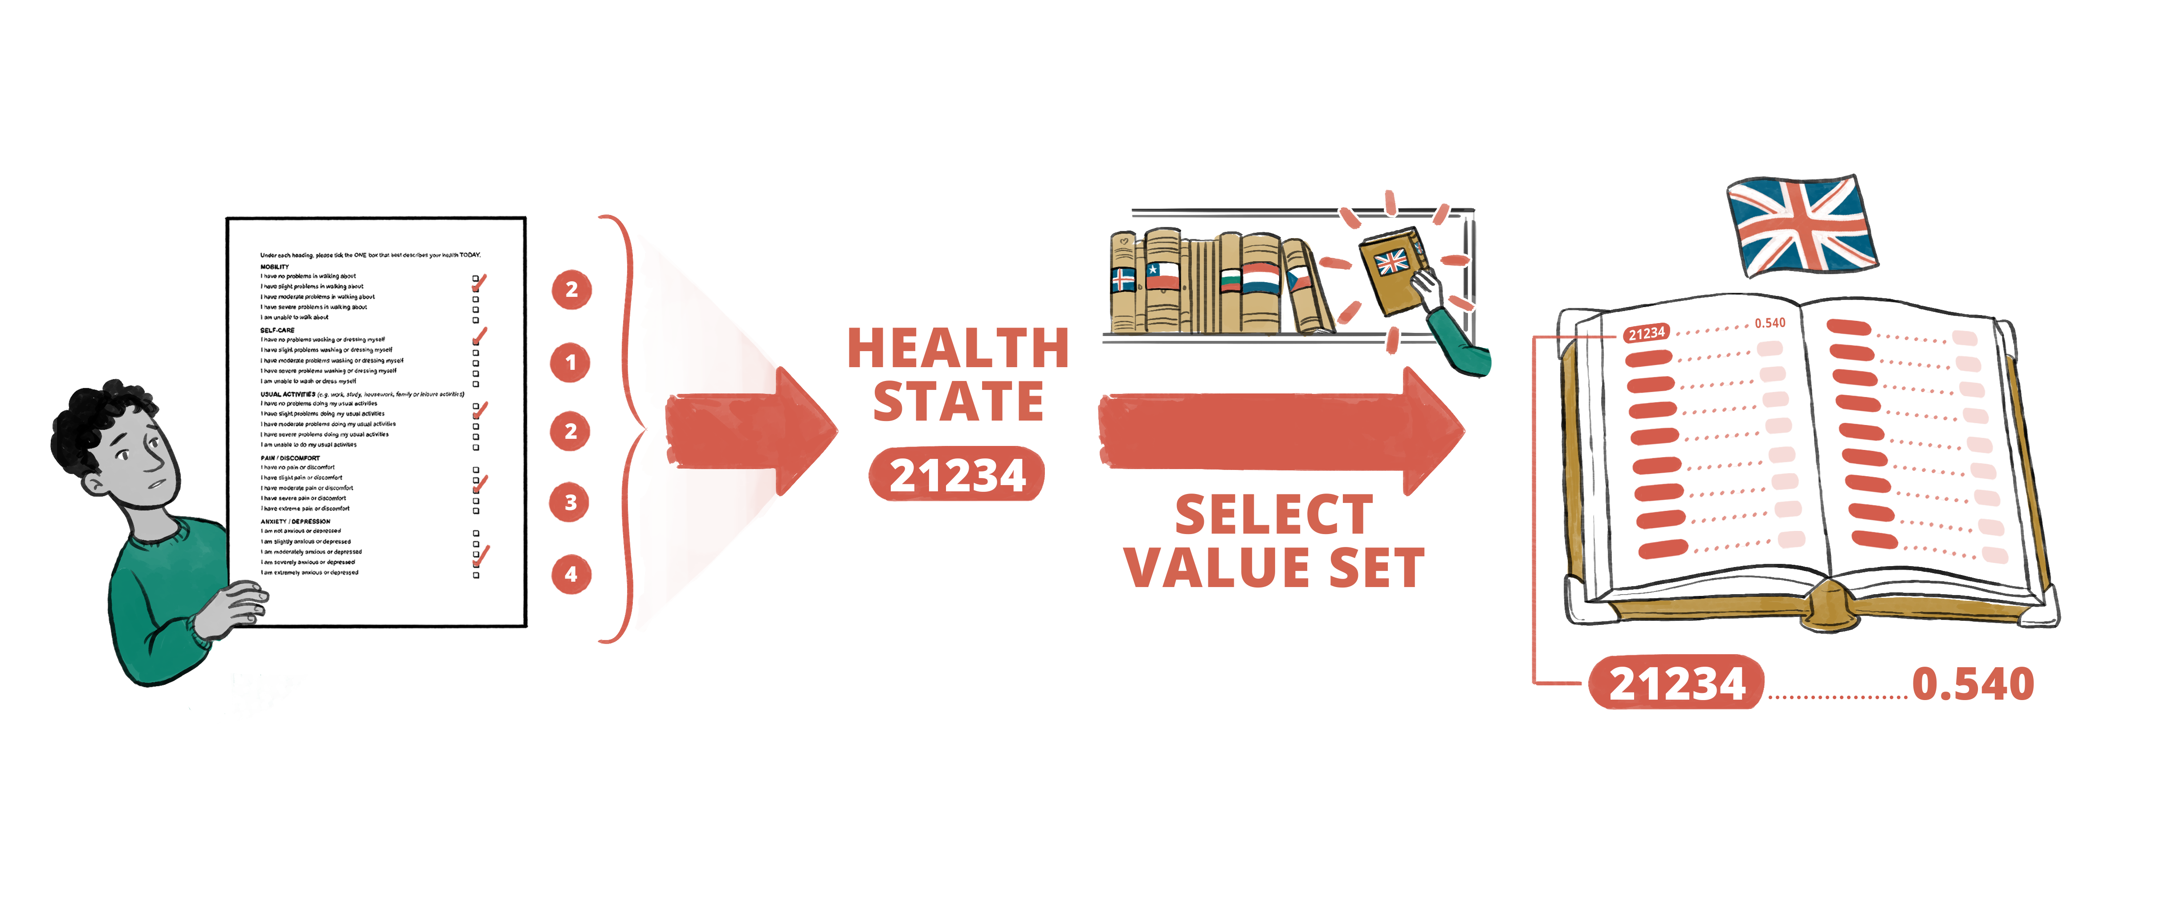
Using a value set – an example
An example of how to use a value set……
          Tom completes the EQ-5D-5L
          His profile of responses is referred to as a health state
          They represent a health state of 21234
          By using the appropriate Value Set (in this case the one for the UK) this health state of 21234 translates to a utility value of 0.540
8
Notes:
This slide deck was developed by the EuroQol Communications Team
Including the copyright line © EuroQol Research Foundation is mandatory when using information and/or images and/or any part of this slide deck in any other work or publication
Neither this presentation nor any of its parts may be sold, distributed or modified for commercial gain

Slide 9


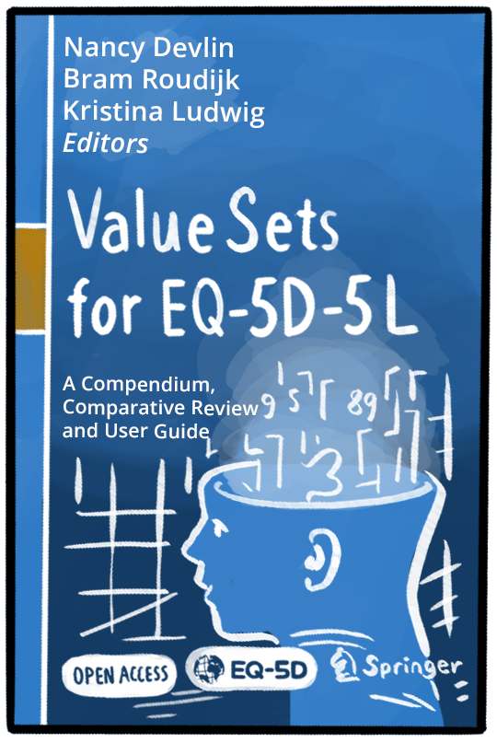
Where can you find value sets?
A complete set of available value sets* is available on the EuroQol website at www.euroqol.org.
The website also includes tools to help calculate EQ values for EQ-5D-3L, EQ-5D-5L, and the EQ-5D-Y-3L*. If the instrument and country/region are selected using the drop-down menus a list of currently available tools (e.g. STATA, SAS, SPSS, R, Excel) will be shown.
An open access book ‘Value sets for EQ-5D-5L’ collates and analyses published EQ-5D-5L value sets, and provides guidance to users on choice of value set
*EuroQol is developing a protocol for the valuation of EQ-5D-Y-5L health states – once finalized, value sets will be developed. It is anticipated that a limited number of value sets will become available in 2027. EuroQol is also developing a crosswalk function which will allow users to link individual responses on the EQ-5D-Y-5L descriptive system with existing EQ-5D-Y-3L value sets.
9
Notes:
This slide deck was developed by the EuroQol Communications Team
Including the copyright line © EuroQol Research Foundation is mandatory when using information and/or images and/or any part of this slide deck in any other work or publication
Neither this presentation nor any of its parts may be sold, distributed or modified for commercial gain

Slide 10
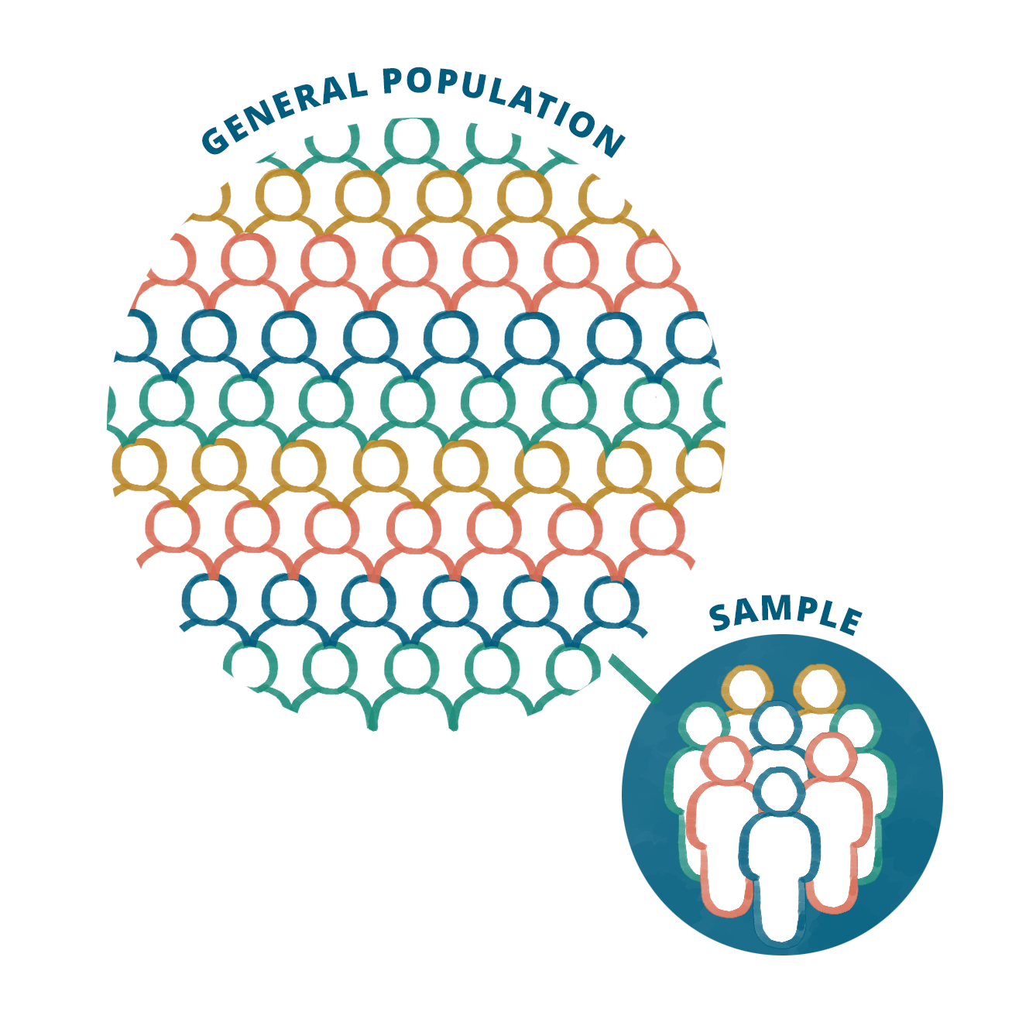
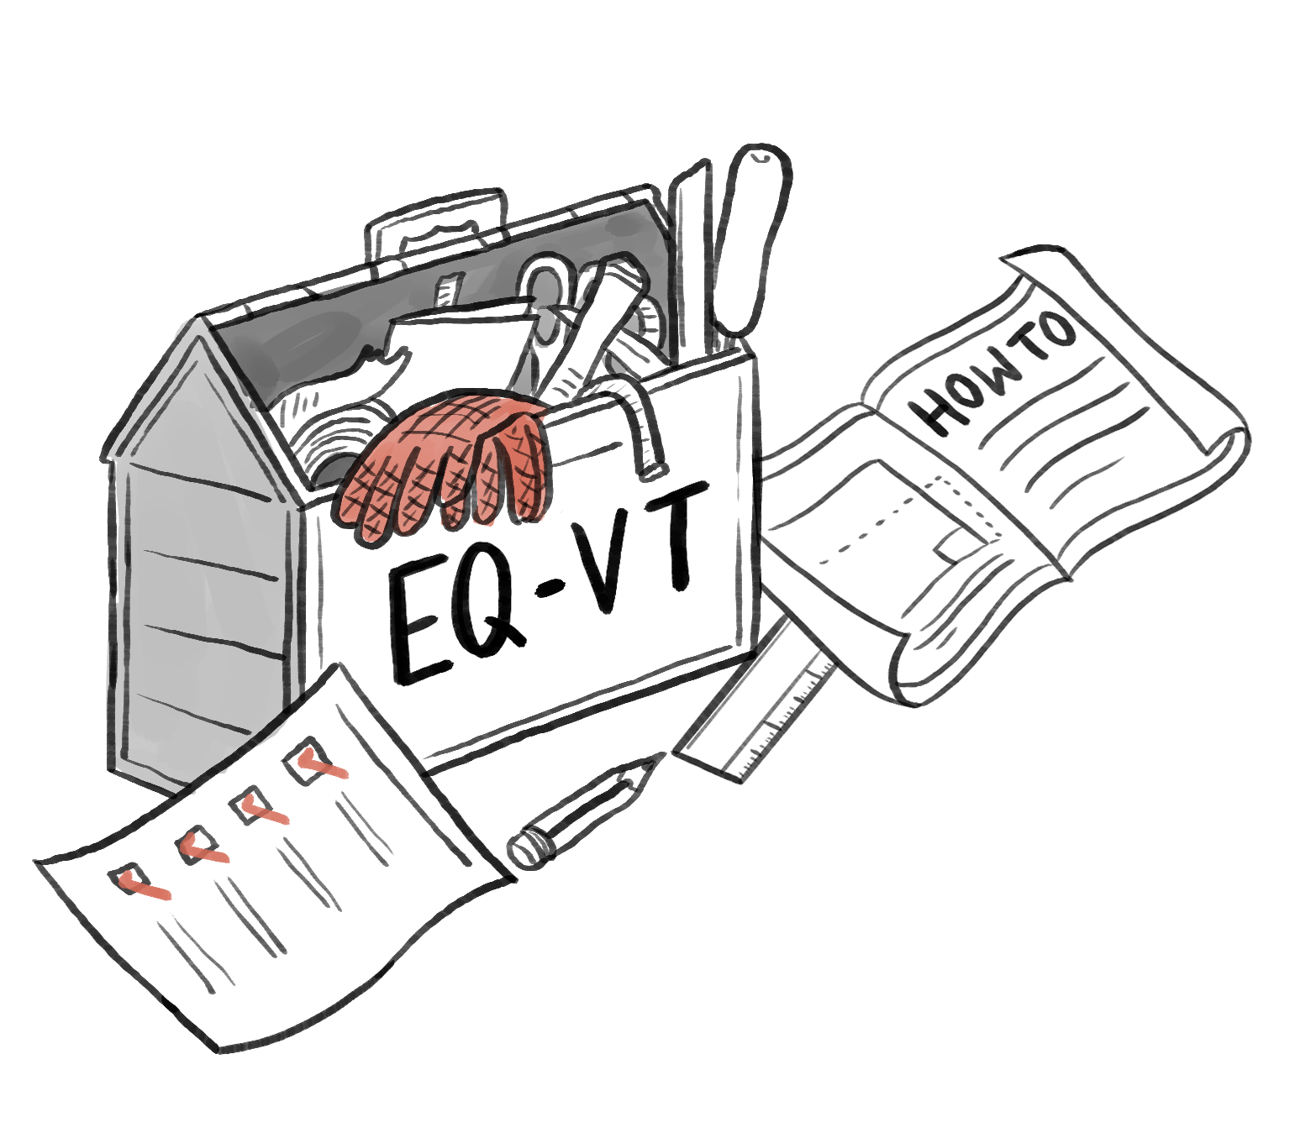
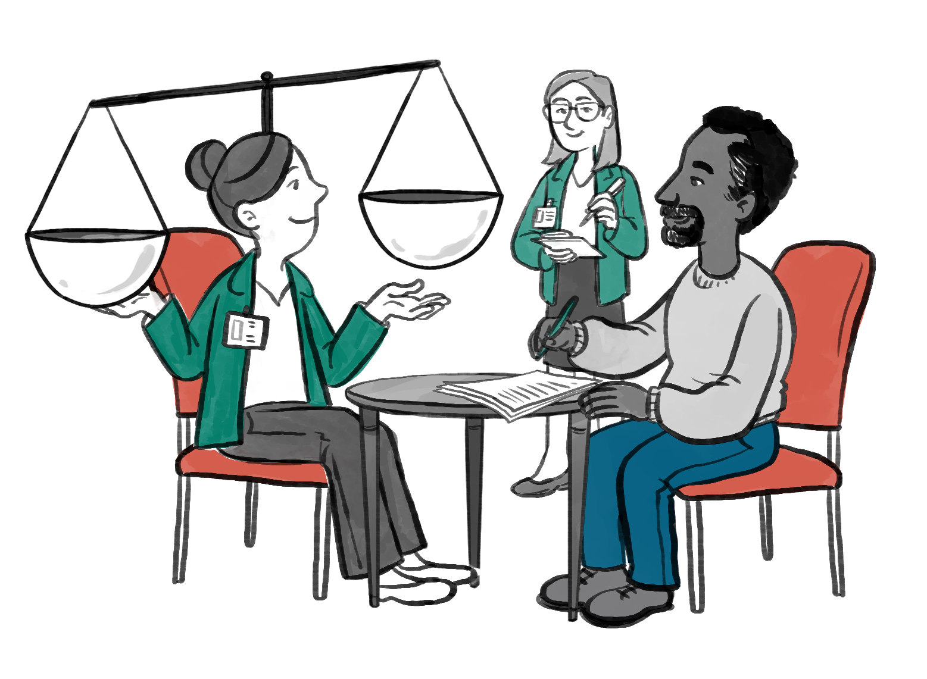
How are value sets developed?
Value sets are derived from valuation studies involving participants from the general population
An international valuation protocol (called EQ-VT) is available to guide the design of valuation studies and the development of value sets. This guidance has enabled teams from all over the world to create value sets and it helps to guarantee quality and consistency
In a valuation study participants are asked questions that enable their preferences for different health states to be determined using well-established scientific methods
Once enough information on preferences has been collected a complete value set can be built
10
Notes:
This slide deck was developed by the EuroQol Communications Team
Including the copyright line © EuroQol Research Foundation is mandatory when using information and/or images and/or any part of this slide deck in any other work or publication
Neither this presentation nor any of its parts may be sold, distributed or modified for commercial gain

Slide 11
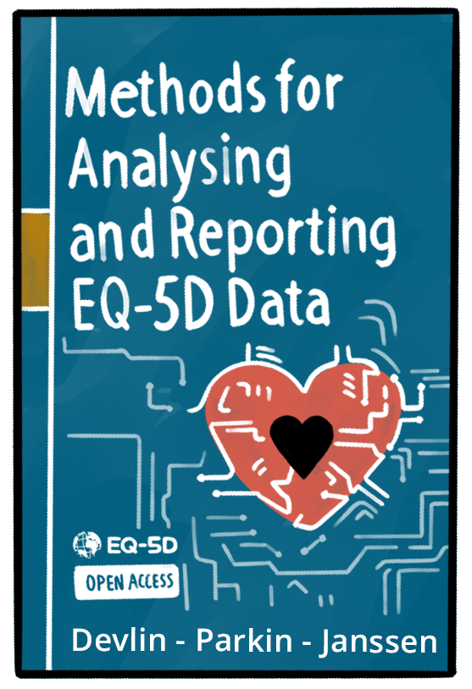
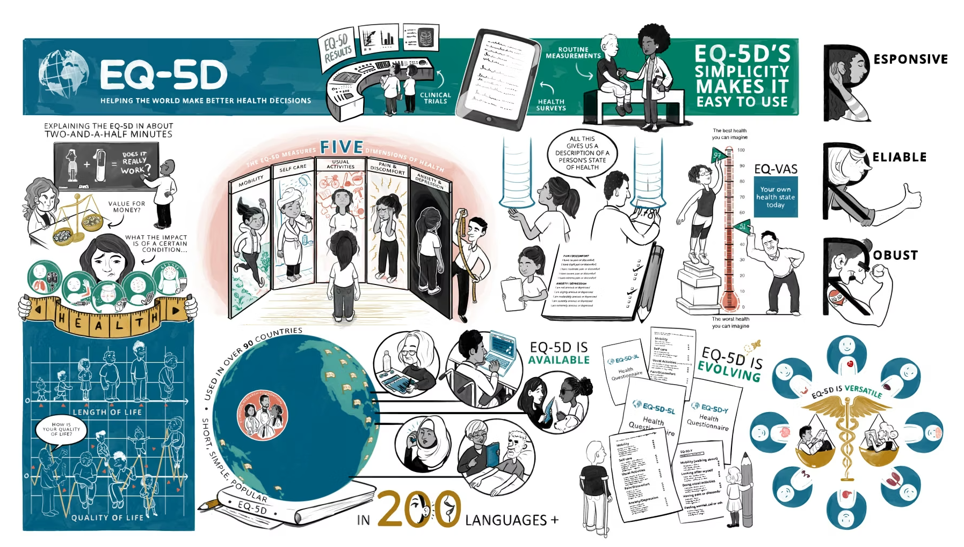
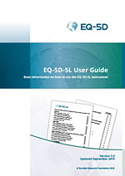
Further information on EQ-5D
The EuroQol website (www.euroqol.org) contains a wealth of information on EQ-5D instruments, and includes links to a number of open-access books
User guides on the different EQ-5D instruments provide guidance on how to use and analyse EQ-5D data
Animated videos provide accessible and quick overviews across a number of useful topics, click here to access: Educational Material - EuroQol
          Explaining the EQ-5D in about two-and-a-half minutes
          The EQ-5D visual analogue scale (EQ VAS)
          The EQ-5D-5L descriptive system
          How to obtain EQ-5D
          Translating Patient Reported Outcome Measures (PROMS) for use around the world: the example of EQ-5D
          Measuring HRQoL in children and adolescents: the EQ-5D-Y-3L
          EQ-5D-Y-5L explained in about two minutes
11
Notes:
This slide deck was developed by the EuroQol Communications Team
Including the copyright line © EuroQol Research Foundation is mandatory when using information and/or images and/or any part of this slide deck in any other work or publication
Neither this presentation nor any of its parts may be sold, distributed or modified for commercial gain

Slide 12
Copyright information
This slide deck was developed by the EuroQol Communications Team
Including the copyright line © EuroQol Research Foundation is mandatory when using information and/or images and/or any part of this slide deck in any other work or publication
Neither this presentation nor any of its parts may be sold, distributed or modified for commercial gain
12

