Slide 1
An introduction to the EQ Visual Analogue Scale (EQ VAS)
October 2026
Notes:
This slide deck was developed by the EuroQol Communications Team
Including the copyright line © EuroQol Research Foundation is mandatory when using information and/or images and/or any part of this slide deck in any other work or publication
Neither this presentation nor any of its parts may be sold, distributed or modified for commercial gain

Slide 2
Overview of slide-deck
This presentation provides a top-level overview of the EQ-5D visual analogue scale (EQ VAS)
Slides in this deck cover the following topics:
          Brief introduction to EQ-5D
          The two components of the EQ-5D questionnaire
          Description of the EQ VAS component of the EQ-5D questionnaire
          What the EQ VAS looks like
          How to complete the EQ VAS
          Examples of settings in which EQ VAS can be used
          Differences between the EQ VAS score and the EQ-5D value*
          Key take-away messages on the EQ VAS
          Where to get further information on the EQ VAS
* Also sometimes known as an index score or utility value
2
Notes:
This slide deck was developed by the EuroQol Communications Team
Including the copyright line © EuroQol Research Foundation is mandatory when using information and/or images and/or any part of this slide deck in any other work or publication
Neither this presentation nor any of its parts may be sold, distributed or modified for commercial gain

Slide 3
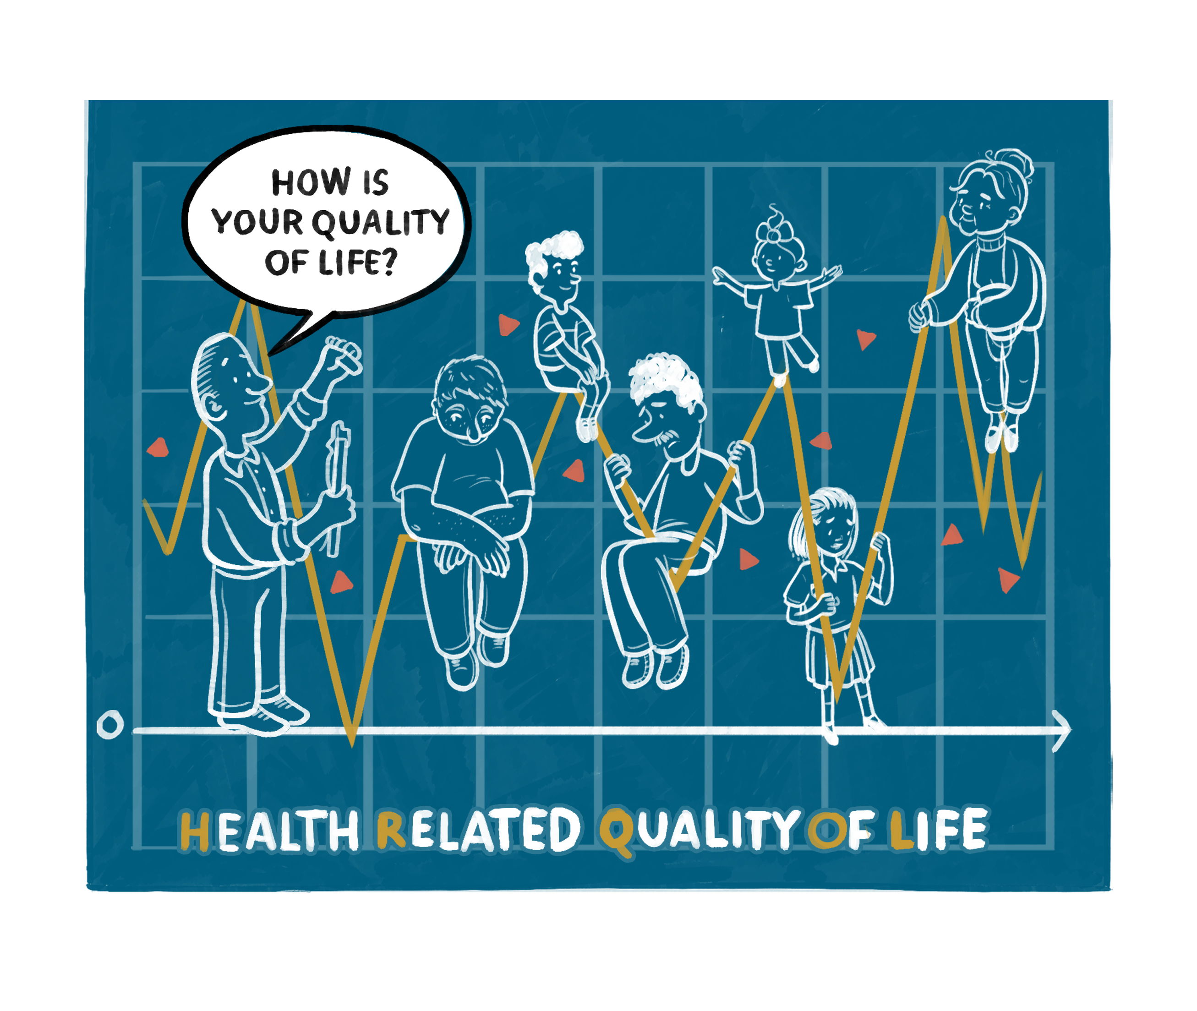
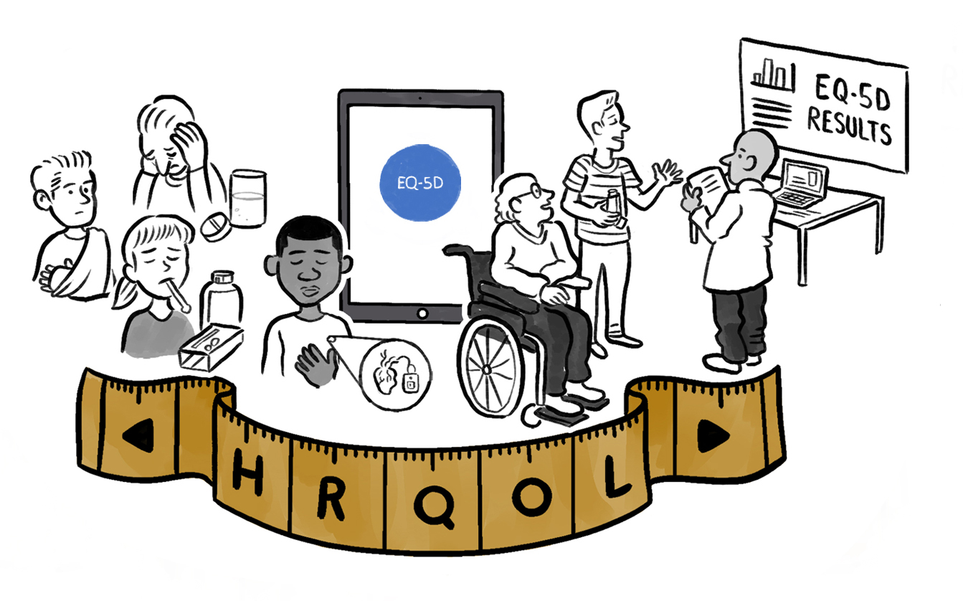
Introduction
Standardised questionnaires of health-related quality of life (HRQoL) play an increasingly important role in health care research and decision-making
The EQ-5D is a family of HRQoL instruments
There are four versions of the EQ-5D
          EQ-5D-3L
          EQ-5D-5L
          EQ-5D-Y-3L
          EQ-5D-Y-5L
adult versions
youth versions
Please note that ‘EQ-5D’ is not an abbreviation and is the correct term to use in print or verbally
3
Notes:
This slide deck was developed by the EuroQol Communications Team
Including the copyright line © EuroQol Research Foundation is mandatory when using information and/or images and/or any part of this slide deck in any other work or publication
Neither this presentation nor any of its parts may be sold, distributed or modified for commercial gain

Slide 4
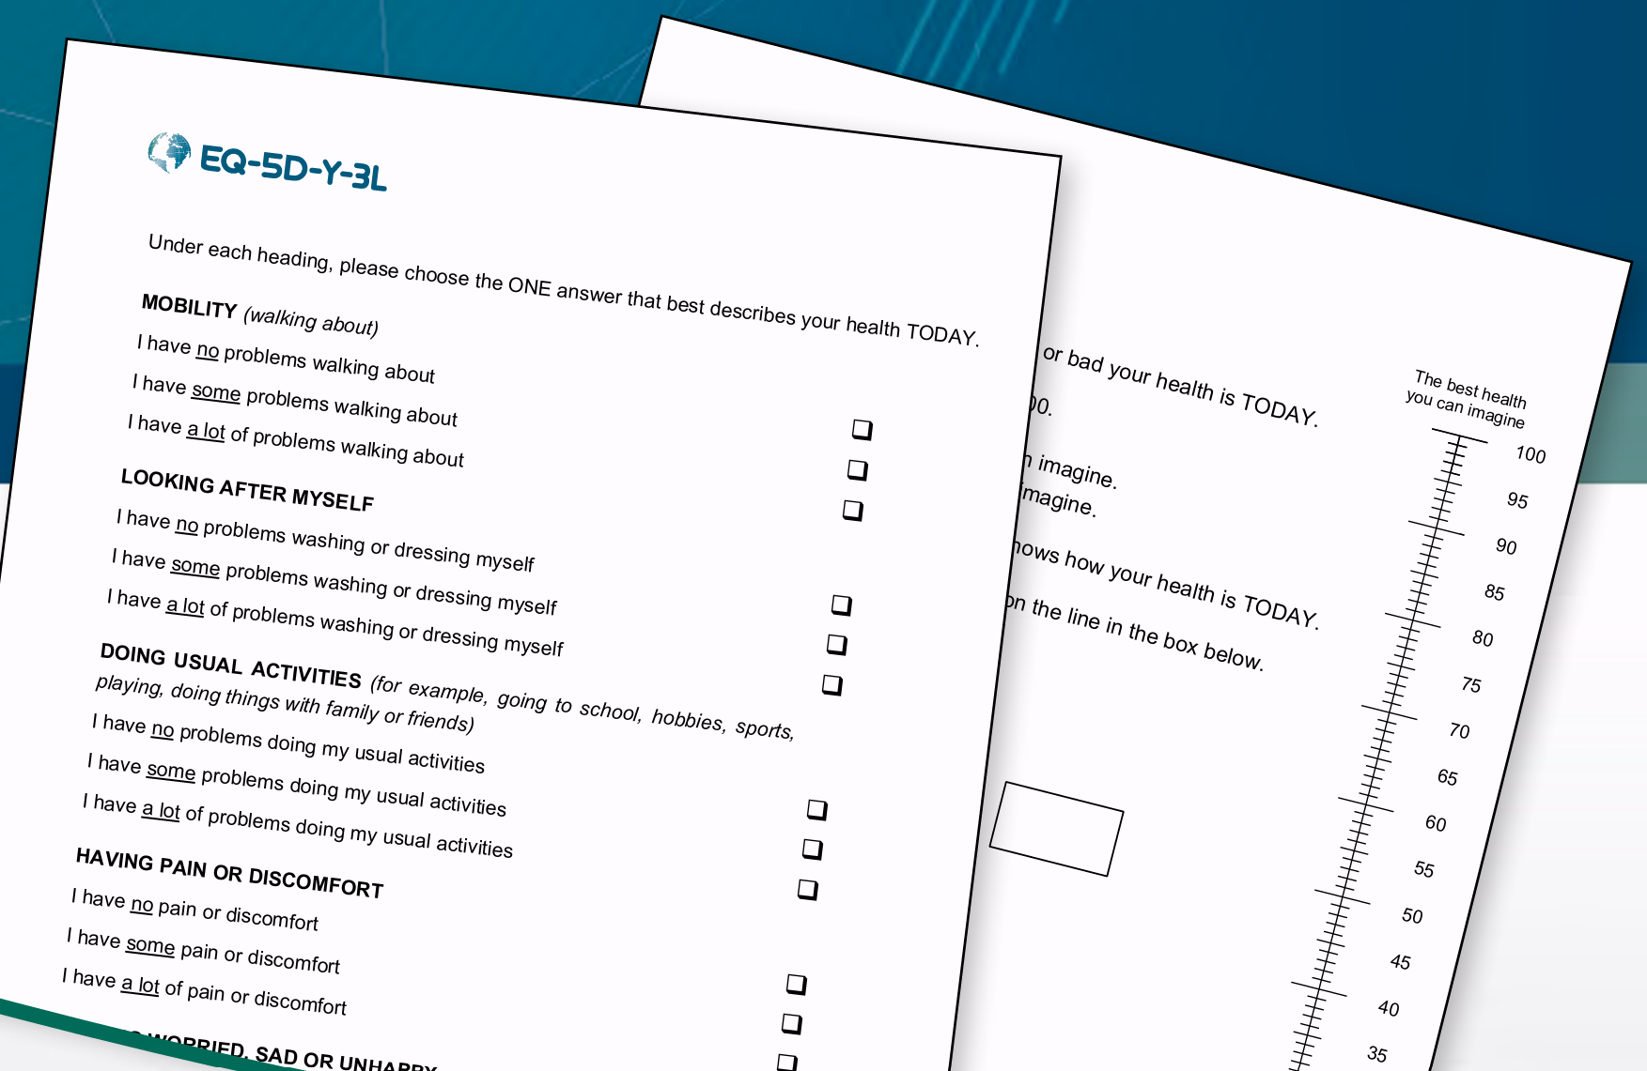
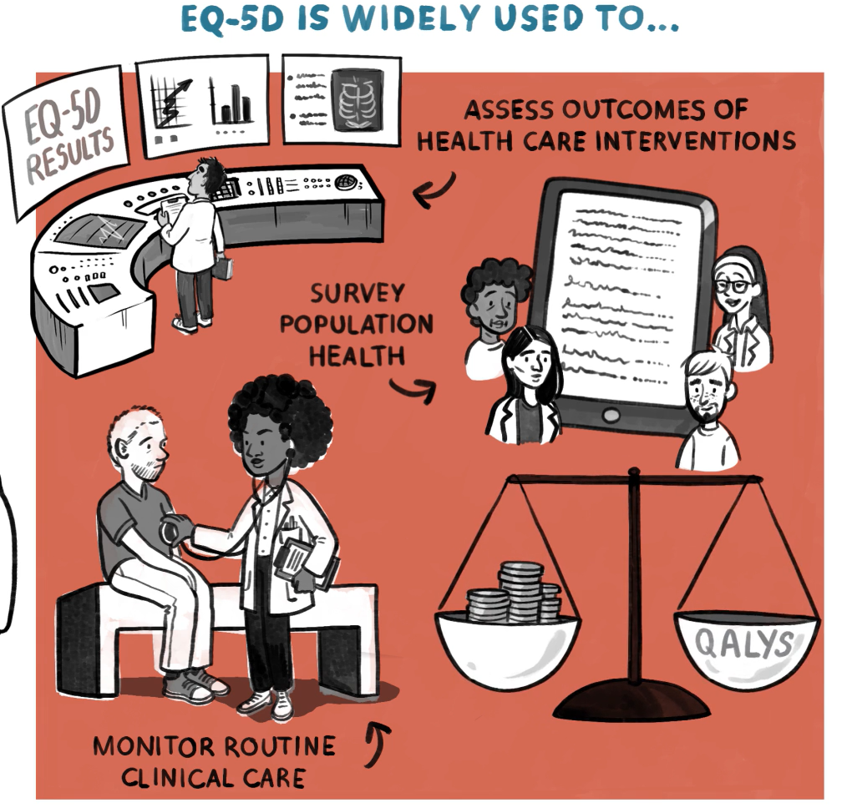
What is the EQ-5D?
Generic: A standardised questionnaire developed to describe and value HRQoL across a wide range of disease areas
Simple: A short and simple questionnaire, it is practical to use in health research and to monitor routine clinical care
Widely used: Commonly used worldwide^{1,2}, it has been translated into numerous languages
The EQ-5D is developed by EuroQol: A not-for-profit research foundation supported by an international network of multidisciplinary researchers dedicated to the measurement of HRQoL
1. Wisløff et al. PharmacoEconomics. 2014; 32(4):367-375. 2. Kennedy-Martin et al. Eur J Health Econ. 2020; 21(8):1245-1257.
4
Notes:
This slide deck was developed by the EuroQol Communications Team
Including the copyright line © EuroQol Research Foundation is mandatory when using information and/or images and/or any part of this slide deck in any other work or publication
Neither this presentation nor any of its parts may be sold, distributed or modified for commercial gain

Slide 5
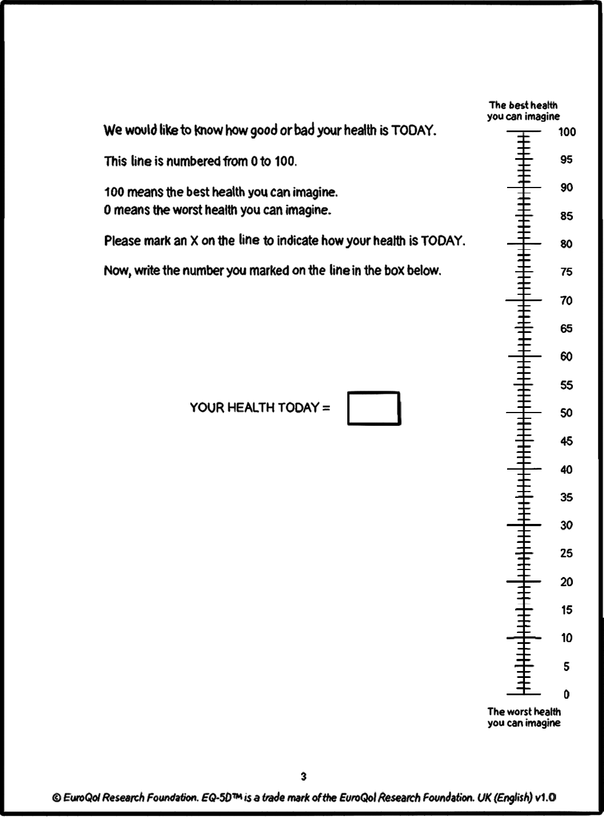
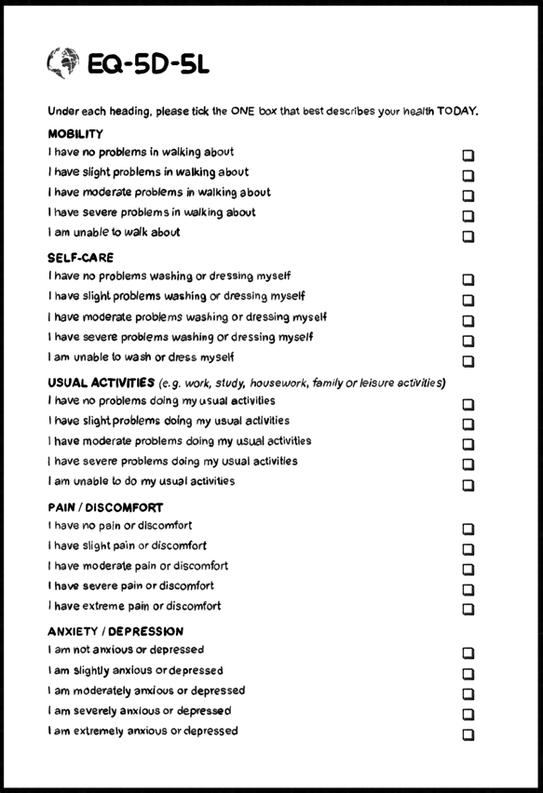
The EQ-5D questionnaire has two parts
A short descriptive system questionnaire where respondents indicate their current health status on 5 dimensions of health*
…and a visual analogue scale (VAS) which is used to obtain a global rating of the respondents self-perceived health status
(EQ VAS)
*The descriptive system is explained in a separate slide set
Both parts of the EQ-5D questionnaire are integral to the instrument and should always be administered together
5
5
Notes:
This slide deck was developed by the EuroQol Communications Team
Including the copyright line © EuroQol Research Foundation is mandatory when using information and/or images and/or any part of this slide deck in any other work or publication
Neither this presentation nor any of its parts may be sold, distributed or modified for commercial gain

Slide 6
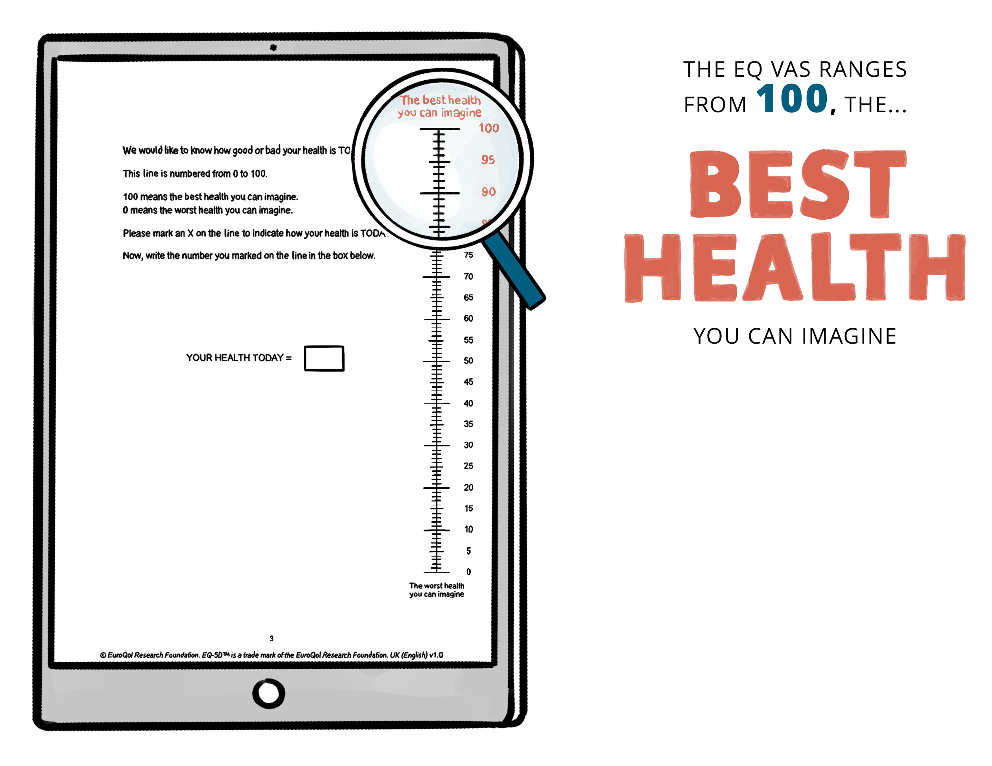
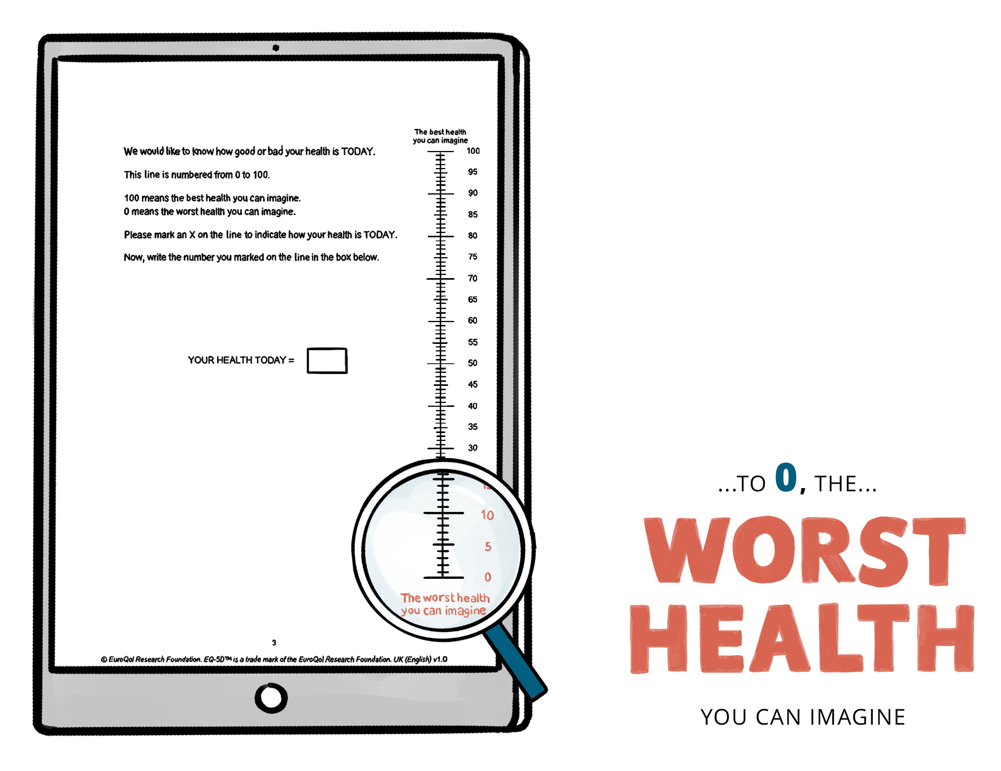
EQ VAS is a vertical, visual analogue scale on which respondents rate their overall health for ‘TODAY’
6
6
Notes:
This slide deck was developed by the EuroQol Communications Team
Including the copyright line © EuroQol Research Foundation is mandatory when using information and/or images and/or any part of this slide deck in any other work or publication
Neither this presentation nor any of its parts may be sold, distributed or modified for commercial gain

Slide 7
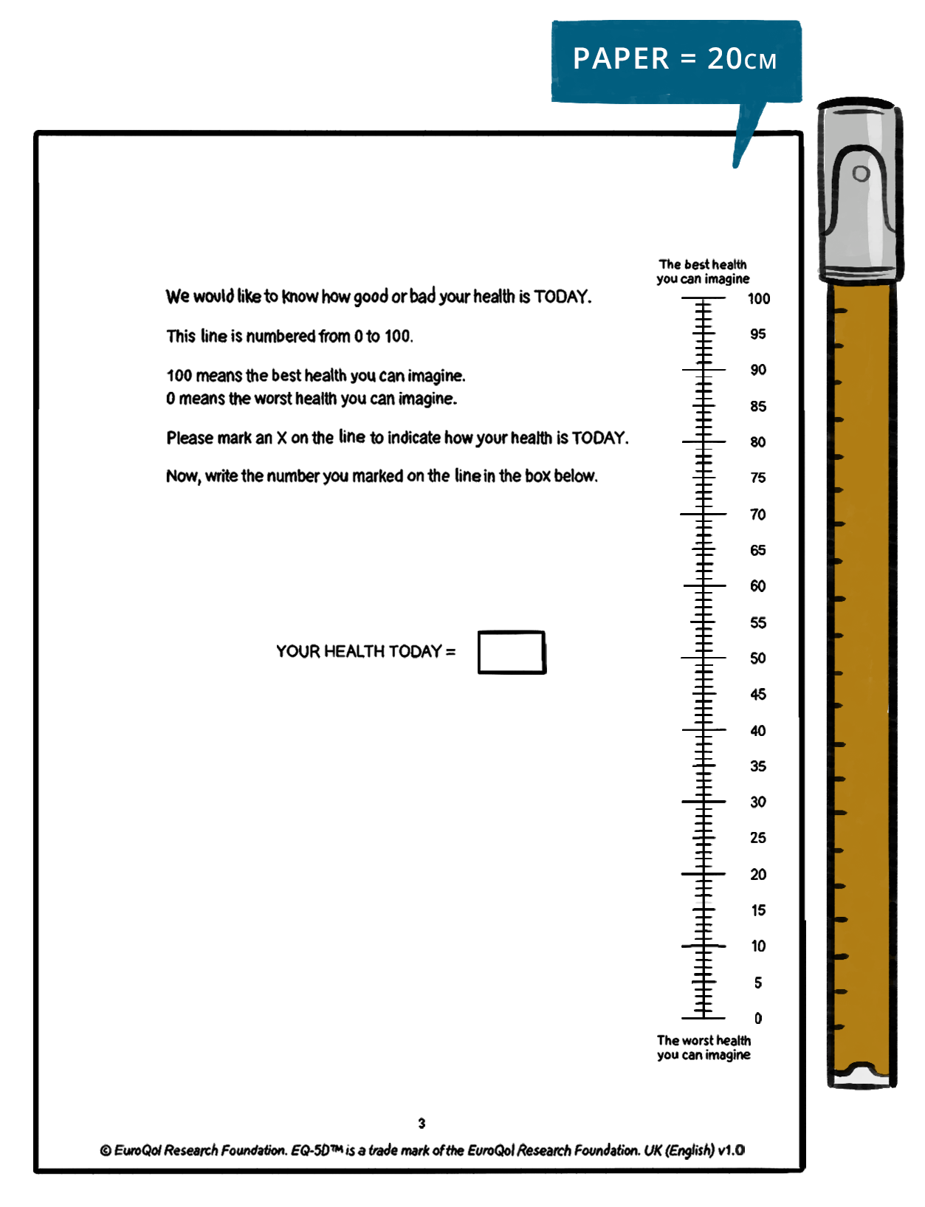
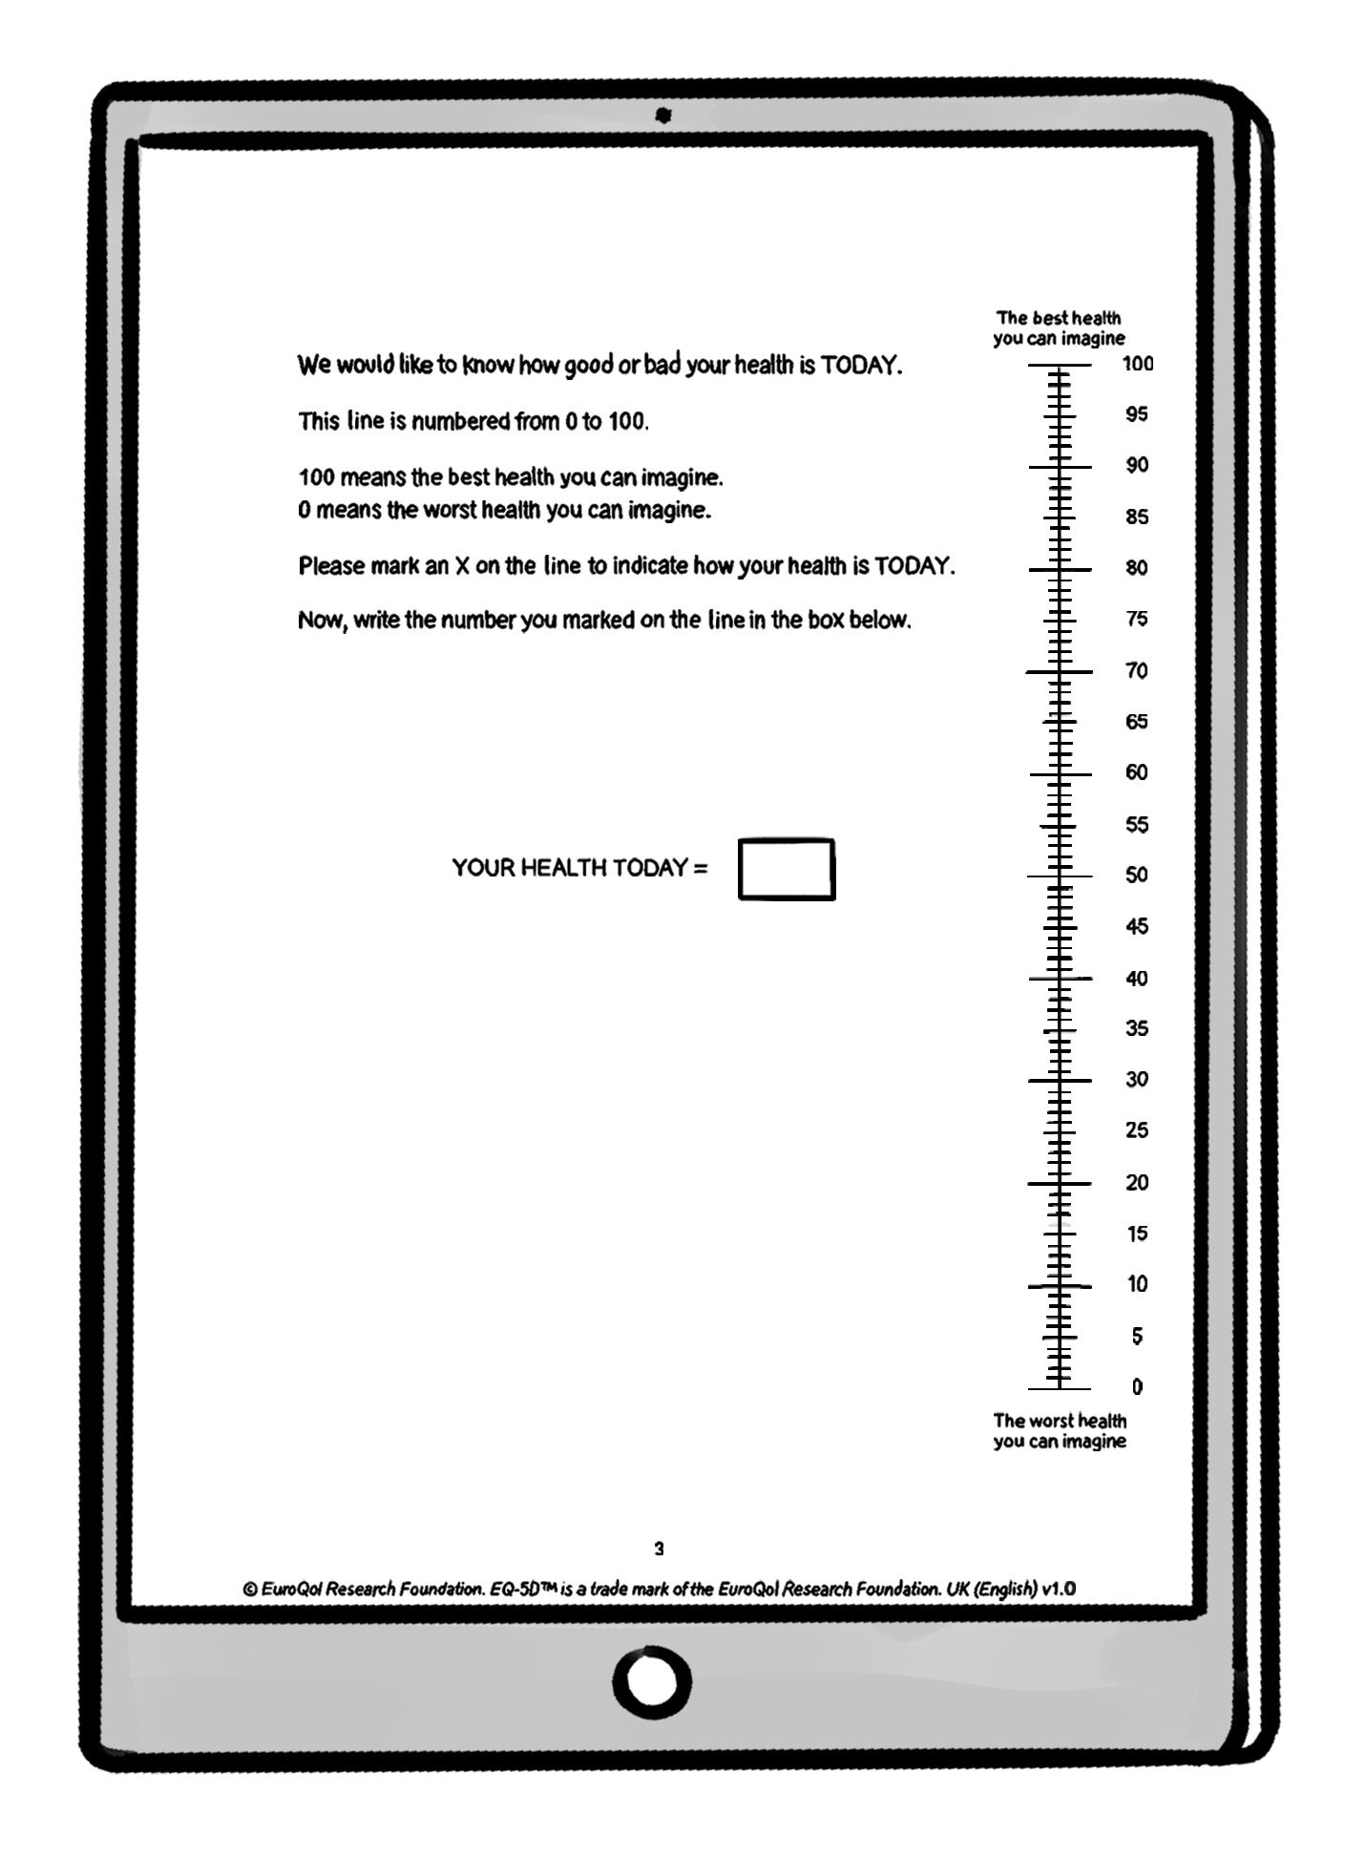
Length of the EQ VAS scale depends on the mode of administration
Digital versions vary in length depending on screen size
The Paper version of the
EQ VAS is 20 cm long
EQ VAS uses a highly standardised lay-out to ensure comparability between studies. It should always be used vertically.*
* Note, when EQ-5D is used in a study the EQ VAS should always be on a separate page to the descriptive system questionnaire
7
7
Notes:
This slide deck was developed by the EuroQol Communications Team
Including the copyright line © EuroQol Research Foundation is mandatory when using information and/or images and/or any part of this slide deck in any other work or publication
Neither this presentation nor any of its parts may be sold, distributed or modified for commercial gain

Slide 8

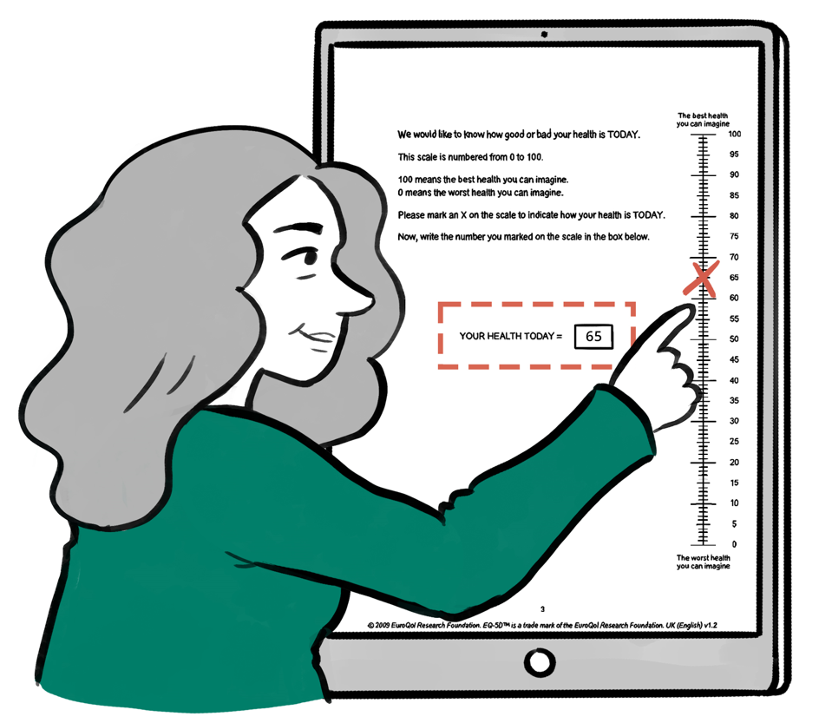
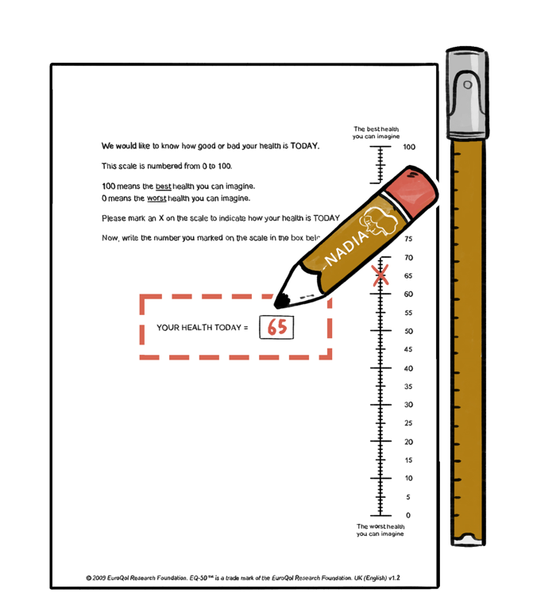
How to complete the EQ VAS
When filling out the EQ VAS, the respondent chooses a score on the line that reflects how good or bad they consider their overall health to be TODAY, relative to the best and worst health they can imagine
If completed digitally, the number corresponding to the point indicated on the line by the person will appear automatically in the box next to the EQ VAS
If completing the paper version, the respondent should mark an X on the vertical line and then write the number in the box provided – this is done to facilitate data entry
8
Notes:
This slide deck was developed by the EuroQol Communications Team
Including the copyright line © EuroQol Research Foundation is mandatory when using information and/or images and/or any part of this slide deck in any other work or publication
Neither this presentation nor any of its parts may be sold, distributed or modified for commercial gain

Slide 9
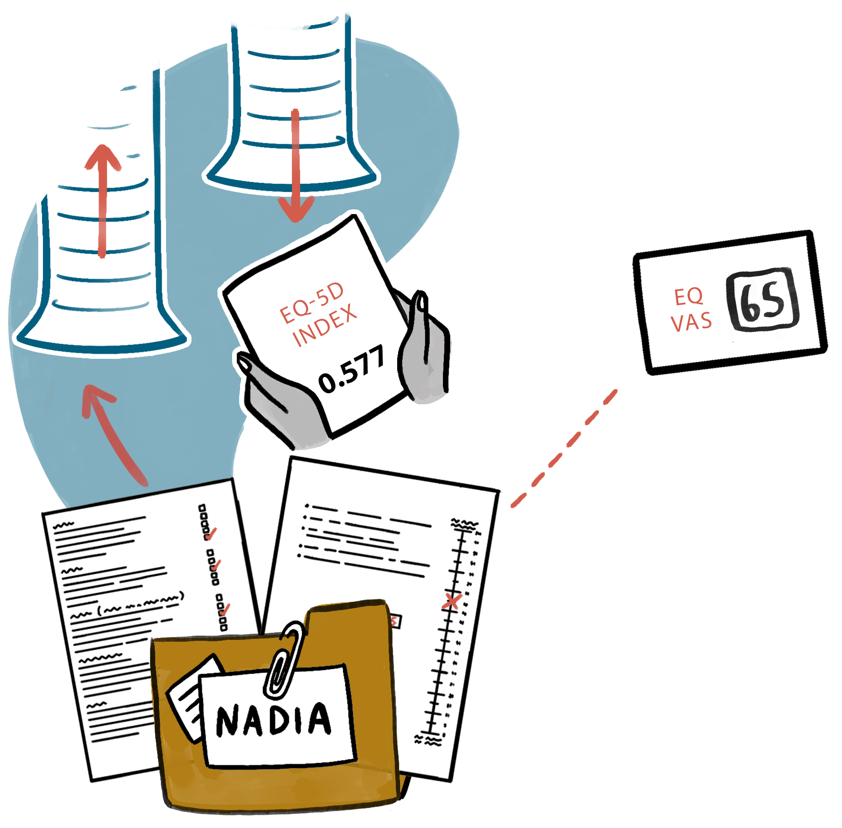
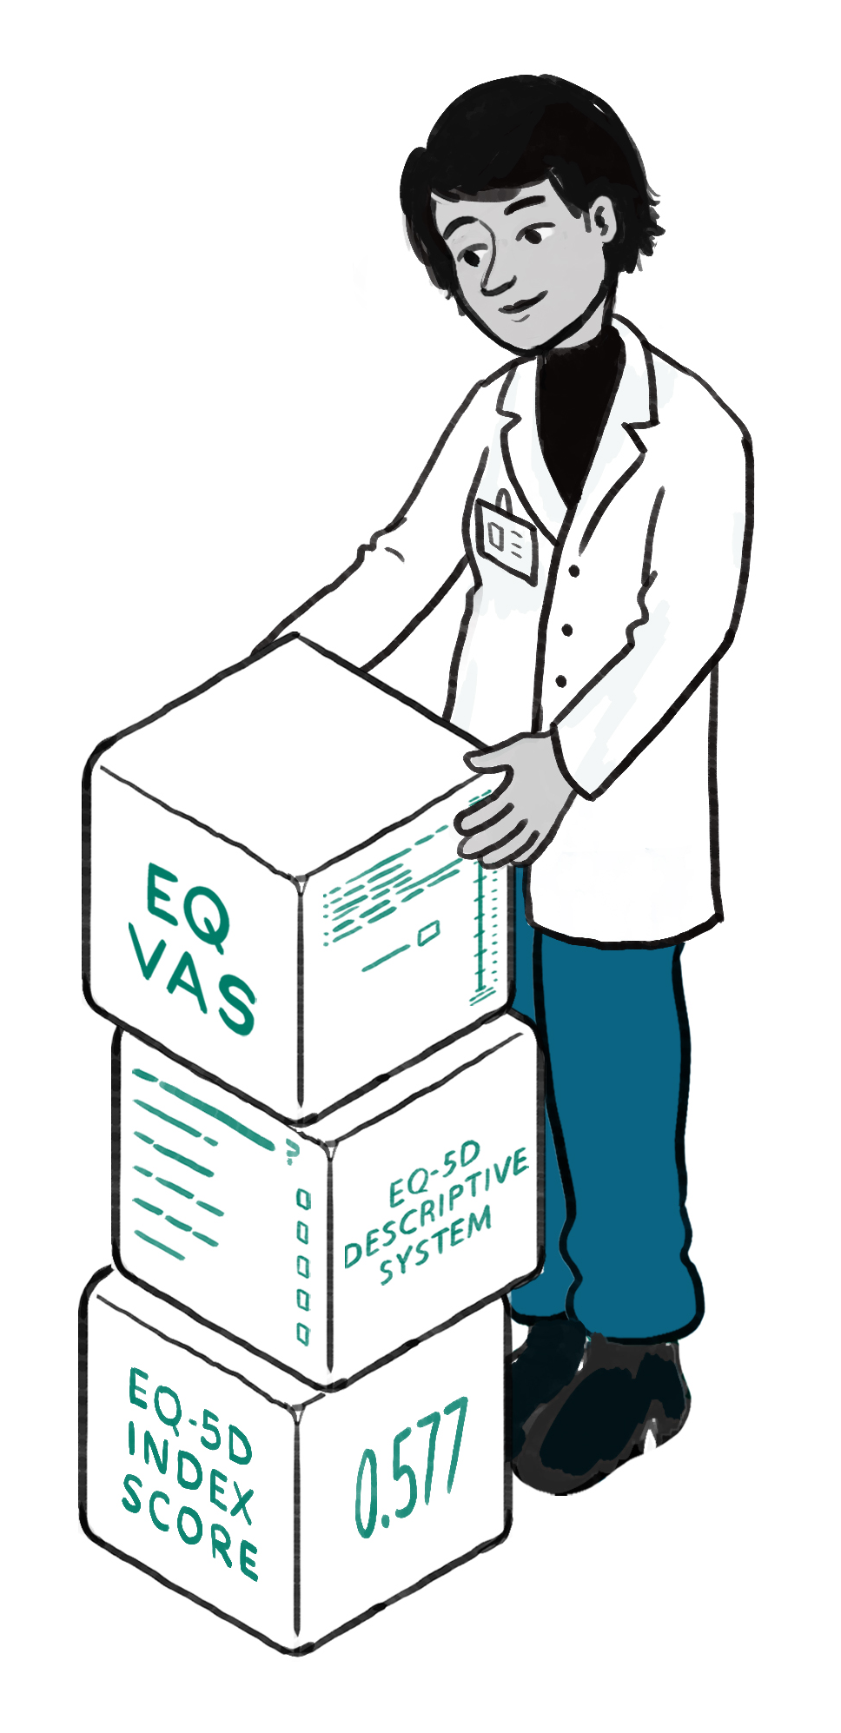

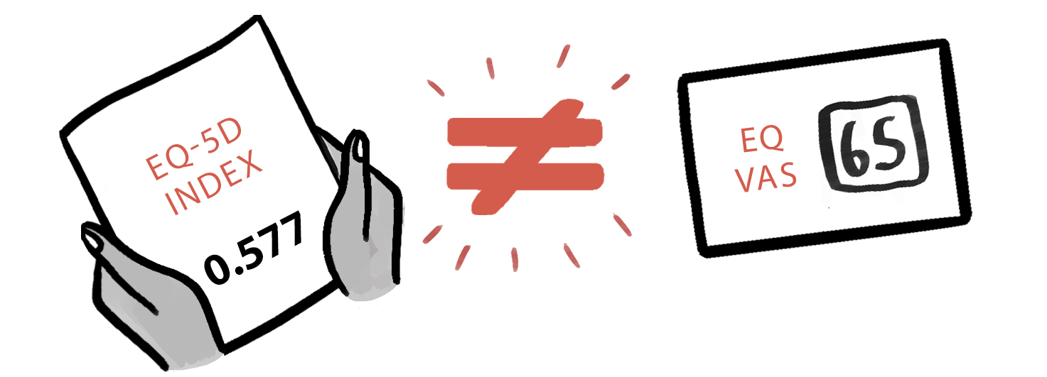
EQ VAS results complement responses on the descriptive system, and also the EQ-5D value
A respondent’s EQ VAS score is collected in addition to their responses to the descriptive system questionnaire
Responses to the descriptive system items can also be used to derive a single numerical score called the EQ-5D value* by linking descriptive system responses with a previously derived value set representing societal preferences for EQ-5D health states
The EQ VAS score is different – it represents a person’s opinion of how good or bad their health state is overall
The EQ VAS score enables the respondent to consider aspects of their health that may not be specifically covered in the descriptive system
* Also sometimes referred to as an index, score, utility or preference weight
9
Notes:
This slide deck was developed by the EuroQol Communications Team
Including the copyright line © EuroQol Research Foundation is mandatory when using information and/or images and/or any part of this slide deck in any other work or publication
Neither this presentation nor any of its parts may be sold, distributed or modified for commercial gain

Slide 10
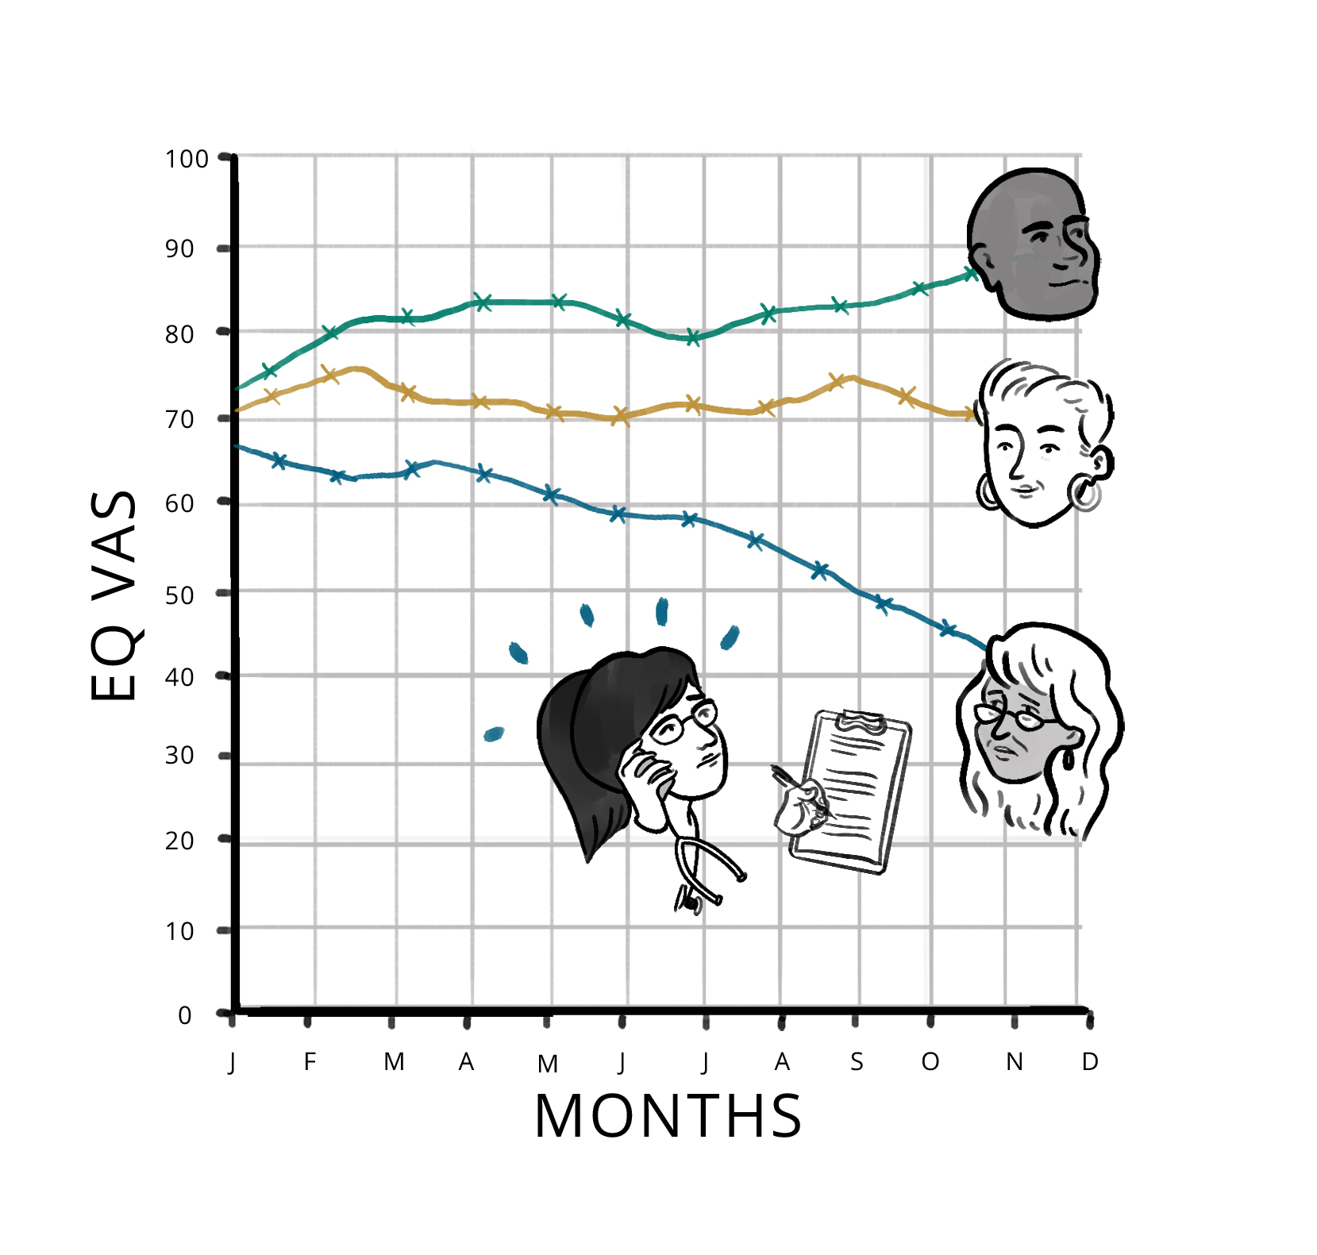
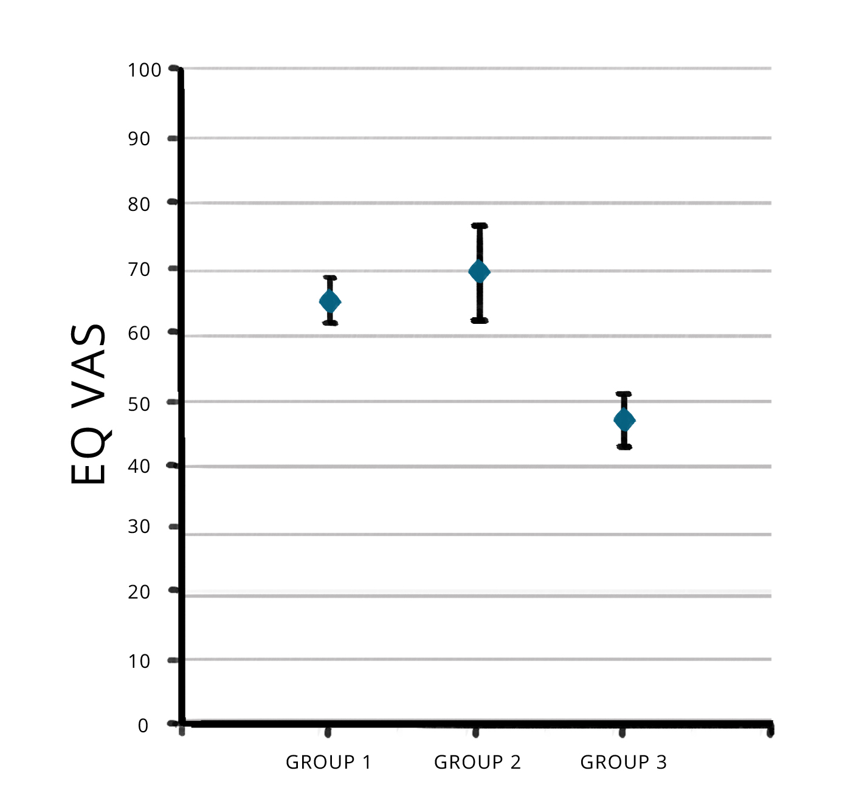
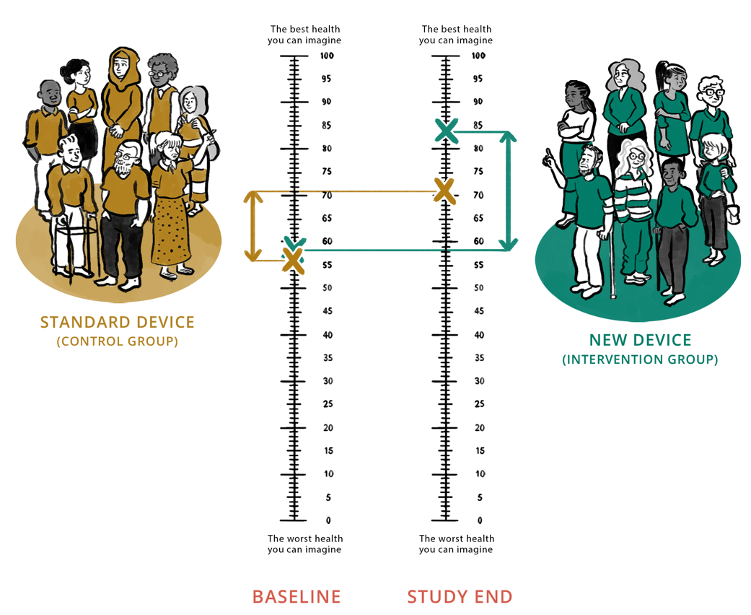
EQ VAS data can be collected in different settings
As part of a clinical trial to investigate change in health status associated with different treatments
In routine outcome measurement, e.g. a registry, to monitor changes in patients’ overall health status over time
To facilitate comparisons of health status across different population groups
10
10
Notes:
This slide deck was developed by the EuroQol Communications Team
Including the copyright line © EuroQol Research Foundation is mandatory when using information and/or images and/or any part of this slide deck in any other work or publication
Neither this presentation nor any of its parts may be sold, distributed or modified for commercial gain

Slide 11
Key take-away messages
The EQ VAS…
          provides a global rating of a respondent’s self-perceived health status
          is a key component of all three EQ-5D questionnaires
          can be completed digitally or by using a paper version
          is a vertical visual analogue scale with a highly standardised lay-out
          complements information gathered from the descriptive system
          is different to the EQ-5D value
          can be used in different settings to help inform decision making
11
Notes:
This slide deck was developed by the EuroQol Communications Team
Including the copyright line © EuroQol Research Foundation is mandatory when using information and/or images and/or any part of this slide deck in any other work or publication
Neither this presentation nor any of its parts may be sold, distributed or modified for commercial gain

Slide 12

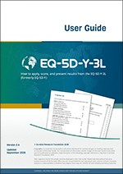
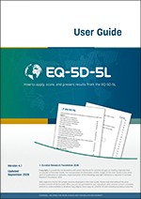
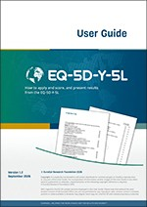
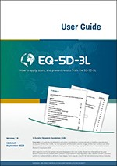
For more info…
Links:
https://euroqol.org/information-and-support/
https://euroqol.org/information-and-support/documentation/books/
12
Notes:
This slide deck was developed by the EuroQol Communications Team
Including the copyright line © EuroQol Research Foundation is mandatory when using information and/or images and/or any part of this slide deck in any other work or publication
Neither this presentation nor any of its parts may be sold, distributed or modified for commercial gain

