Slide 1
Translating Patient-Reported Outcome Measures for use around the world:
The example of EQ-5D
October 2026
Notes:
This slide deck was developed by the EuroQol Communications Team
Including the copyright line © EuroQol Research Foundation is mandatory when using information and/or images and/or any part of this slide deck in any other work or publication
Neither this presentation nor any of its parts may be sold, distributed or modified for commercial gain

Slide 2
Overview
This presentation provides a top-level overview of how to translate a patient-reported outcome measure (PROM) by showing how EuroQol undertakes the process for EQ-5D
Slides in this deck cover the following topics:
          What are PROs and PROMs?
          Uses of PROMs
          Why do PROMs need to be translated?
          The importance of a rigorous and robust translation process
          Some challenges around translating a PROM
          The EuroQol process for translating a PROM – using EQ-5D as an example
          Translations available for EQ-5D
          The process for requesting a new language version of the EQ-5D
          Key take-away messages
          Where to get further information
2
Notes:
This slide deck was developed by the EuroQol Communications Team
Including the copyright line © EuroQol Research Foundation is mandatory when using information and/or images and/or any part of this slide deck in any other work or publication
Neither this presentation nor any of its parts may be sold, distributed or modified for commercial gain

Slide 3

What are PROs and PROMs?
A patient-reported outcome (PRO) is a
measurement of any aspect of a patient’s
health status that comes directly from the
patient (i.e., without interpretation of their
responses by a physician or anyone else)¹
Patient-reported outcome measures (PROMs) are questionnaires or instruments that capture information directly from patients on outcomes such as symptoms, functioning, health status or quality of life
PROMs are different from clinician-reported outcome assessments or observer-reported outcome assessments. The EQ-5D is an example of a PROM
The importance of evaluating the patient’s experience when considering the impact of healthcare interventions is increasingly being recognised²
1. FDA, 2006; 2. EMA, 2022
3
Notes:
This slide deck was developed by the EuroQol Communications Team
Including the copyright line © EuroQol Research Foundation is mandatory when using information and/or images and/or any part of this slide deck in any other work or publication
Neither this presentation nor any of its parts may be sold, distributed or modified for commercial gain

Slide 4
Uses of PROMs
PROMS are now often included as a measure of treatment effectiveness in clinical trials and the FDA and the EMA have released guidance and reflection papers on their use in drug development^{1–3}
PROMs are also being used in routine outcome measurement, e.g.:
          NHS in England is an example of a healthcare system where PROMS data
          (EQ-5D-3L, Oxford Hip Score and Oxford Knee Score) are being captured at a national level to help assess the impact of interventions on a patient’s self-perceived health^{4,5}
          In a provincial health system in Canada (152 urban and rural sites), the use of the EQ-5D-5L in the community rehabilitation setting was reported to add value at the clinical (micro), programmatic (meso) and health-system (macro) levels. Its use was also seen to promote the importance of incorporating the patient’s voice into outcome measurement⁶
1. FDA, 2009; 2. EMA, 2016; 3. EMA, 2014; 4. NHS, 2023; 5. NJR, 2022; 6. Churchill et al, 2021
EMA: European Medicines Agency, FDA: Food and Drug Administration
4
Notes:
This slide deck was developed by the EuroQol Communications Team
Including the copyright line © EuroQol Research Foundation is mandatory when using information and/or images and/or any part of this slide deck in any other work or publication
Neither this presentation nor any of its parts may be sold, distributed or modified for commercial gain

Slide 5
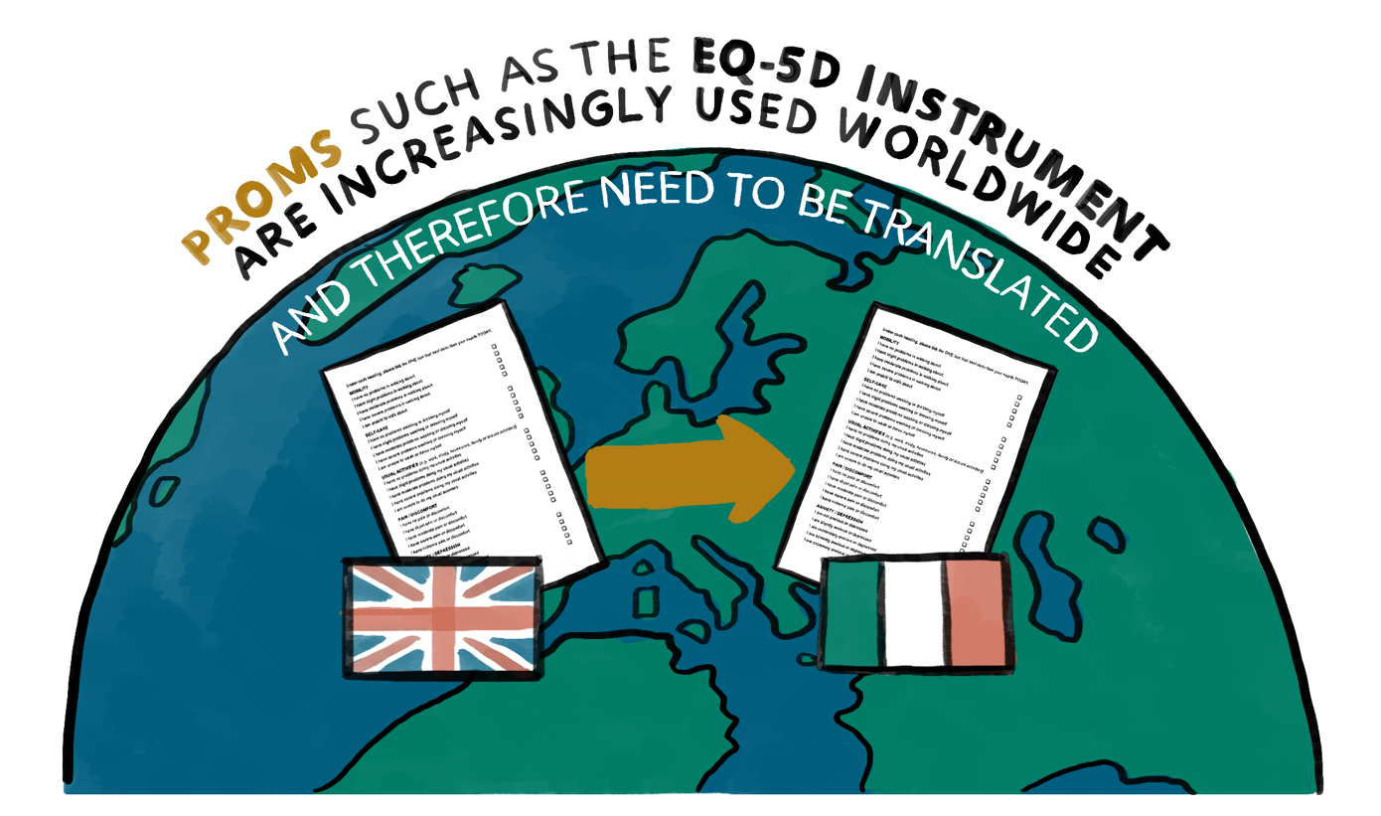
Why do PROMs need to be translated?
A PROMs tend to be initially developed in a single (source) language – often English
Most of the world’s population do not speak English, but there is a demand
for PROMs in different countries
around the world
Therefore, PROMs often need to be
translated from the source language
to a variety of ‘target’ languages
5
Notes:
This slide deck was developed by the EuroQol Communications Team
Including the copyright line © EuroQol Research Foundation is mandatory when using information and/or images and/or any part of this slide deck in any other work or publication
Neither this presentation nor any of its parts may be sold, distributed or modified for commercial gain

Slide 6
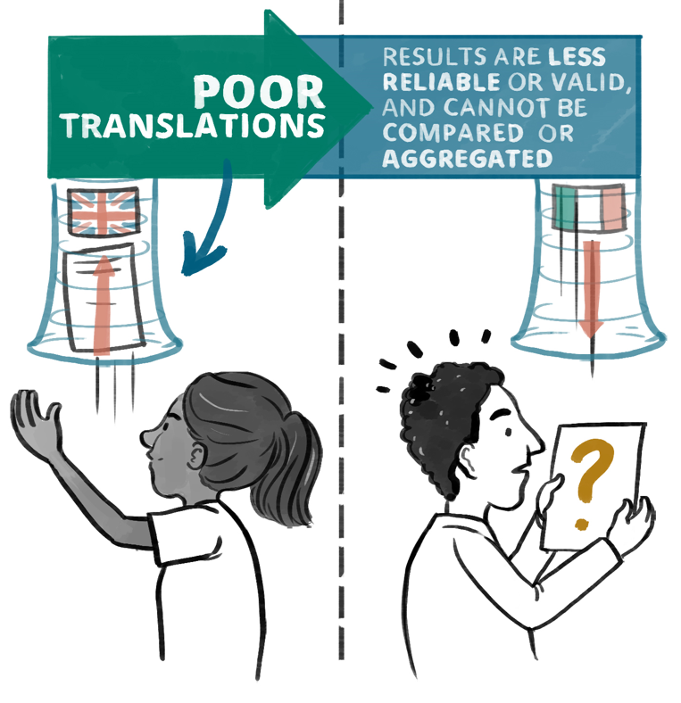
Why do PROMs need to be translated?
The translation process needs to be rigorous and robust to ensure that the psychometric properties of the original source instrument are not compromised
Poor translations can undermine the credibility of a study’s findings and the ability to compare or aggregate results across countries
Well-accepted methodologies exist that should be followed when translating a PROM^{1,2}
Later in this slide deck, we describe in detail the EuroQol guidelines for translating EQ-5D
1. Wild et al, 2005; 2. Rabin et al, 2014
6
Notes:
This slide deck was developed by the EuroQol Communications Team
Including the copyright line © EuroQol Research Foundation is mandatory when using information and/or images and/or any part of this slide deck in any other work or publication
Neither this presentation nor any of its parts may be sold, distributed or modified for commercial gain

Slide 7

Some challenges around translating a PROM…
When translating a PROM, it is not enough to simply translate the words from one language to another
The language and content in the translation must be acceptable and relevant for the target population
Careful translation, or even adaptation of items to make them culturally relevant, is critical
For, example trying to gain insight on physical functioning by asking about playing golf or vacuuming wouldn’t be appropriate in many countries
7
Notes:
This slide deck was developed by the EuroQol Communications Team
Including the copyright line © EuroQol Research Foundation is mandatory when using information and/or images and/or any part of this slide deck in any other work or publication
Neither this presentation nor any of its parts may be sold, distributed or modified for commercial gain

Slide 8
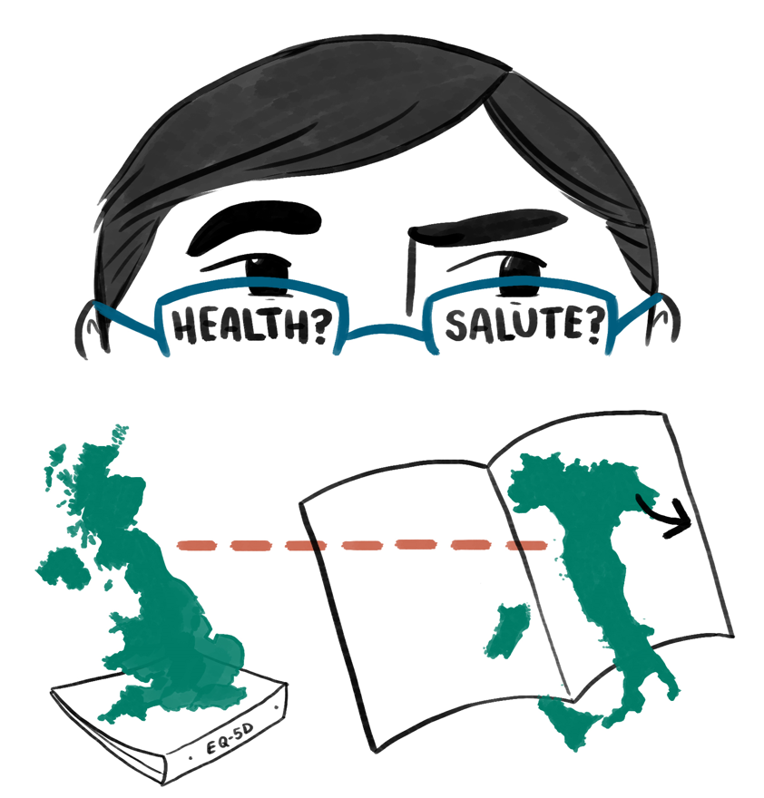
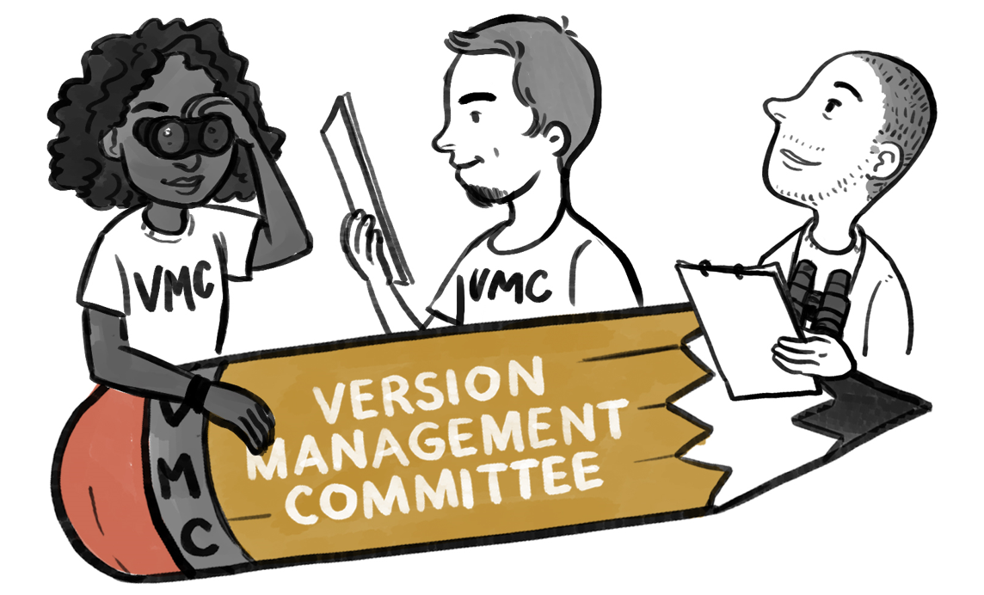
The EuroQol process for translating a PROM – using EQ-5D as an example
Let’s look at an example of how EuroQol would translate EQ-5D* from English to Italian
EuroQol uses a rigorous, standardised, state-of-the-art translation procedure that is based on internationally accepted guidelines
EuroQol’s in-house Version Management Committee (VMC) oversees all translation work and is responsible for quality assurance of all new translations
1. Wild et al, 2005; 2. Rabin et al, 2014
8
Notes:
This slide deck was developed by the EuroQol Communications Team
Including the copyright line © EuroQol Research Foundation is mandatory when using information and/or images and/or any part of this slide deck in any other work or publication
Neither this presentation nor any of its parts may be sold, distributed or modified for commercial gain

Slide 9
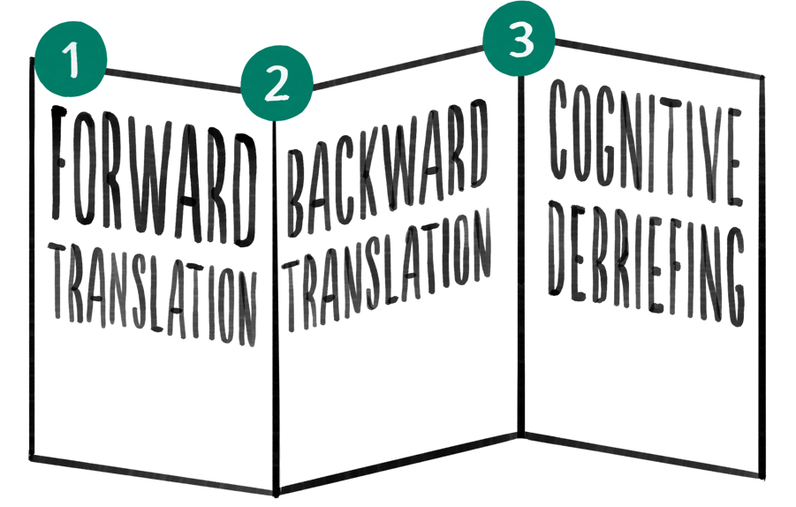
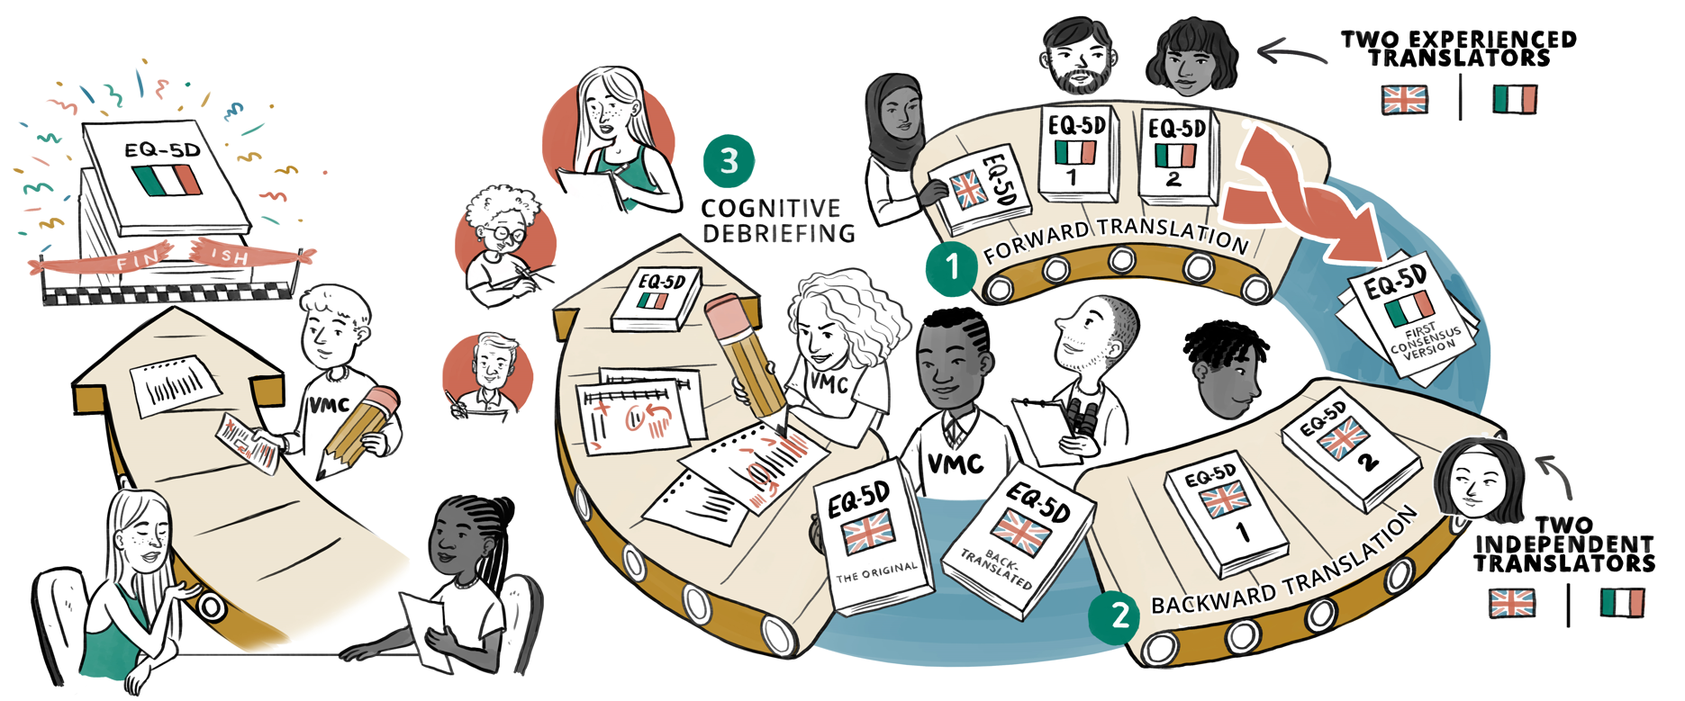
The translation process: Overview
The overall translation process, which consists of three stages,
can be represented by the figure below
In the following slides, we describe each of the main stages of the process:
1. Forward translation; 2. Backward translation; 3. Cognitive debriefing
A member of the Version Management Committee reviews and provides feedback to the translation team at each stage
9
Notes:
This slide deck was developed by the EuroQol Communications Team
Including the copyright line © EuroQol Research Foundation is mandatory when using information and/or images and/or any part of this slide deck in any other work or publication
Neither this presentation nor any of its parts may be sold, distributed or modified for commercial gain

Slide 10
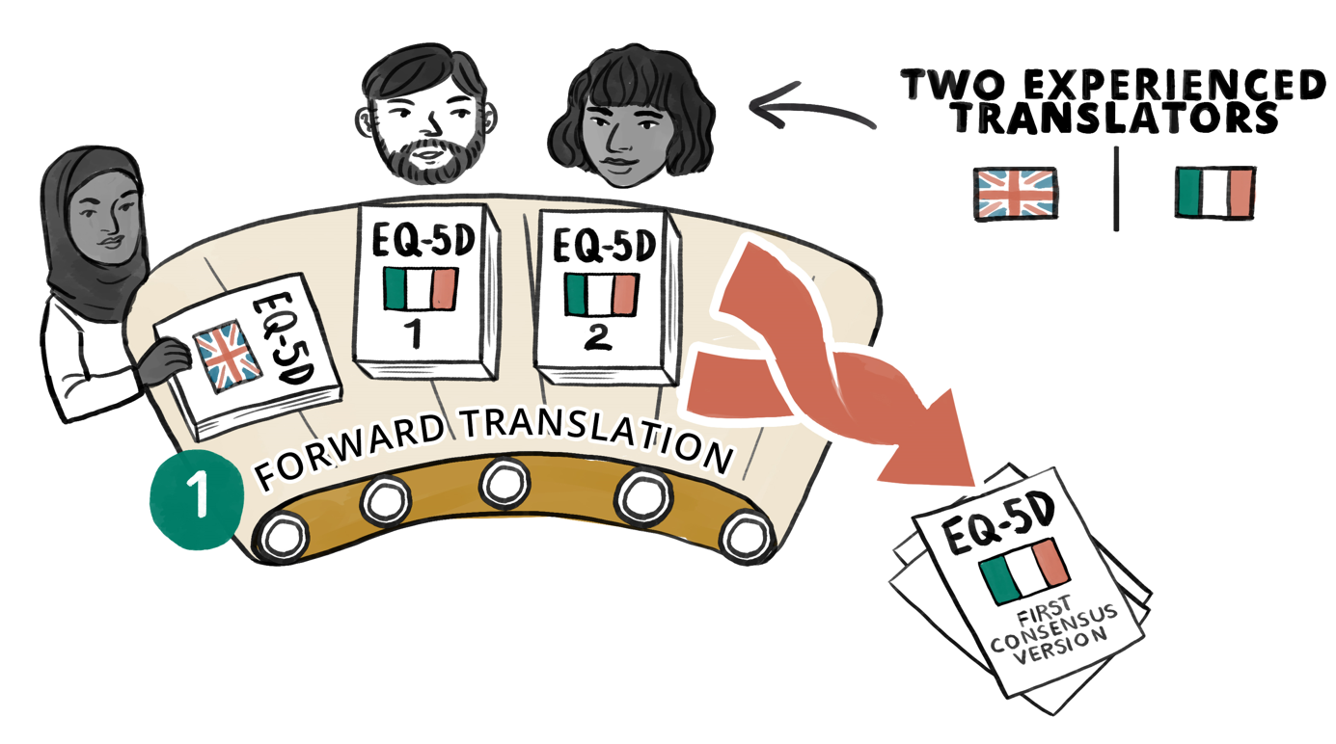
Step 1: Forward translation
In the first stage of the translation process, two experienced translators who are native speakers of the target language (in this case Italian), and also fluent in the source language (English), independently translate the EQ-5D from English into Italian
These two translations are compared in a meeting between the research team and the translators and blended into a first consensus version in Italian
10
Notes:
This slide deck was developed by the EuroQol Communications Team
Including the copyright line © EuroQol Research Foundation is mandatory when using information and/or images and/or any part of this slide deck in any other work or publication
Neither this presentation nor any of its parts may be sold, distributed or modified for commercial gain

Slide 11
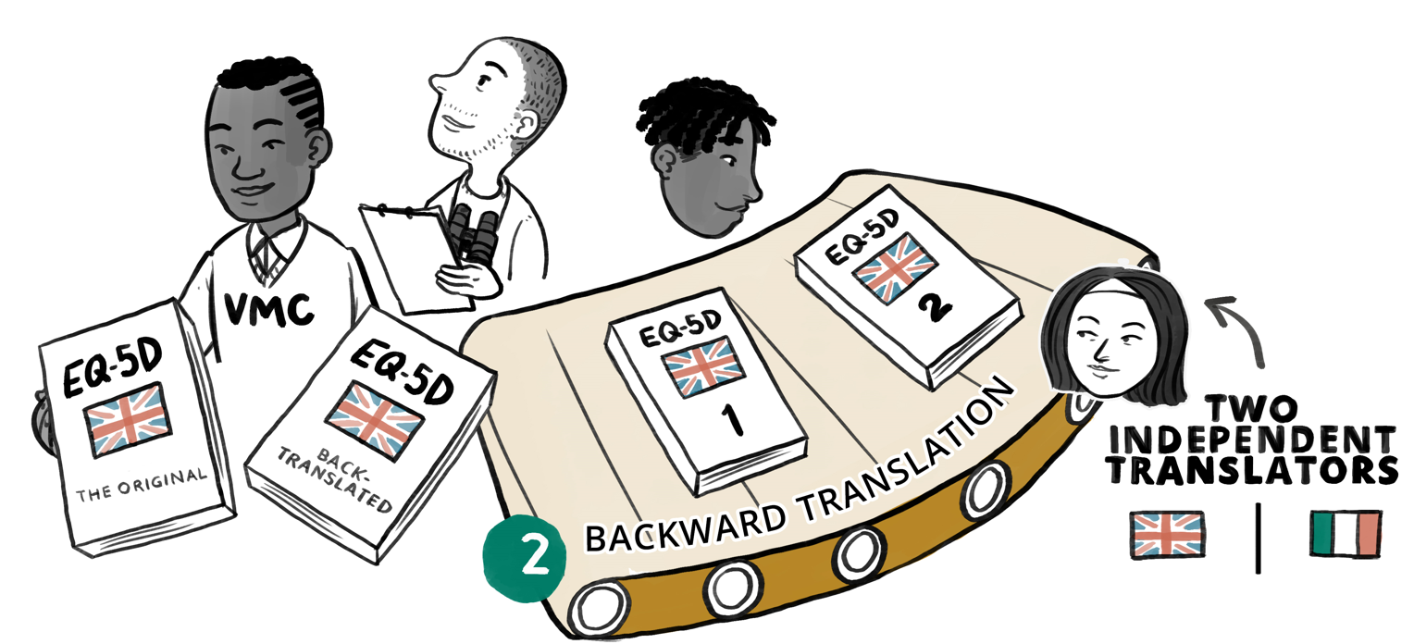
Step 2: Backward translation
In the second stage of the translation process, the first consensus Italian version is translated back into English by two independent translators who are native English speakers and fluent in Italian
By comparing the back-translations with the source (English) version, it is possible to see if the initial Italian version satisfactorily conveys the meaning of the source material
If there are differences between the back-translations and the source English version, the Italian version may be modified
11
Notes:
This slide deck was developed by the EuroQol Communications Team
Including the copyright line © EuroQol Research Foundation is mandatory when using information and/or images and/or any part of this slide deck in any other work or publication
Neither this presentation nor any of its parts may be sold, distributed or modified for commercial gain

Slide 12

Step 3: Cognitive debriefing
In the final stage of the translation process, several native Italian speakers complete the translated version of EQ-5D and give feedback in face-to-face interviews
Respondents should have a range of demographic and health characteristics
Interviews focus on the acceptability, ease of understanding, and appropriateness of the wording in Italian
In response to interviewee feedback. the translation may be modified again
This process is iterative and continues until those involved are confident that the translation is understood as intended, and that the content is clear and acceptable in Italian
12
Notes:
This slide deck was developed by the EuroQol Communications Team
Including the copyright line © EuroQol Research Foundation is mandatory when using information and/or images and/or any part of this slide deck in any other work or publication
Neither this presentation nor any of its parts may be sold, distributed or modified for commercial gain

Slide 13
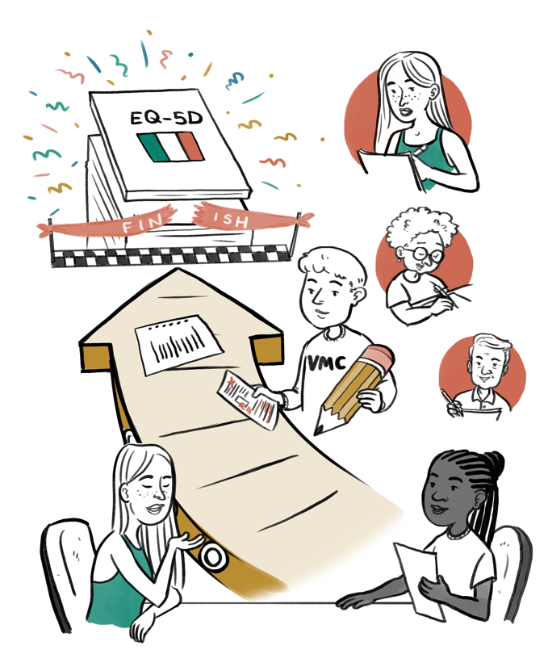
Completion of the translation process
Once cognitive debriefing is satisfactorily completed, the Italian version will receive a final proofreading from an independent linguist
The whole translation process is also reviewed by a further member of the EuroQol Group’s VMC before the translated, linguistically validated version of the EQ-5D in Italian is made available for use
13
Notes:
This slide deck was developed by the EuroQol Communications Team
Including the copyright line © EuroQol Research Foundation is mandatory when using information and/or images and/or any part of this slide deck in any other work or publication
Neither this presentation nor any of its parts may be sold, distributed or modified for commercial gain

Slide 14
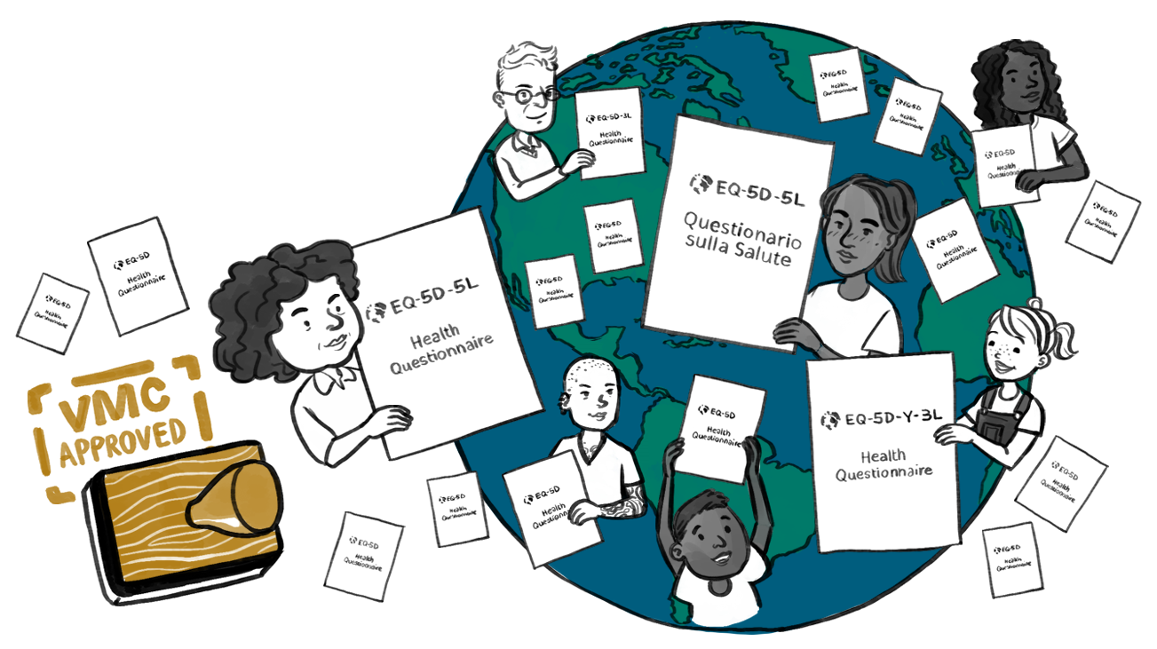
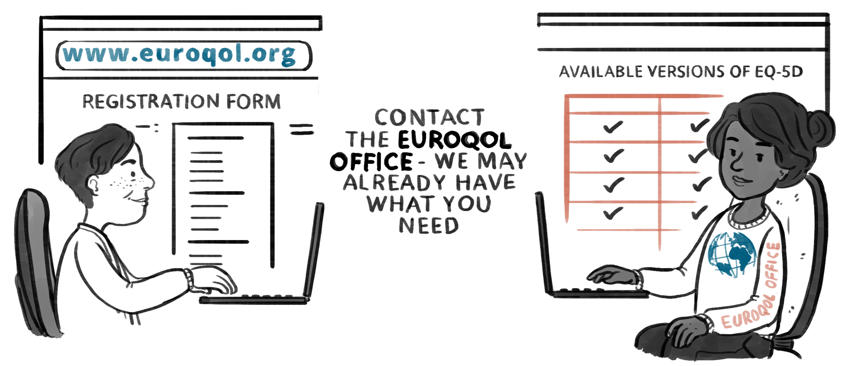
Translations available for EQ-5D
EQ-5D instruments are currently available in more than 200 languages worldwide
There is also a British sign language version available
If you need a translated version of the EQ-5D, it is very likely that we already have it available for use
If we don’t have a translation available, you can request EuroQol to develop a new language version
14
Notes:
This slide deck was developed by the EuroQol Communications Team
Including the copyright line © EuroQol Research Foundation is mandatory when using information and/or images and/or any part of this slide deck in any other work or publication
Neither this presentation nor any of its parts may be sold, distributed or modified for commercial gain

Slide 15
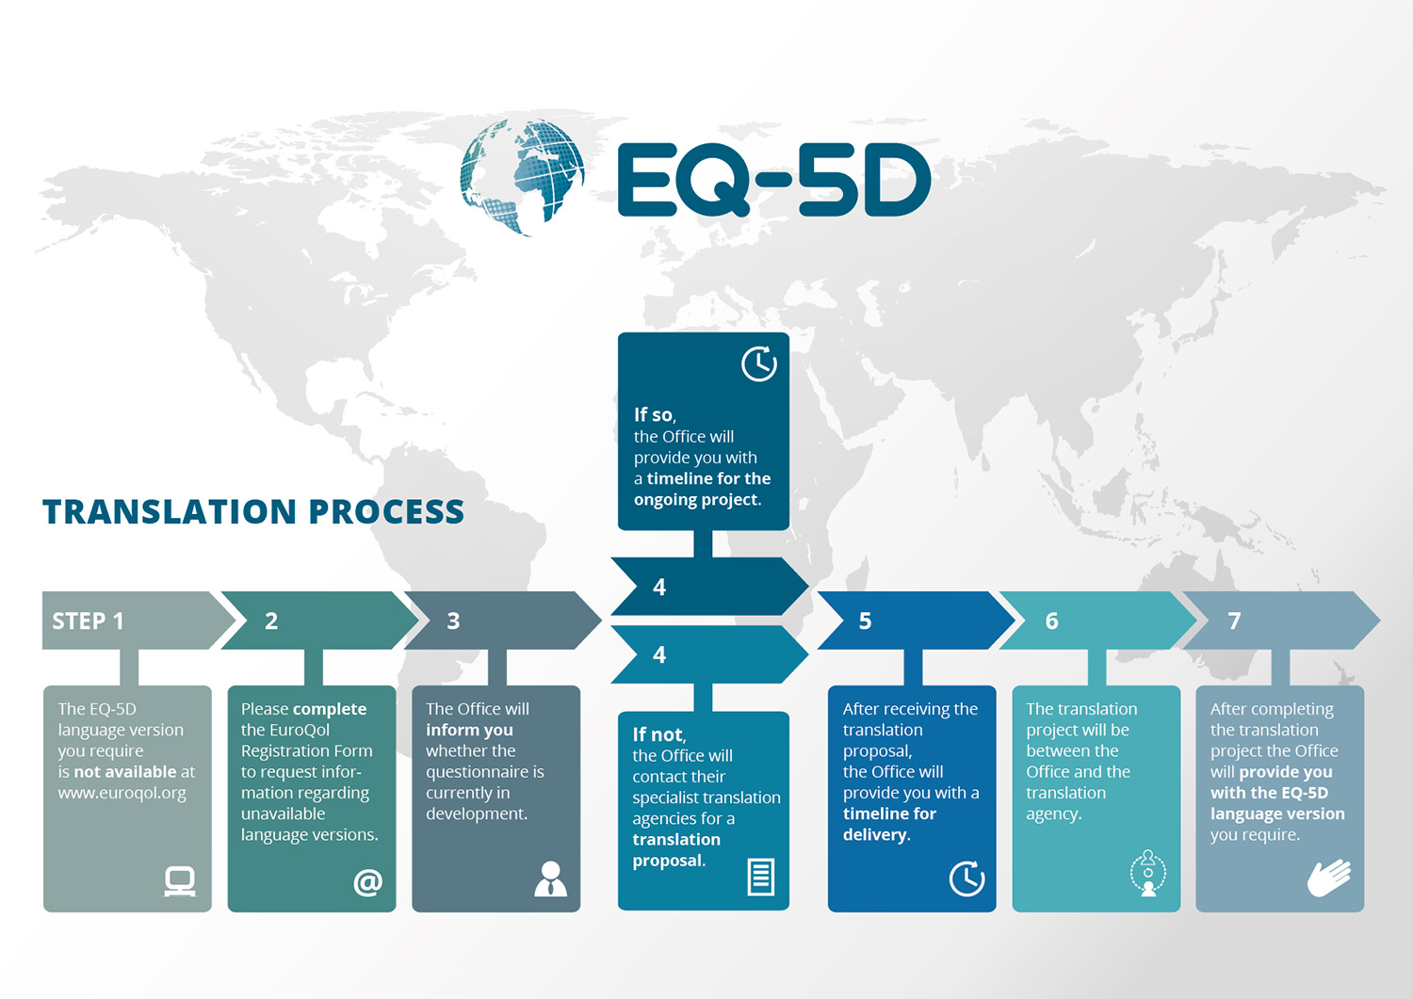
The process for requesting a new language version of the EQ-5D
Translations are typically paid by the customer
For some non-commercial customers, the costs are waived
In some cases, EuroQol funds the translation work for a new series of versions
15
Notes:
This slide deck was developed by the EuroQol Communications Team
Including the copyright line © EuroQol Research Foundation is mandatory when using information and/or images and/or any part of this slide deck in any other work or publication
Neither this presentation nor any of its parts may be sold, distributed or modified for commercial gain

Slide 16
Key take-away messages
Translating PROMs…
          …is important because instruments need to be used worldwide, in various languages
          …needs to be undertaken using a rigorous and robust approach to ensure that meaning is preserved, wording is acceptable to respondents in the new language, and psychometric properties are maintained; and to allow comparison or aggregation of results across countries
          …should involve forward and backward translation and cognitive debriefing, as in the EuroQol translation process
EuroQol’s well-defined and methodologically sound approach helps guarantee the quality of the many different language versions of EQ-5D (>200) that exist
16
Notes:
This slide deck was developed by the EuroQol Communications Team
Including the copyright line © EuroQol Research Foundation is mandatory when using information and/or images and/or any part of this slide deck in any other work or publication
Neither this presentation nor any of its parts may be sold, distributed or modified for commercial gain

Slide 17
For more info…
For general information on EuroQol and the EQ-5D, please refer to the EuroQol website at EQ-5D (euroqol.org)
An overview of the EuroQol translation process is available at: Translation Process – EQ-5D (euroqol.org)
More information on the VMC is available at: Version Management Committee – EQ-5D (euroqol.org)
17
Notes:
This slide deck was developed by the EuroQol Communications Team
Including the copyright line © EuroQol Research Foundation is mandatory when using information and/or images and/or any part of this slide deck in any other work or publication
Neither this presentation nor any of its parts may be sold, distributed or modified for commercial gain

Slide 18
References
Churchill K, Warner L, Keogh E, et al 2021 Implementation of EQ-5D-5L as a routine outcome measure in community outpatient and specialized rehabilitation services. J Patient Rep Outcomes 5 (suppl 2): 103.
European Medicines Agency (EMA) 2014 Reflection Paper on the use of patient-reported outcome (PRO) measures in oncology studies.
European Medicines Agency (EMA) 2016 Appendix 2 to the guideline on the evaluation of anticancer medicinal products in man.
European Medicines Agency (EMA) 2020 ICH Reflection Paper on proposed ICH guideline work to advance patient focused drug development.
European Medicines Agency (EMA) 2022 Executive summary: Patient experience data in EU medicines development and regulatory decision-making workshop.
Food and Drug Administration (FDA) 2006 Guidance for industry: patient-reported outcome measures: use in medical product development to support labeling claims: draft guidance. Health Qual Life Outcomes 4: 79.
Food and Drug Administration (FDA) 2009 Guidance for industry patient-reported outcome measures: Use in medical product development to support labeling claims.
National Health Service (NHS) 2023 Background information about PROMs.
National Joint Registry 2022 NJR Patient-reported outcome measures (PROMs).
Rabin R, Gudex C, Selai C, et al 2014 From translation to version management: a history and review of methods for the cultural adaptation of the EuroQol five-dimensional questionnaire. Value Health 17(1): 70–76.
Wild D, Grove A, Martin M, et al 2005 Principles of good practice for the translation and cultural adaptation process for patient-reported outcomes (PRO) measures: Report of the ISPOR Task Force for Translation and Cultural Adaptation. Value Health 8(2): 94–104.
18
Notes:
This slide deck was developed by the EuroQol Communications Team
Including the copyright line © EuroQol Research Foundation is mandatory when using information and/or images and/or any part of this slide deck in any other work or publication
Neither this presentation nor any of its parts may be sold, distributed or modified for commercial gain

Slide 19
Data sharing
This slide set was developed by the EuroQol Communications Team
Including the copyright line © EuroQol Research Foundation is mandatory when using information and/or images and/or any part of this slide deck in any other work or publication
Neither this presentation nor any of its parts may be sold, distributed or modified for commercial gain
19
Notes:
This slide deck was developed by the EuroQol Communications Team
Including the copyright line © EuroQol Research Foundation is mandatory when using information and/or images and/or any part of this slide deck in any other work or publication
Neither this presentation nor any of its parts may be sold, distributed or modified for commercial gain

