Slide 1
Measuring health-related quality of life
in children and adolescents:
the EQ-5D-Y-3L
October 2026
Notes:
This slide deck was developed by the EuroQol Communications Team
Including the copyright line © EuroQol Research Foundation is mandatory when using information and/or images and/or any part of this slide deck in any other work or publication
Neither this presentation nor any of its parts may be sold, distributed or modified for commercial gain

Slide 2
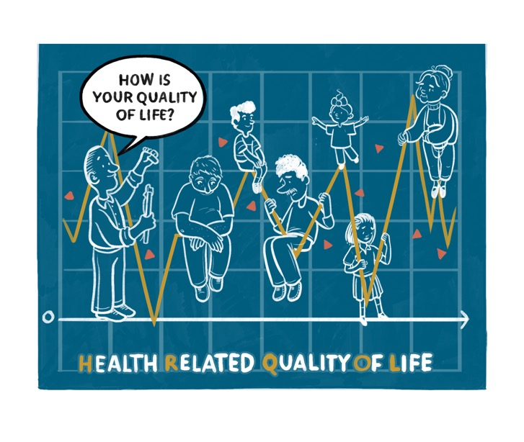
Introduction
Standardised questionnaires of health-related quality of life (HRQoL) play an increasingly important role in healthcare research and decision-making
The EQ-5D is a family of HRQoL instruments
This presentation introduces the original EQ-5D questionnaire developed for use with children and adolescents, the
EQ-5D-Y-3L*
An accompanying animation about the EQ-5D-Y-3L can be viewed here
* A new version of the youth instrument has now been developed with 5-response levels (the EQ-5D-Y-5L), which is introduced in a separate slide deck
2
Notes:
This slide deck was developed by the EuroQol Communications Team
Including the copyright line © EuroQol Research Foundation is mandatory when using information and/or images and/or any part of this slide deck in any other work or publication
Neither this presentation nor any of its parts may be sold, distributed or modified for commercial gain

Slide 3
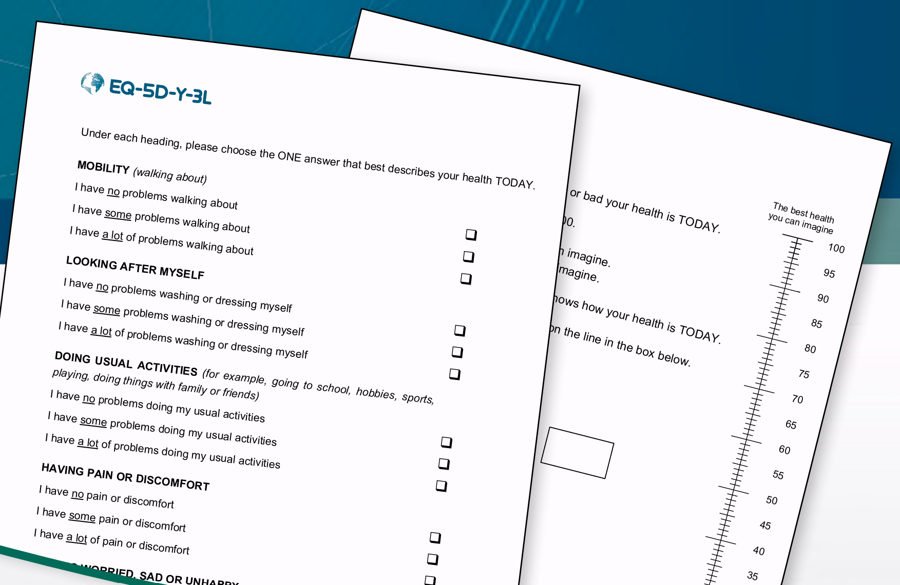
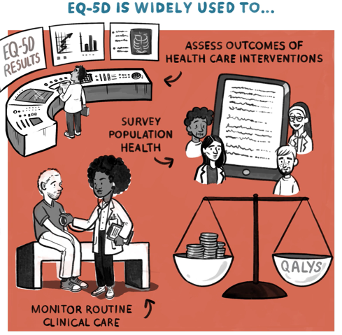
What is the EQ-5D?
The EQ-5D instrument is:
          Generic: A standardised measure developed to describe and value health across a wide range of disease areas
          Simple: A short and simple questionnaire, it is practical to use in health research and to monitor routine clinical care
          Widely used: One of the world’s most popular measures of health outcomes and translated into numerous languages
          A family of instruments: Four EQ-5D versions (two adult versions and two youth versions)
The EQ-5D is developed by EuroQol: A not-for-profit research foundation supported by an international network of multidisciplinary researchers dedicated to the measurement of health status
Please note that ‘EQ-5D’ is not an abbreviation and is the correct term to use in print or verbally
3
Notes:
This slide deck was developed by the EuroQol Communications Team
Including the copyright line © EuroQol Research Foundation is mandatory when using information and/or images and/or any part of this slide deck in any other work or publication
Neither this presentation nor any of its parts may be sold, distributed or modified for commercial gain

Slide 4
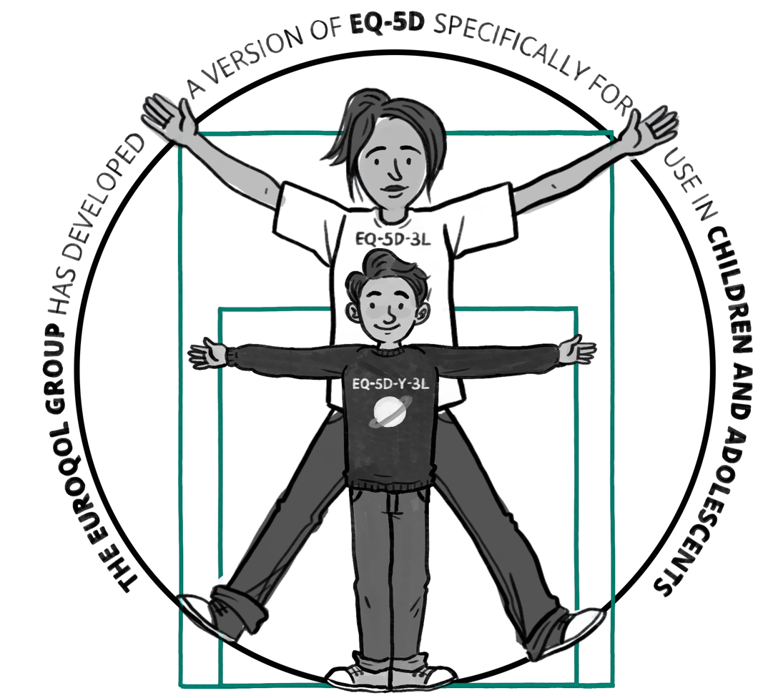
Why develop EQ-5D-Y-3L
First version of EQ-5D (EQ-5D-3L) was developed for adults
But accurate and reliable measurement of HRQoL is just as important for younger populations
EuroQol found there was increasing demand for a
version that allowed younger respondents to directly
self-report their health, without having to rely on
reports from intermediaries (e.g. adult proxies)
Consequently, the EuroQol Group developed a
version of EQ-5D specifically for use in children and adolescents: the EQ-5D-Y-3L (originally named EQ-5D-Y)
Please note, EQ-5D-Y-3L is the full name of the instrument, it is not an abbreviation
4
Notes:
This slide deck was developed by the EuroQol Communications Team
Including the copyright line © EuroQol Research Foundation is mandatory when using information and/or images and/or any part of this slide deck in any other work or publication
Neither this presentation nor any of its parts may be sold, distributed or modified for commercial gain

Slide 5
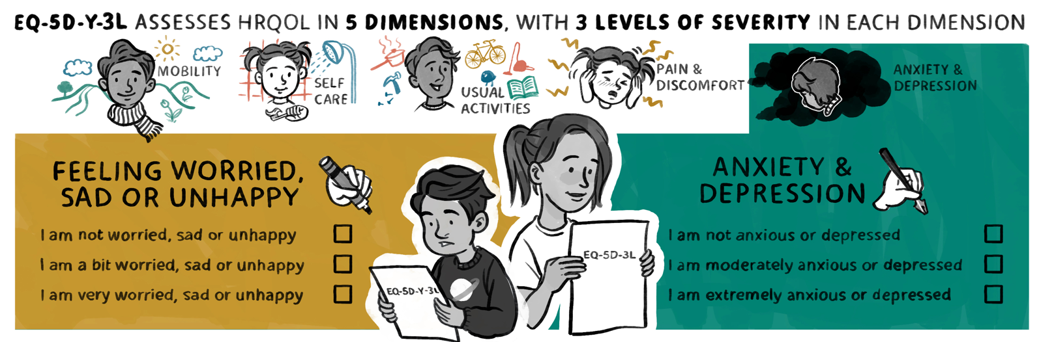
The EQ-5D-Y-3L has child-friendly wording
Like the EQ-5D-3L, EQ-5D-Y-3L assesses HRQoL in five dimensions, with three levels of severity in each dimension
However, the EQ-5D-Y-3L uses child-friendly wording to maximise ease of use and relevance for younger populations
For example:
          Instead of asking about anxiety and depression...
          The EQ-5D-Y-3L asks if the child is feeling worried, sad or unhappy
5
Notes:
This slide deck was developed by the EuroQol Communications Team
Including the copyright line © EuroQol Research Foundation is mandatory when using information and/or images and/or any part of this slide deck in any other work or publication
Neither this presentation nor any of its parts may be sold, distributed or modified for commercial gain

Slide 6
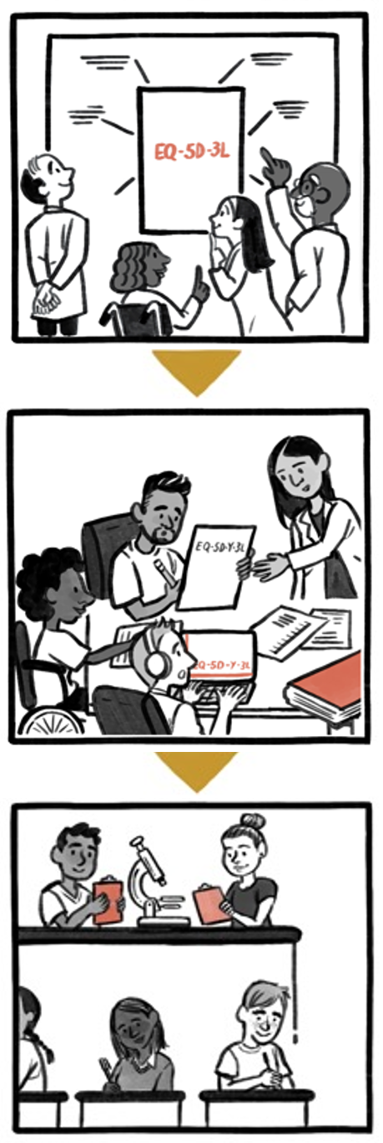
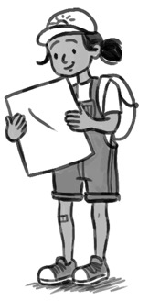
How was EQ-5D-Y-3L developed?
EQ-5D-Y (for ‘youth’) was carefully developed from the EQ-5D-3L through multiple rounds of expert review and pilot testing in young people aged 8 to 18
Development and initial testing consisted of six steps:
          Review of adult version to confirm applicability of the five EQ-5D domains to a younger age group
          Revision of questionnaire to use age-appropriate wording
          Translation of standardised source version
          Cognitive debriefing interviews in 4 countries in samples of healthy and chronically ill young people to assess item comprehension, acceptability and interpretation
          Integration of results and linguistic harmonisation of new questionnaire
          Comparison of results between the new EQ-5D-Y-3L and the standard adult
          EQ-5D
6
Notes:
This slide deck was developed by the EuroQol Communications Team
Including the copyright line © EuroQol Research Foundation is mandatory when using information and/or images and/or any part of this slide deck in any other work or publication
Neither this presentation nor any of its parts may be sold, distributed or modified for commercial gain

Slide 7
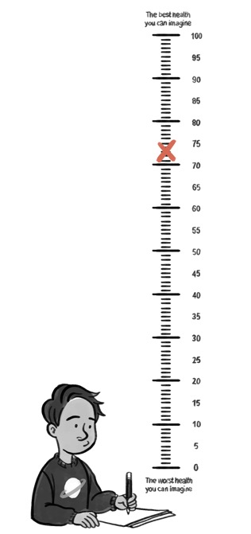
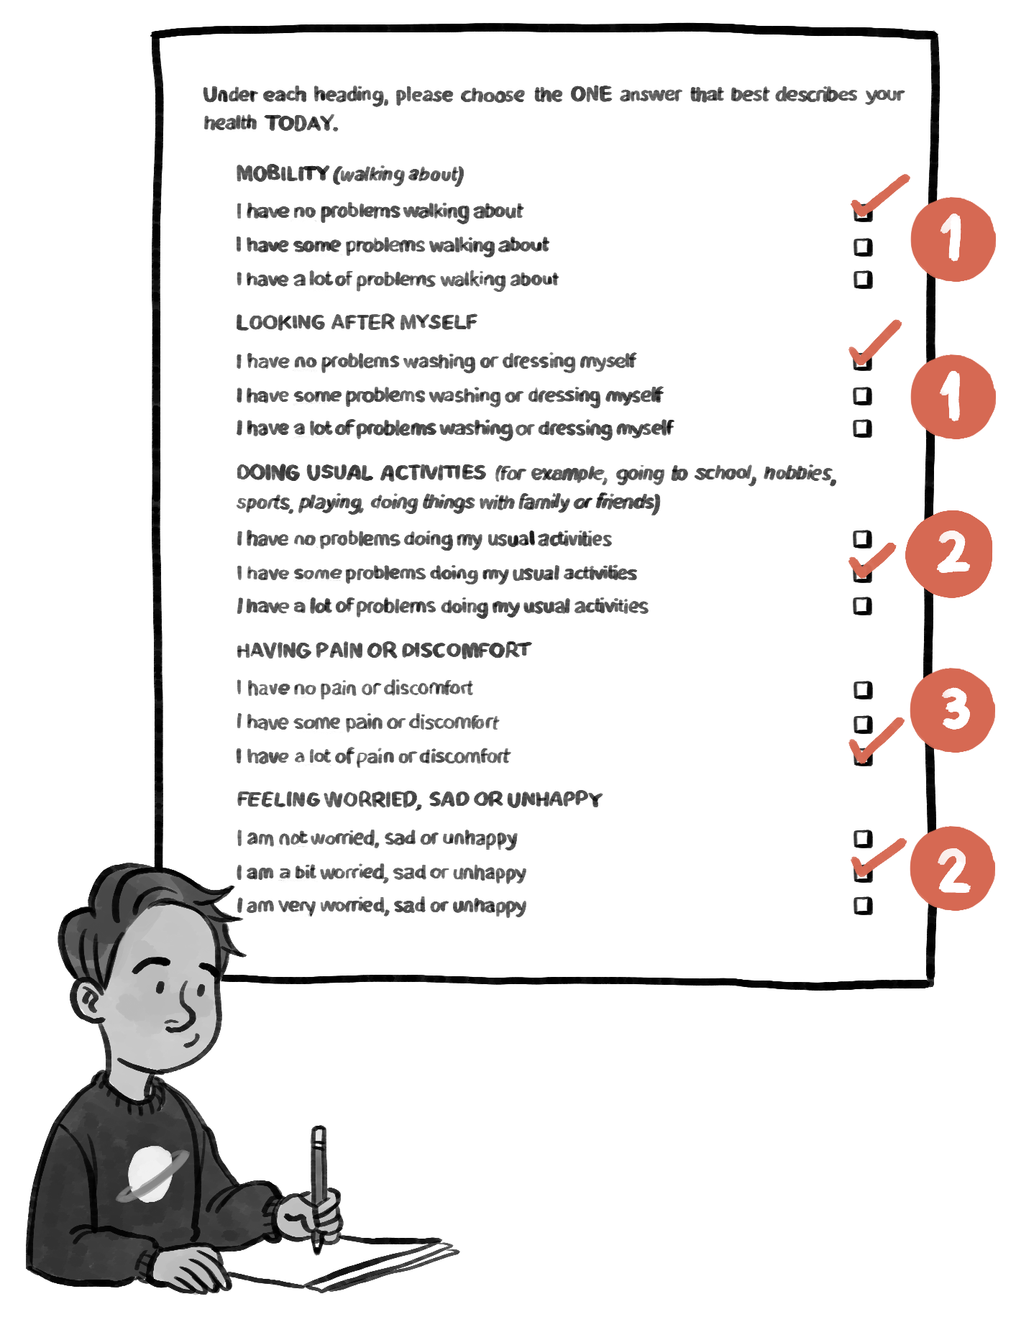
How to complete EQ-5D-Y-3L?
The EQ-5D-Y-3L comprises two parts: the descriptive system and the EQ VAS
On the descriptive system part of the questionnaire, the child checks boxes to indicate the answers that best represent their health today – across five health dimensions
The child then rates how good or bad their overall health is that day on the EQ VAS (visual analogue scale)
7
Notes:
This slide deck was developed by the EuroQol Communications Team
Including the copyright line © EuroQol Research Foundation is mandatory when using information and/or images and/or any part of this slide deck in any other work or publication
Neither this presentation nor any of its parts may be sold, distributed or modified for commercial gain

Slide 8
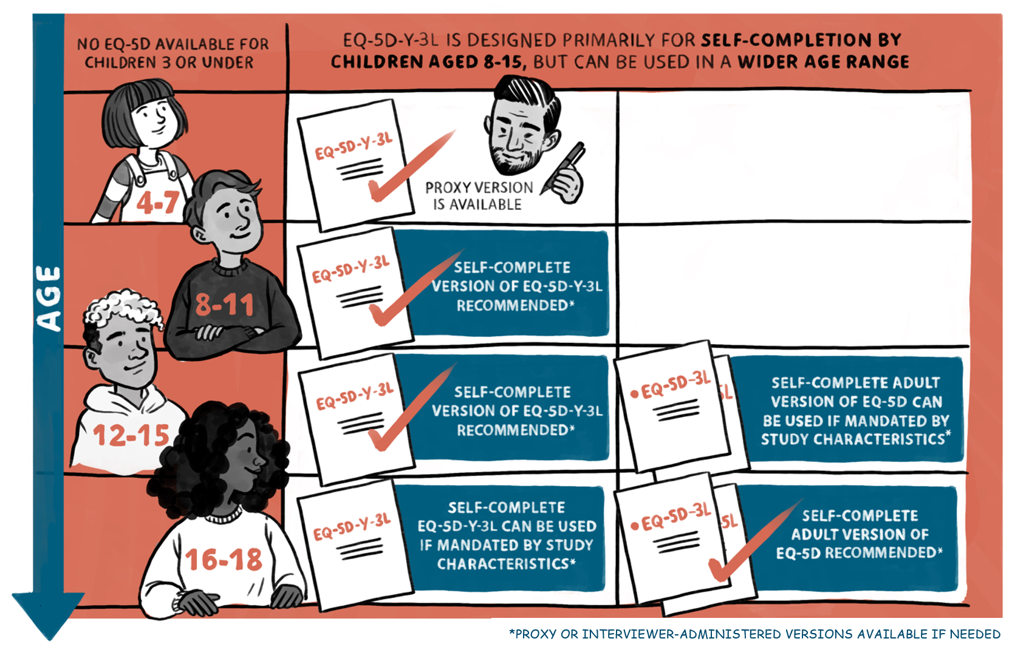
Recommended age range of users of the EQ-5D-Y-3L version
In young children (aged 4–7 years), proxy and interviewer-administered versions can be used
In children aged 8–11 years, the
EQ-5D-Y-3L* is generally recommended
For older adolescents (12–15 years) EQ-5D-Y-3L* is generally recommended, but sometimes it may be more appropriate to use an adult EQ-5D version
For those aged 16–18 the adult version is recommended, but the EQ-5D-Y-3L* can also be used
Research on how to measure HRQoL in children aged <4 years is work in progress**
* Or EQ-5D-Y-5L. ** A new instrument, EQ-TIPs, is in development to measure and value health in children aged 0-3 years
8
Notes:
This slide deck was developed by the EuroQol Communications Team
Including the copyright line © EuroQol Research Foundation is mandatory when using information and/or images and/or any part of this slide deck in any other work or publication
Neither this presentation nor any of its parts may be sold, distributed or modified for commercial gain

Slide 9
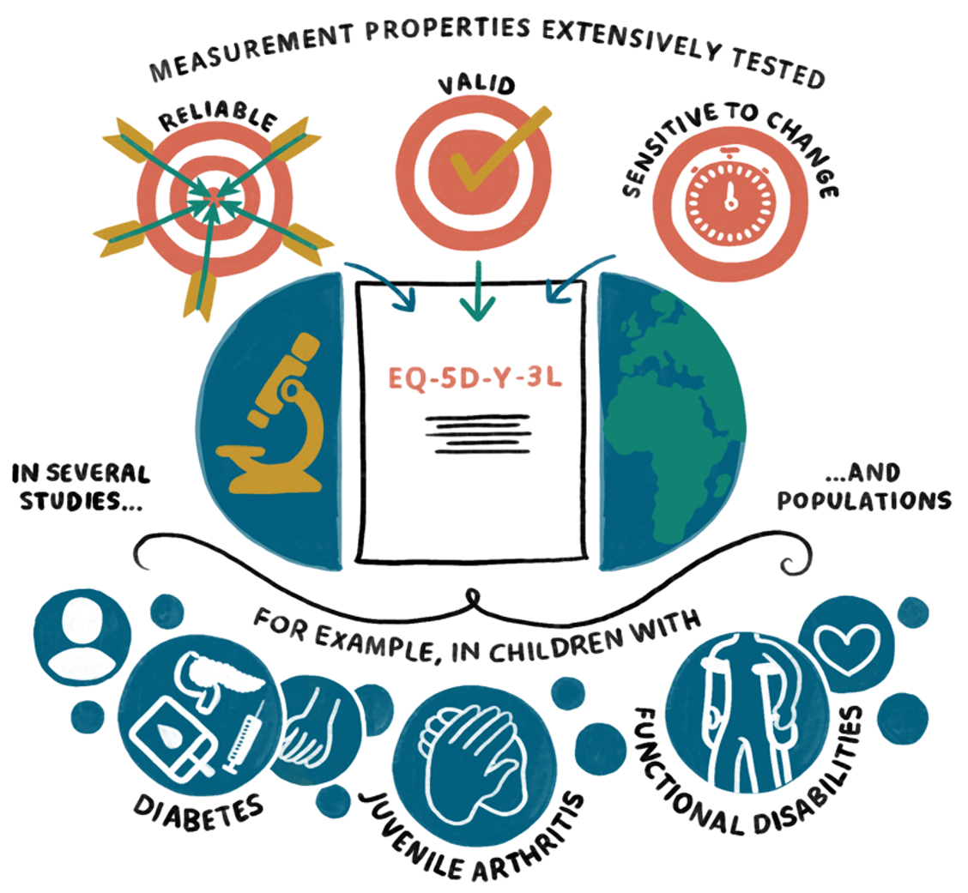
The psychometrics of EQ-5D-Y-3L have been extensively tested
For further information, a systematic review on the measurement properties of the
EQ-5D-Y-3L was published in June 2022 ¹
1. Golicki D, Młyńczak K. Measurement properties of the EQ-5D-Y: A systematic review. Value Health 2022 Jun 22:S1098-3015(22)02001-0
9
Notes:
This slide deck was developed by the EuroQol Communications Team
Including the copyright line © EuroQol Research Foundation is mandatory when using information and/or images and/or any part of this slide deck in any other work or publication
Neither this presentation nor any of its parts may be sold, distributed or modified for commercial gain

Slide 10
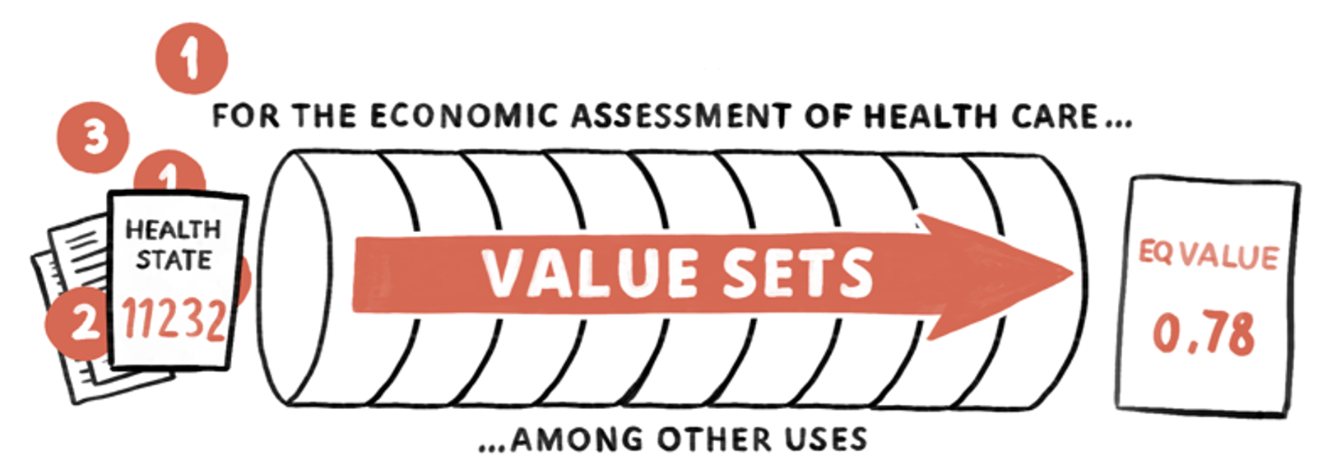
Using EQ-5D-Y-3L value sets in economic evaluations
An important feature of the EQ-5D instruments is the associated value sets, which reflect population preferences for the health states generated by the instruments
When the descriptive system profile is linked to a value set, a single summary index value for health status is derived
Index values facilitate the calculation of quality-adjusted life years (QALYs) that are used to inform economic evaluations of healthcare interventions
A number of value sets for the EQ-5D-Y-3L have been published, with more in development around the world
For a list of available EQ-5D-Y-3L valuation studies, see the EuroQol website: euroqol.org/information-and-support/resources/value-sets/
10
Notes:
This slide deck was developed by the EuroQol Communications Team
Including the copyright line © EuroQol Research Foundation is mandatory when using information and/or images and/or any part of this slide deck in any other work or publication
Neither this presentation nor any of its parts may be sold, distributed or modified for commercial gain

Slide 11


EQ-5D-Y-3L translations and modes of administration
EQ-5D-Y is already available in more than 50 languages…
… and several different modes of administration (self-complete versions on paper, digital devices, REDCap or Qualtrics survey platforms; interviewer-administered versions; proxy versions)
11
Notes:
This slide deck was developed by the EuroQol Communications Team
Including the copyright line © EuroQol Research Foundation is mandatory when using information and/or images and/or any part of this slide deck in any other work or publication
Neither this presentation nor any of its parts may be sold, distributed or modified for commercial gain

Slide 12
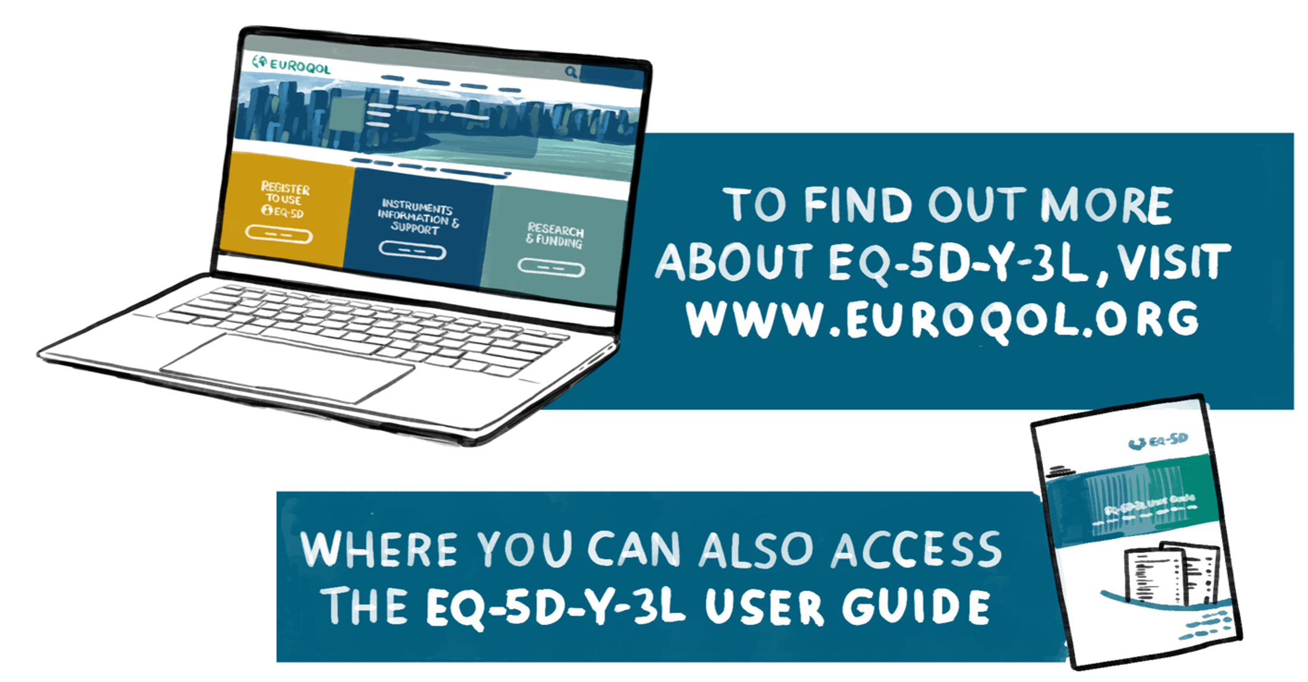
For more info…
Links: https://euroqol.org/information-and-support/euroqol-instruments/eq-5d-y-3l/ https://euroqol.org/information-and-support/documentation/user-guides/
12
Notes:
This slide deck was developed by the EuroQol Communications Team
Including the copyright line © EuroQol Research Foundation is mandatory when using information and/or images and/or any part of this slide deck in any other work or publication
Neither this presentation nor any of its parts may be sold, distributed or modified for commercial gain

Slide 13
Copyright of this PowerPoint presentation
Including the copyright line ‘© EuroQol Research Foundation’ is mandatory when using information and/or images and/or any part of this slide deck in any other work or publication
Neither this presentation nor any of its parts may be sold, distributed or modified for commercial gain
13

